Slide 1


Slide 2

Good Morning

Slide 3
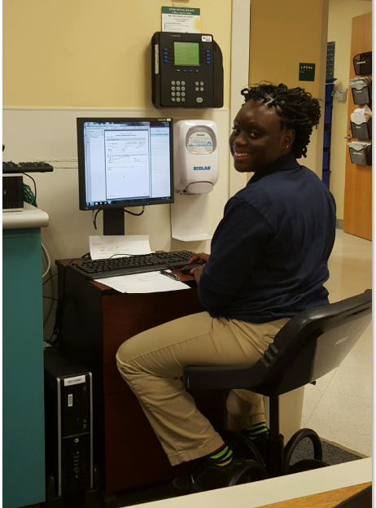
I am the Clinical Engineering Service Coordinator at Christiana Care for just over 10 years. It has been my pleasure to work here with a great Department and team members. My job has grown since I started, from answering phones, contracts, to workorder workflow, and helping the technicians as needed. And that's where our talk will start.
Clinical Engineering Service Coordinator

Slide 4

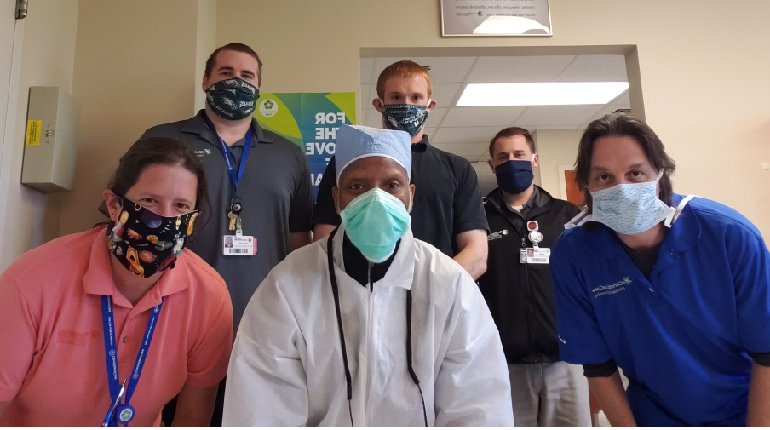

Slide 5
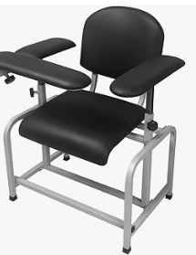
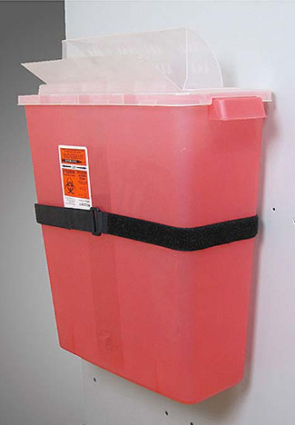
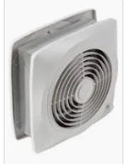

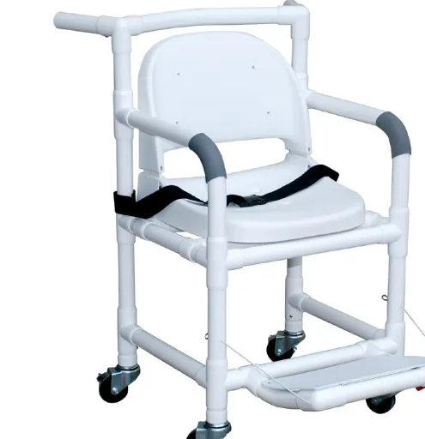
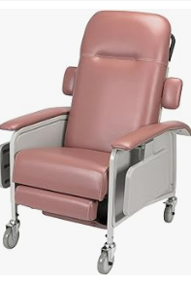
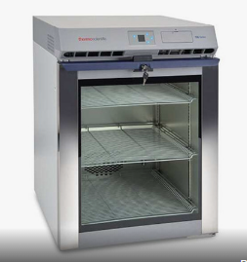
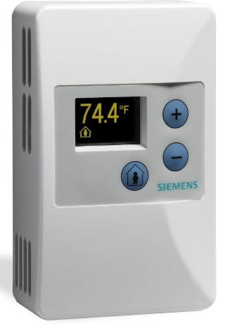
Your solution Provider

Slide 6


Slide 7
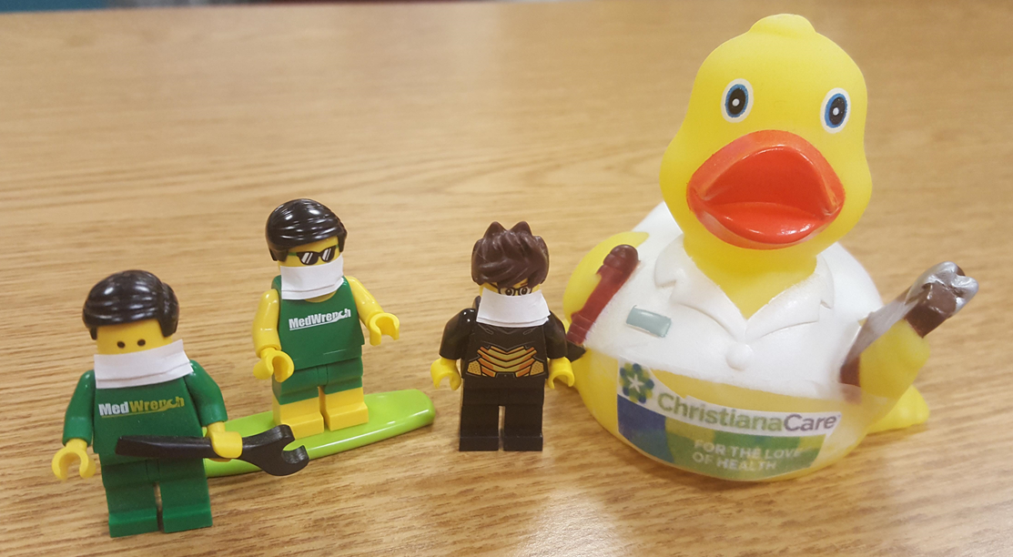
The Breakdown of Clinical Engineering:
Administration – Director, Manager, 4 supervisors, Parts, and 2 part time
Inspector Team of 4
Sterilizer Team of 3
Biomed Team of 13
Imaging Team of 9

Slide 8
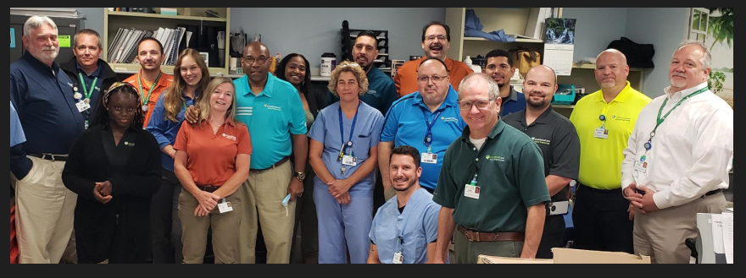
Technician’s
Modality: MRI, CT HVIS, Linacc, Mammo, Ultrasound, Anesthesia, Hemo, Ballon Pumps, Patient Monitor, pacemakers, EKG, Chambers, Sterilizers, autoclaves
Training: What is your tech trained on, who needs training
Work Schedule: Who are your early starters and who closes the shop
Family Life: find out what their family life is about.
Get to know your Tech

Slide 9
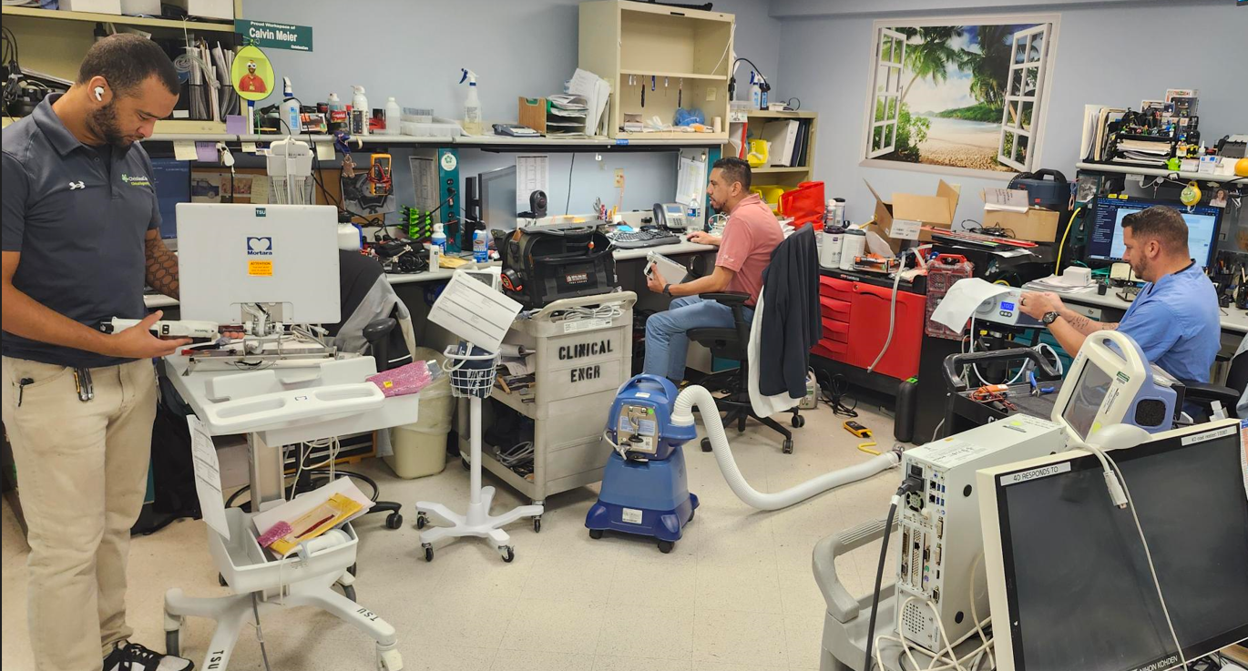
Technician’s
What can you take off their plate for them to keep turning a wrench?
Ideas? Phone, emails, vendors……

Slide 10
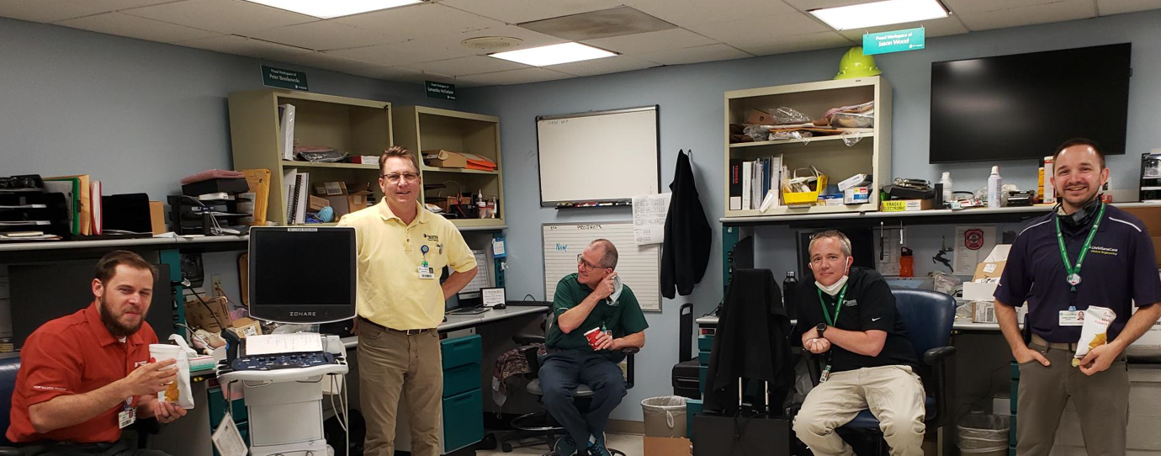
CESC Support
Bring down the assets to shop
Rounding the floors to find broken assets
Taking asset back to department
Following up on work orders
Calling for RMA/RGA
Shipping asset out
Following up on asset that are out with vendor
Once asset comes back from vendor- scan service report to work order
Cables -switch out broken cables
**reminder to document everything in the workorder
How to efficiently support Techs

Slide 11
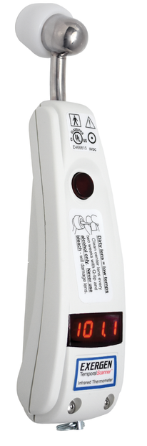
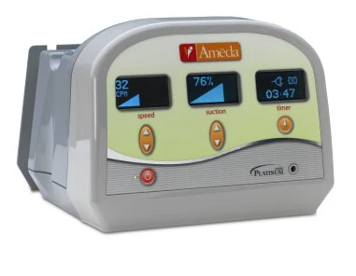
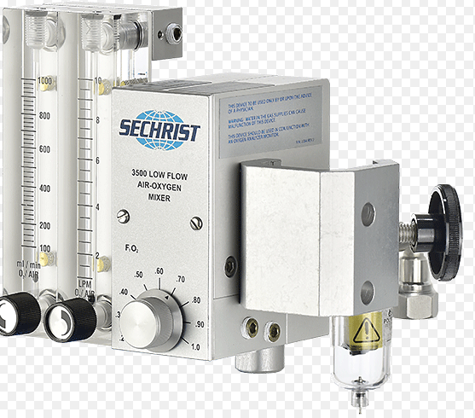

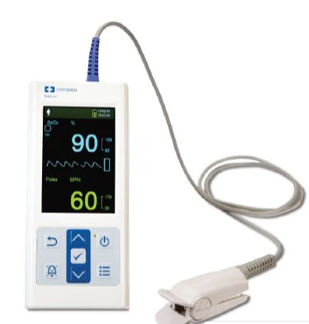
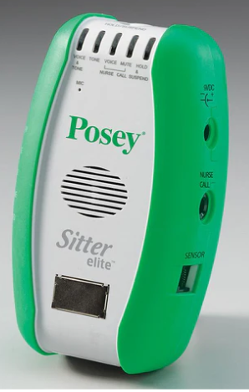
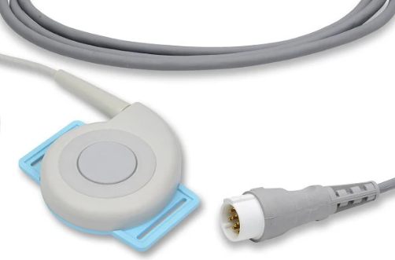
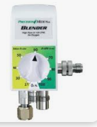
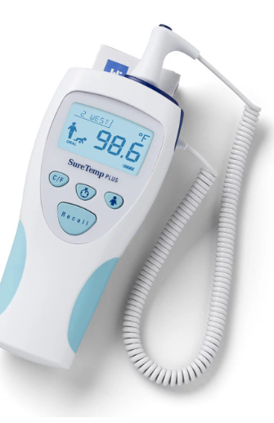
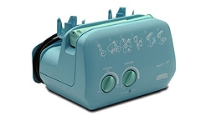
Devices to call for RMA
Philips Bilichek getting that case number and RMA can take 20 minutes on the phone
Blenders PM5200/PM5300
Sechrist Blenders
Toco/ US Transducers
M692 Thermometers
Posey Alarms
Exergen Tat-5000/Tat-5000s
Epumps
Breast Pump exchanges
PM10N Pulse ox

Slide 12
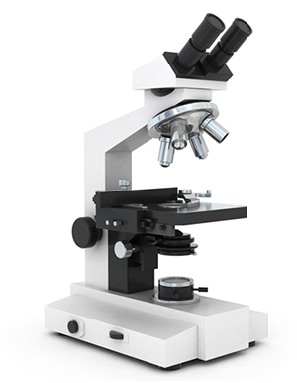
Vendors
Vendors with large qualities devices (spreadsheet)
Microscopes
Autoclaves
Exercise Equipment (Rehab / Gyms)

Slide 13
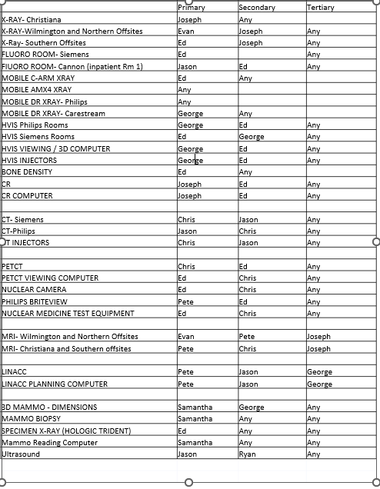
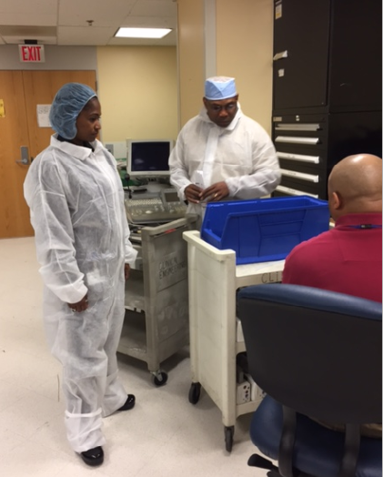
Create a spreadsheet with Modalities

Slide 14
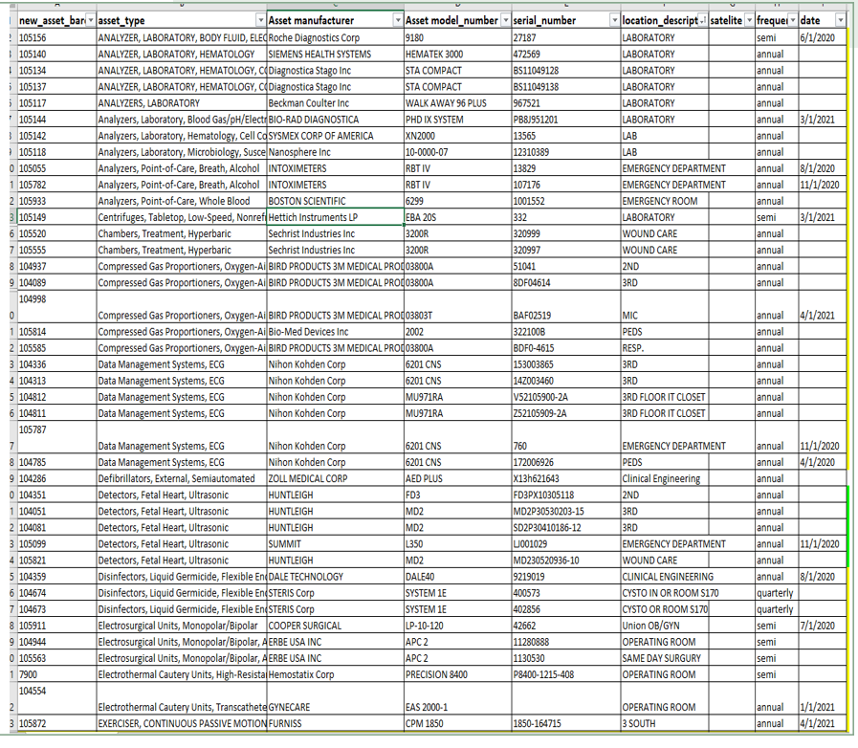
Asset Type and PM frequency

Slide 15

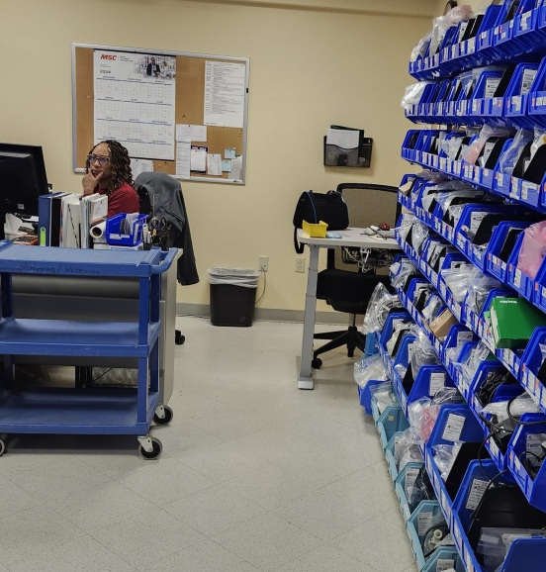
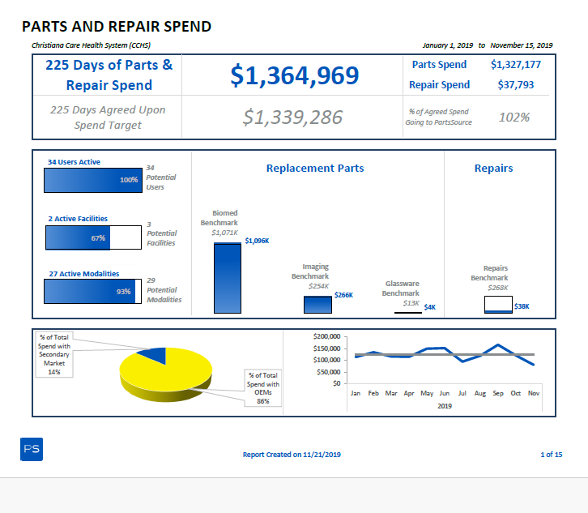
Parts
Being able to use PartsSouce helps us with our ISO 9001
-reports generated from PartsSource
help group orders and save on shipping
helps with repairs
exchange/ core returns
Parts go into the workorder as they order them.
Cost savings too

Slide 16
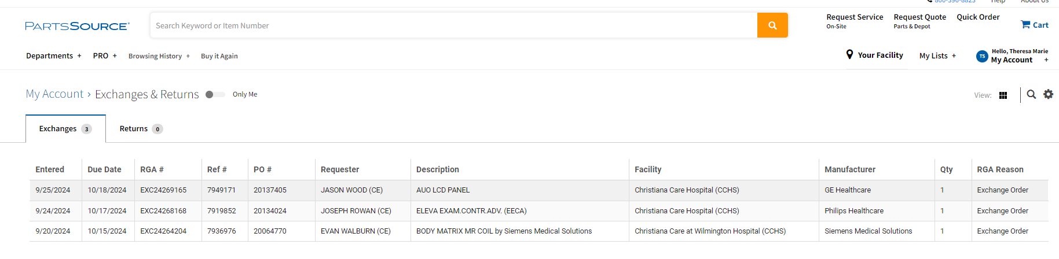

Core Return / Exchanges
DashBoard helps to see what need to be returned
Parts Person – puts this large sticker on parts ordered with an Outright/Tested Exchange helping tech to send back broken part for the exchange

Slide 17

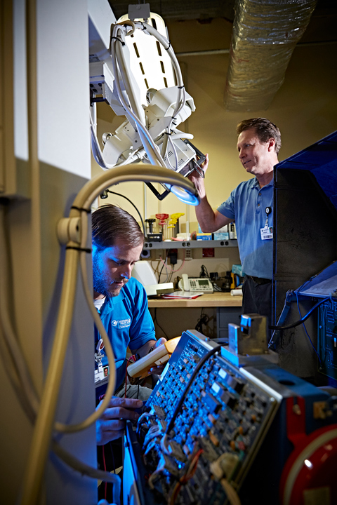
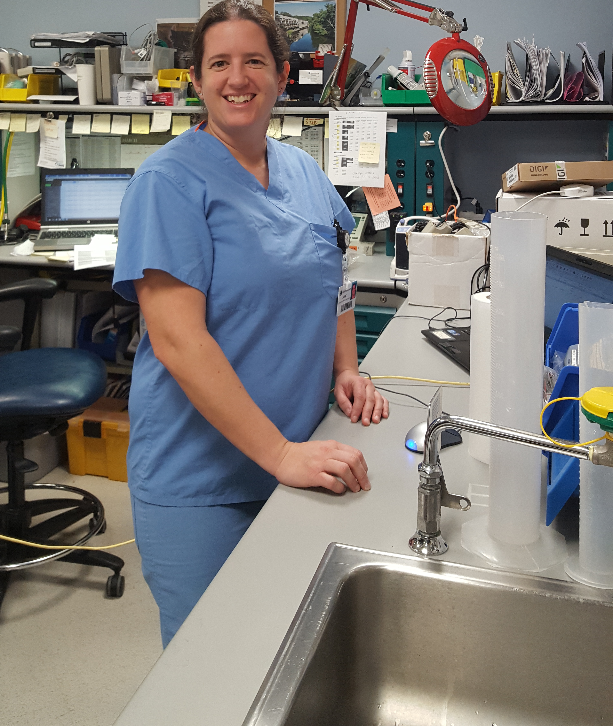
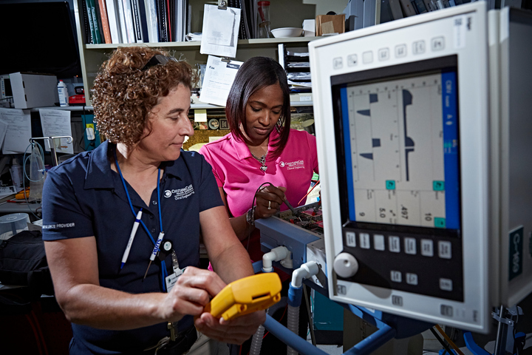

Slide 18
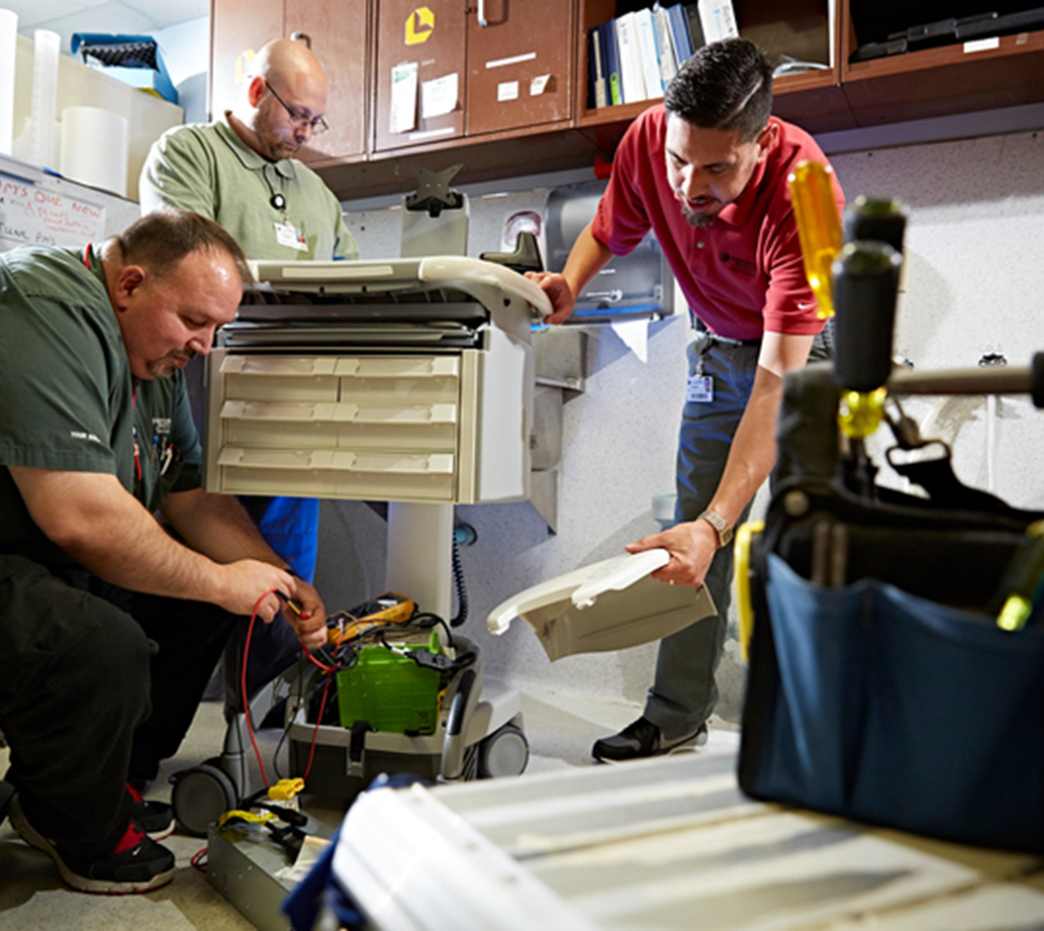
Benefits for the Tech
Saving time, giving techs the opportunity to do other things (Turning a Wrench)
Able to spend more time to problem solving other challenges
Having a greater impact each day on work orders
Engaging with other techs helping each other
Growth of knowledge – learned by working together
Best Part is it gives the Techs more time to spend with our Care Givers and strengthen our relationships

Slide 19


Slide 20
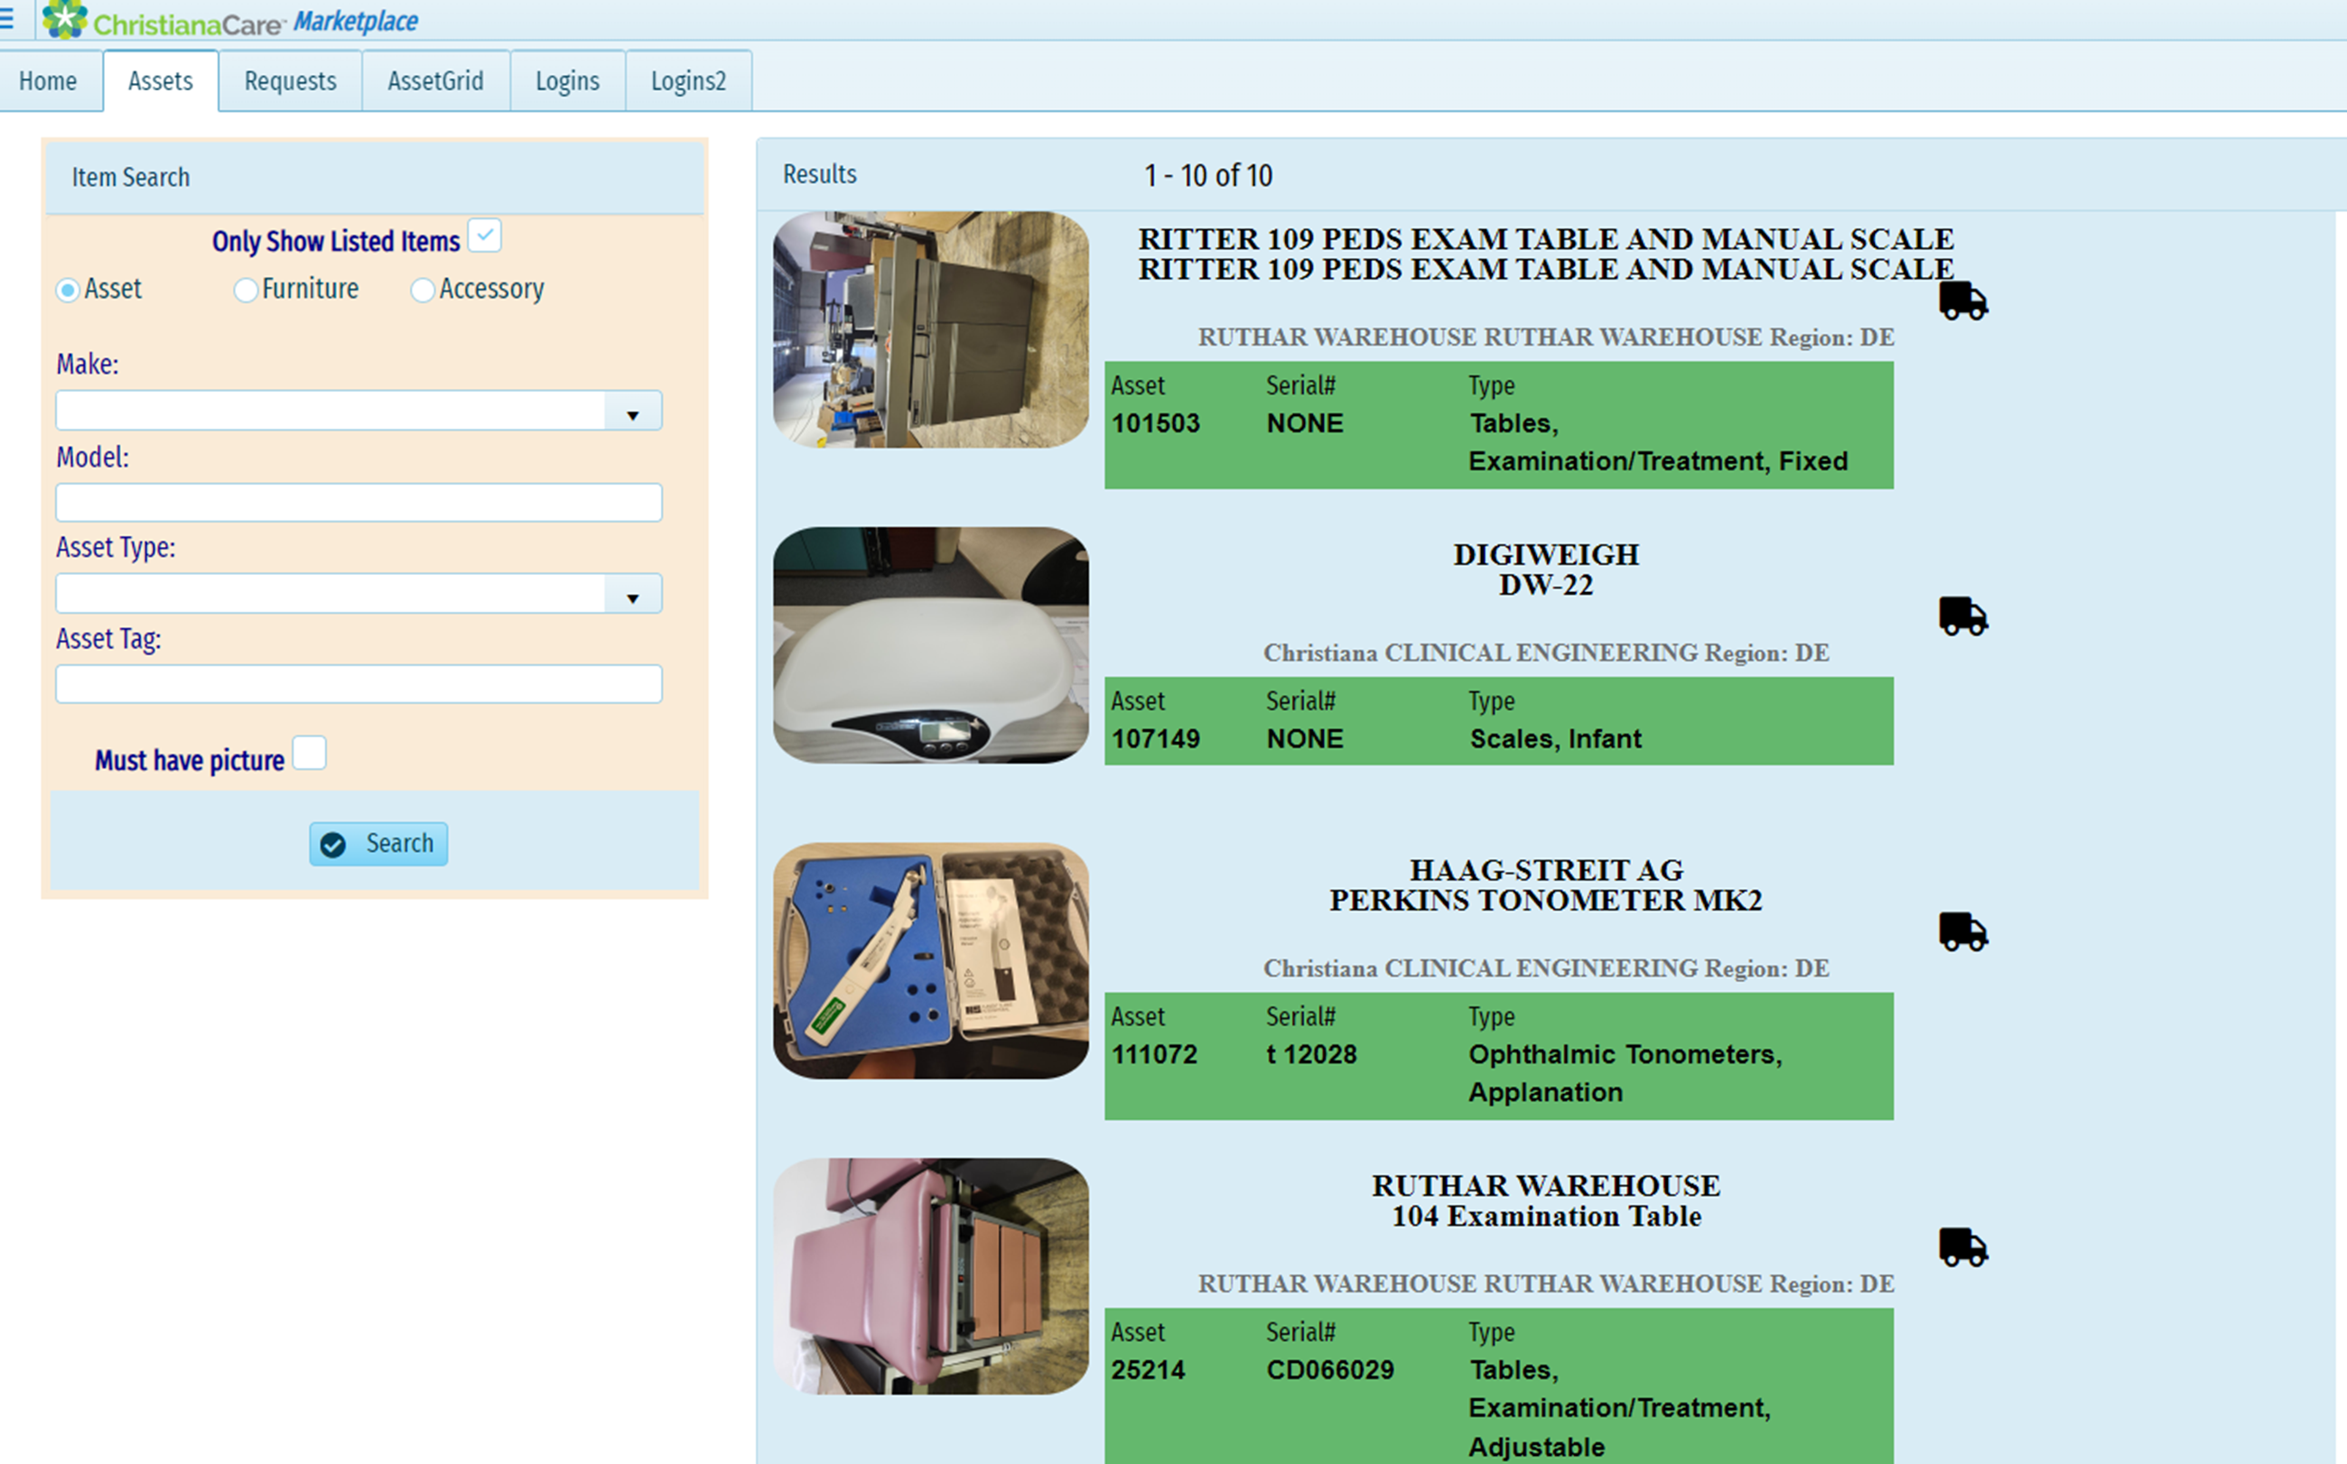
Marketplace within Christiana Care

Slide 21
Take Aways-
Always ask the Tech as they are responsible for completed work.
Phone/Calling:
  RMA/RGA repairs, returns, core parts
  Service reports with vendor
  Scanning them to workorders
  Scheduling PM with Vendors
  Calling vendors with contracts to schedule service
Emails:
  Sending the emails to get service report
  Bring vendors in

Slide 22
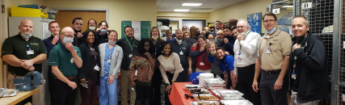
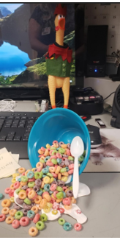
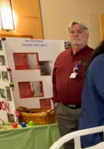
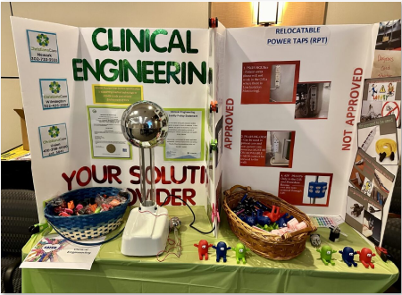
Clinical Engineering Service Coordinator
By adding these tasks to Operation Team, I was able to add a second part time person and move up to Supervisor.

Slide 23


Slide 24


Slide 25
Thank You
Theresa Street
Blake Collins
302.733.3555
BLCollins@christianacare.org
TheresaMarie.Street@christianacare.org

