Slide 1
Challenges of Implementing Biomedical Equipment into an Information Technology Environment
Gregory Goll CHTM CBET BS
Manager. Projects and Medical Imaging Services
WellStar Health System
Marietta, Georgia

Slide 2
Background
Continual evolution due to advancements in Information Technologies, require adaptation
Security has become more important as medical devices become vulnerable to cyber threats

Slide 3
Something to think about:
Research is what I’m doing when I don’t know what I’m doing.
Wernher von Braun

Slide 4
Things to ponder- The ever changing world of IT
BYOD- Bring Your Own Device, is now a common requirement for many new employees
Remote monitoring of patient's real time vital sign, providing feedback to care givers
Interoperability - Systems need to send and receive data that will be compatible on all user platforms.
Device Mobility can reduce operation costs by 40%
50 Billion wireless devices are expected to be added by 2020
65% of all Data Breaches are from Inside a company

Slide 5
Getting Started:
Checking your inventory
Internal Inventory
  Your/Staff Educational Background
  Experience
  Educational Background of Staff
  Certifications

Slide 6
Understanding Basic Components
Software
Anti-Virus software local and network administered
Hardware
Interface Issues
Network Limitations
Network Components
Network Designs / Topography

Slide 7
Common Ways to expose your equipment and network
Medical Devices with open access to internet
Unencrypted USB drives
Open USB ports on any device
Unauthorized software installations
Social Media
Unsecured Laptops (not locked down)
Lax update processes

Slide 8
Ways to protect equipment
Never share service/configuration passwords with users.
Insure only proper access levels with users.
Limit access outside hospital network. No Internet unless absolutely necessary on clinical equipment.
Create an exception list of all IP addresses of Clinical Equipment, this will minimize risks of automatic software updates.
Lock USB ports either physically or by software.

Slide 9
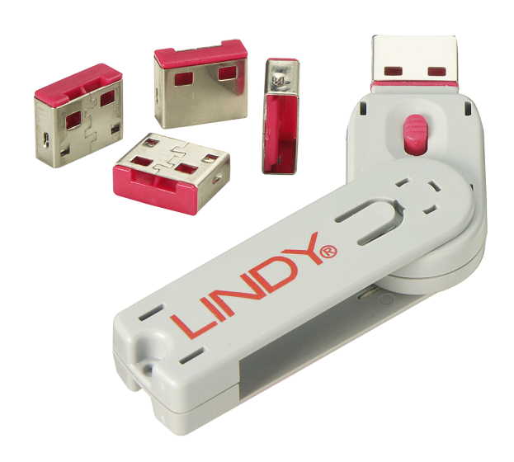
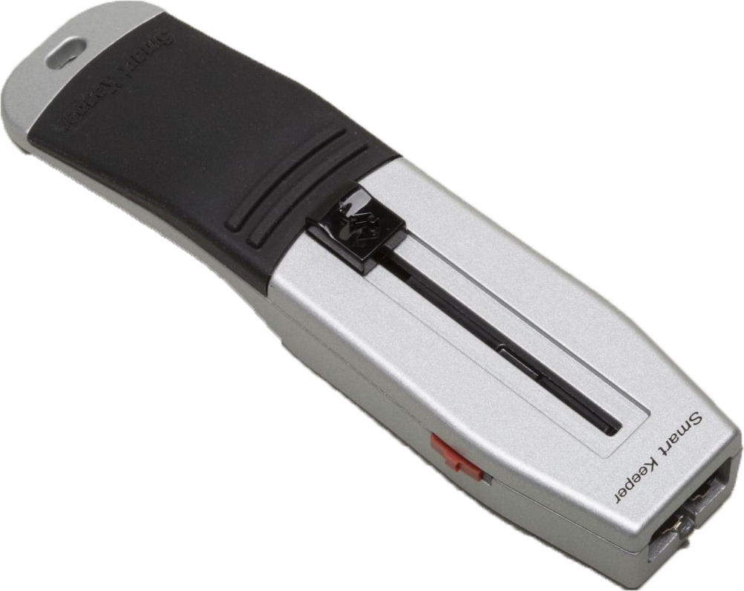
Physical Locks for RJ45/USB www.connectivitycenter.com

Slide 10
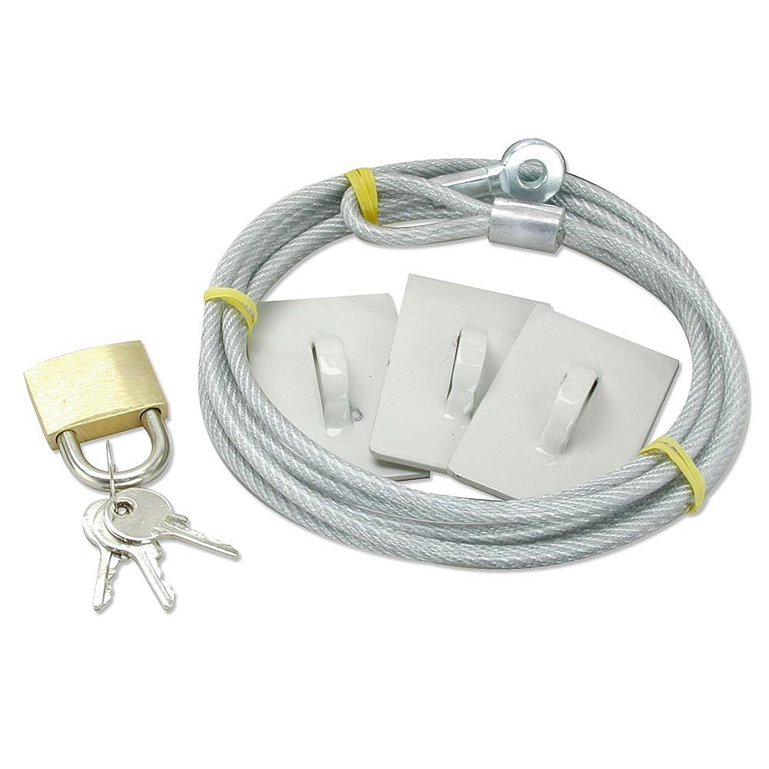
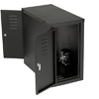
Desktop and Lap Top Locks

Slide 11
WOW Carts, Nurse Call, Smart Devices, PACS
Historically these may or may not fall into Clinical/Biomedical areas of support.
Any device with a fan eventually will accumulate dust and debris, this may cause over heating issues.
Smart Beds
Connection to PACS

Slide 12
Understanding Your Departments Internal Boundary
How far does your department currently work in the Information Technologies Environment?
Is your IT services in-house, contracted or a mixture?
What are the limitations of your access into the IT Environment?
What is your relationship with your IT provider?
What is you employers' limitations into the IT Environment? (do they pull their own cables/ install networks)
Who assigns/controls IP addresses

Slide 13
Process for requesting IT support/ project involvement
Is there a formal process for requesting IT support in a project/installation.
Who determines the priority of a request?
What is the process for requesting cable pulls or network jack activation. Who pulls cables?
Is there a lead time for building interfaces.
Does IT create their own separate budget.

Slide 14
Software/ IT information
Support
Ensure all compliance documents/issues are addressed on arrival.
Secure any software and license documentation immediately.
Any loss of software licenses can directly affect future vendor support and potential additional cost.
Make a backup copy of any software if possible and create a secondary storage area, separate from primary storage area.
Document software revisions, IP address, AE Title, anti-virus type, and any other important information in the equipment record.
Document as many of the network relationships as possible.

Slide 15
Hardware Requirements
Specifications in writing
Operating System Software
Who supplies what in writing
Issues of using OEM and alternative suppliers (Cisco verses Nortel)
Mix and match components
Can identical components be purchased through hospital sources verses vendor (example printers)

Slide 16
Security- ask the questions (HIPAA)-Heath Insurance Portability and Accountability Act
Will there be any interface to a medical record?
Will patient data with unique identifiers be stored on the devices?
Is remote physician access needed.
Who owns any computers used for remote access?
What is the hospital policy for remote access to patient information by clinical staff?

Slide 17
Support Issues between IT and Medical Devices
Understand the work order assignment priority process.
IT support many times is by the application verses the specific device.
Medical Imaging and Biomedical support are primarily focused on the device level.
Resistance to allow remote vendor support via network access.

Slide 18
In House Testing
Purchase test equipment
Development of in-house testing area
Obtain secure location
Establish network connections
Obtain common components needed to completely build desired network configuration
Obtain any patient monitoring components to function as setup found in clinical areas
Make area available for clinical staff as needed

Slide 19
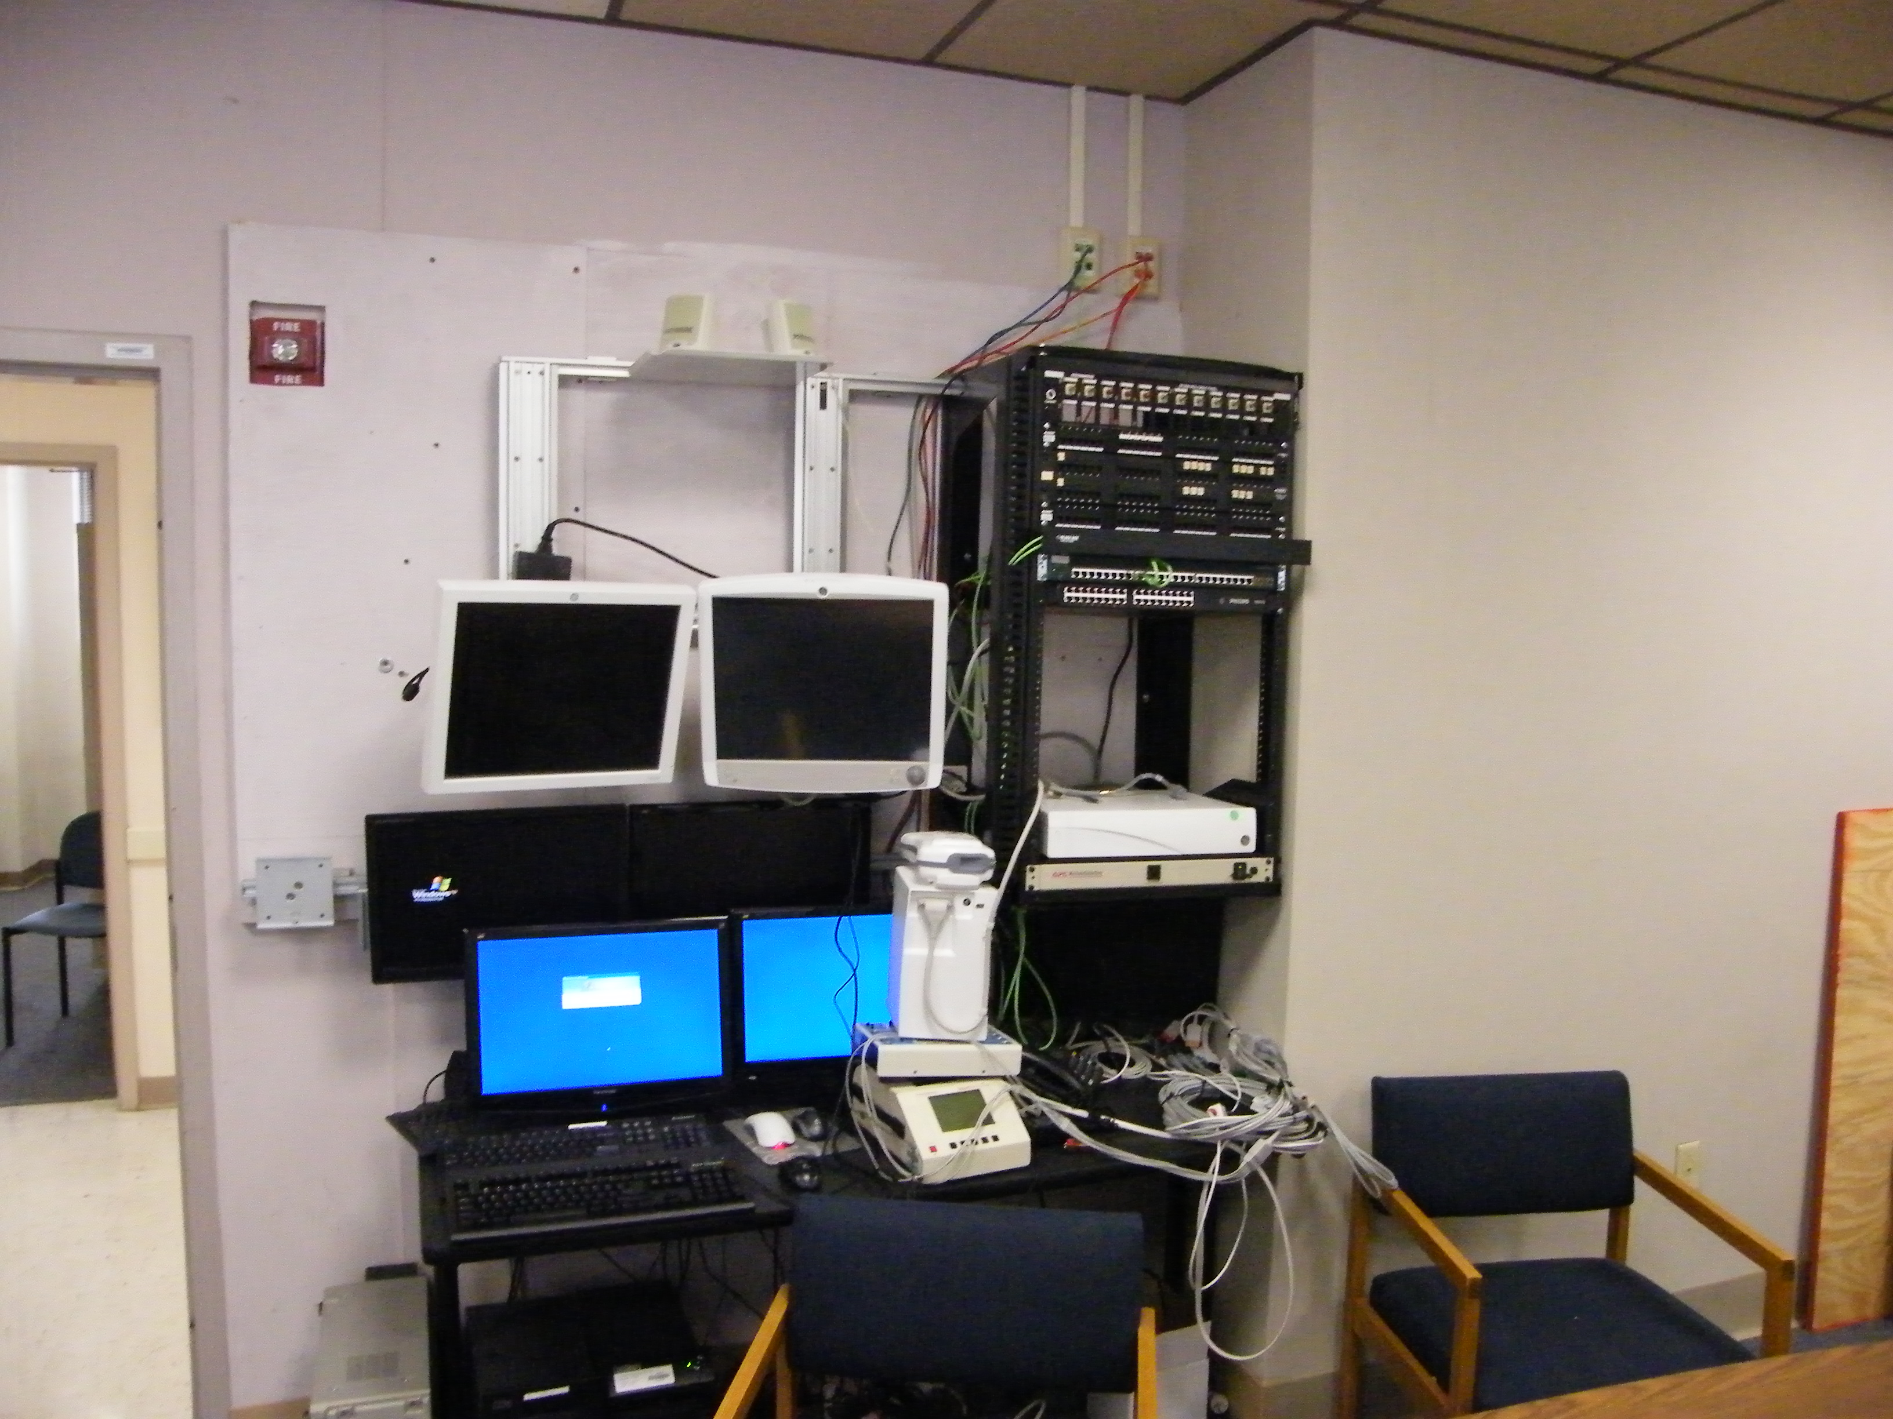
Clinical Engineering testing area

Slide 20
The difference between opportunity and a dead end.
Most common pitfalls of ending up supporting IT the wrong way.
  Supporting devices which are not directly connected to patient care.
  Assuming support roles without supporting funding.
  Working as a system administrator, focused on the clinical side of application.
  Taking on any support outside the skill set of your staff, never assume you can find a perfect new employee.

Slide 21
Watch for Good Opportunities
Solarwinds – network monitor
Zingbox- network monitor
BrainsGate – stroke treatment system

Slide 22
Pre-planning
What staff members/ departments need to be involved.
Who is the primary sponsor?
Where is the location?
Obtain all documentation possible. Floor plans, engineering diagrams, vendor specifications.
Define expectations of your role and the role of your department.

Slide 23
Planning Stages
What is the purpose of the equipment being replaced?
Has anyone involved clinical staff?
What is the support requirements of the new equipment?
What is the budget for the equipment and on-going support?
How critical is the equipment to daily operation?
Are there any long-term support issues?
Data storage needs?
Has a system administrator been determined?

Slide 24
There is no such thing as a free puppy, beware of reuse!
Be absolutely certain of condition of any device you plan to reuse.
Make sure the technology is current.
Watch for free left-over equipment, will it meet all of the current and future needs.
Just because you can do it mean you should? (reusing similar components from different vendors)

Slide 25
Budget Issues
Has the budget already been set?
Early involvement in the Budget process, define your internal issues/costs.
Define all components of support, Software License, Installation requirements for hardware, and any changes required to facility including network connections and network closets.
Data conversion requirements for legacy data.

Slide 26
Vendor Software/Support
What is the installation requirements. (Hardware)
Is vendor remote access needed?
What is the operating system (OS)?
How long has this been used?
Any future plans for future upgrades to OS?
What is the anti-virus, in any installed? (Hospital update process)
Upgrade path/ever green to keep current.
Remediation of software conflict issues.
Annual support costs? Hourly Time/Materials cost?
License costs for expansions?

Slide 27
Tools for Wireless Spectrum Survey
Metageek-Chanalyzer Pro/cost $500
Signal Hound/cost $1000
Spectrum Analyzer/ cost $8000 – $30,000

Slide 28
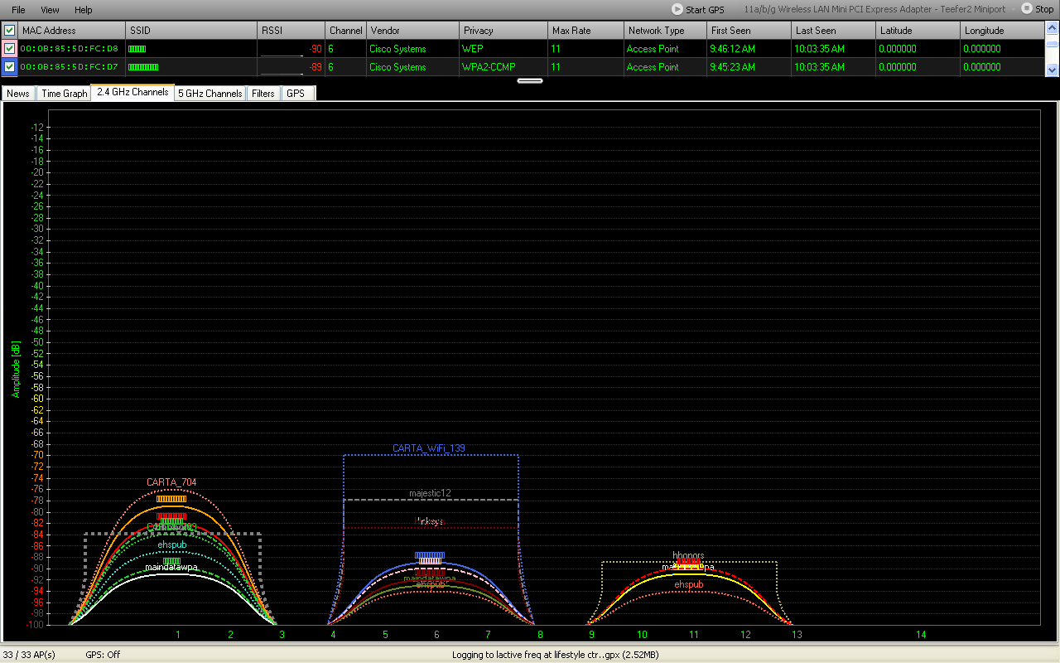
Site Survey- expect surprises

Slide 29
In House Site Survey
Insure all documentation is the latest version and that all people involved in the process have the same version.
Define locations of all network closets
Make sure each person at this stage has the power to make decisions.
Locate challenging areas

Slide 30
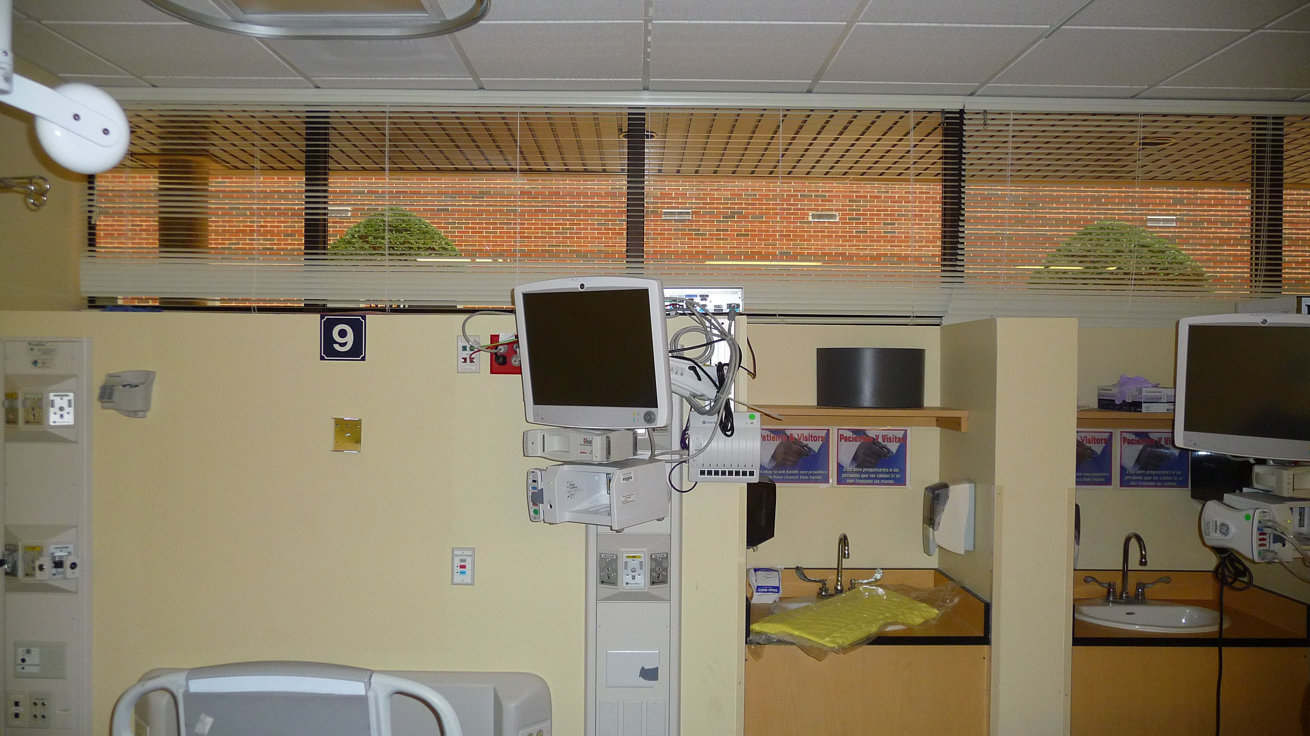
Network design considerations
Redundant coverage

Slide 31
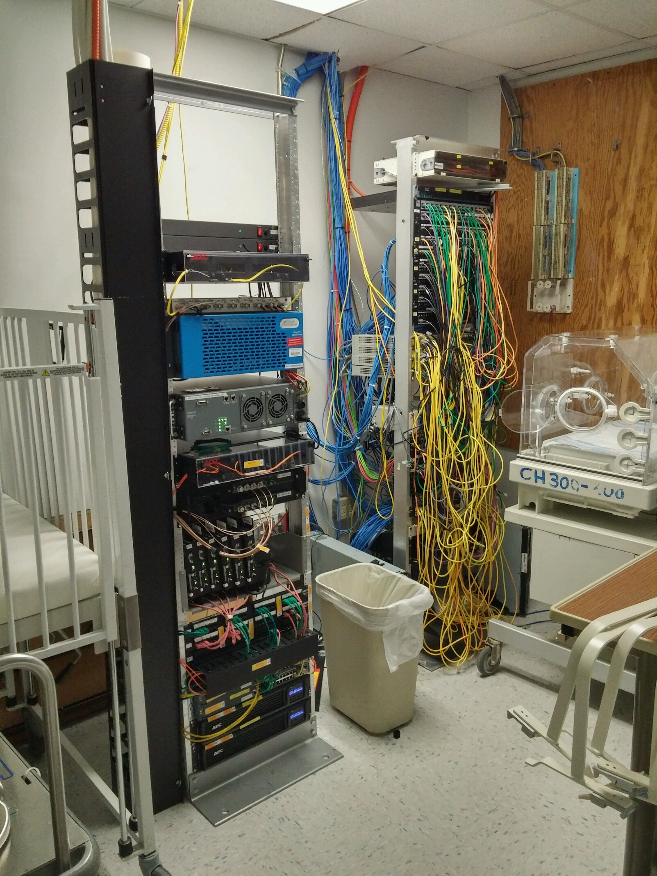
Beauty and the Beast

Slide 32
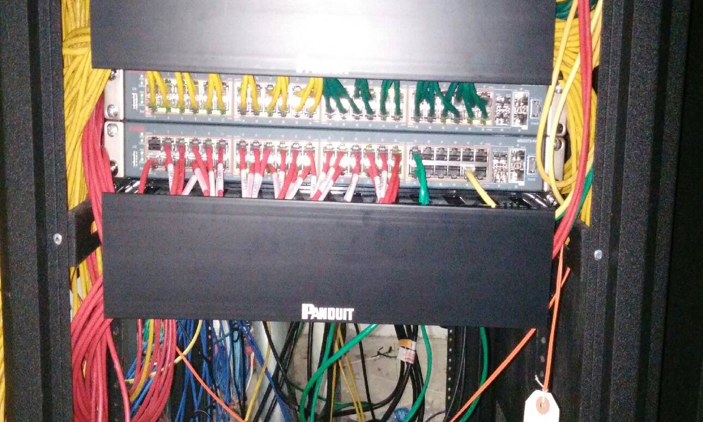
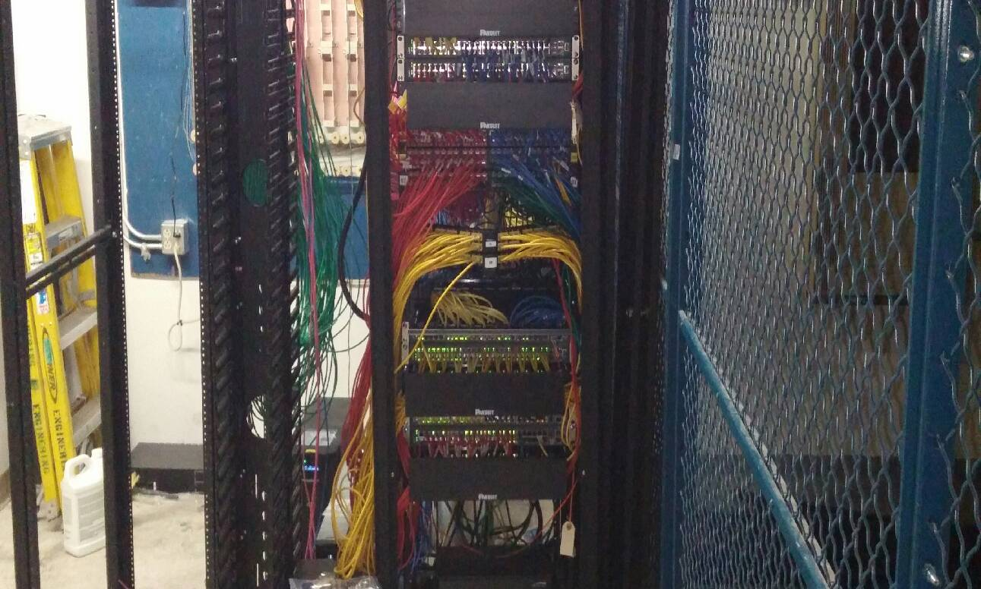
Network Setup Details
Patch Panel Details
The complete rack

Slide 33
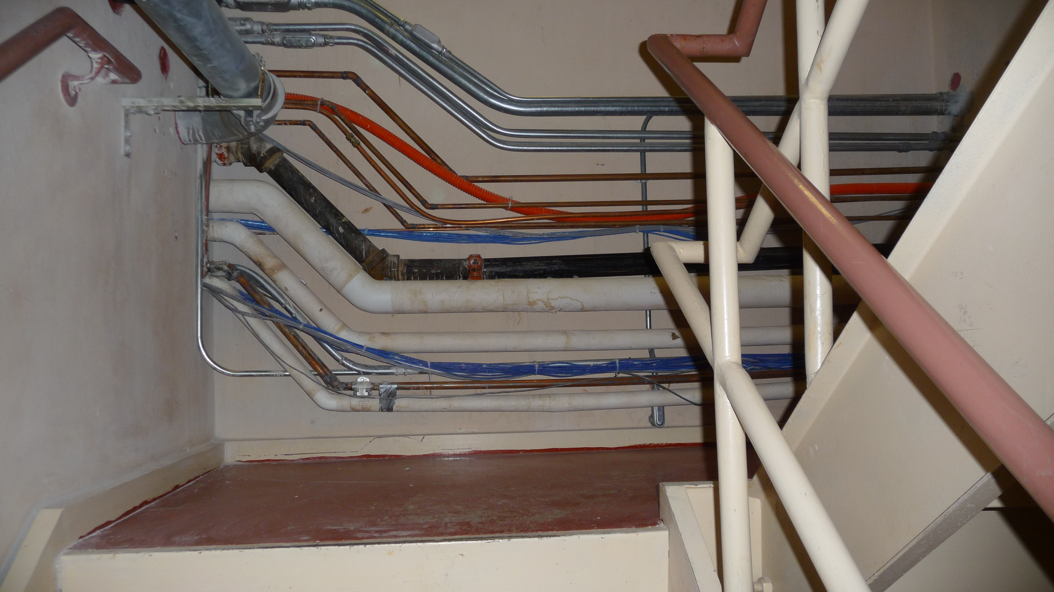
Challenging Area

Slide 34
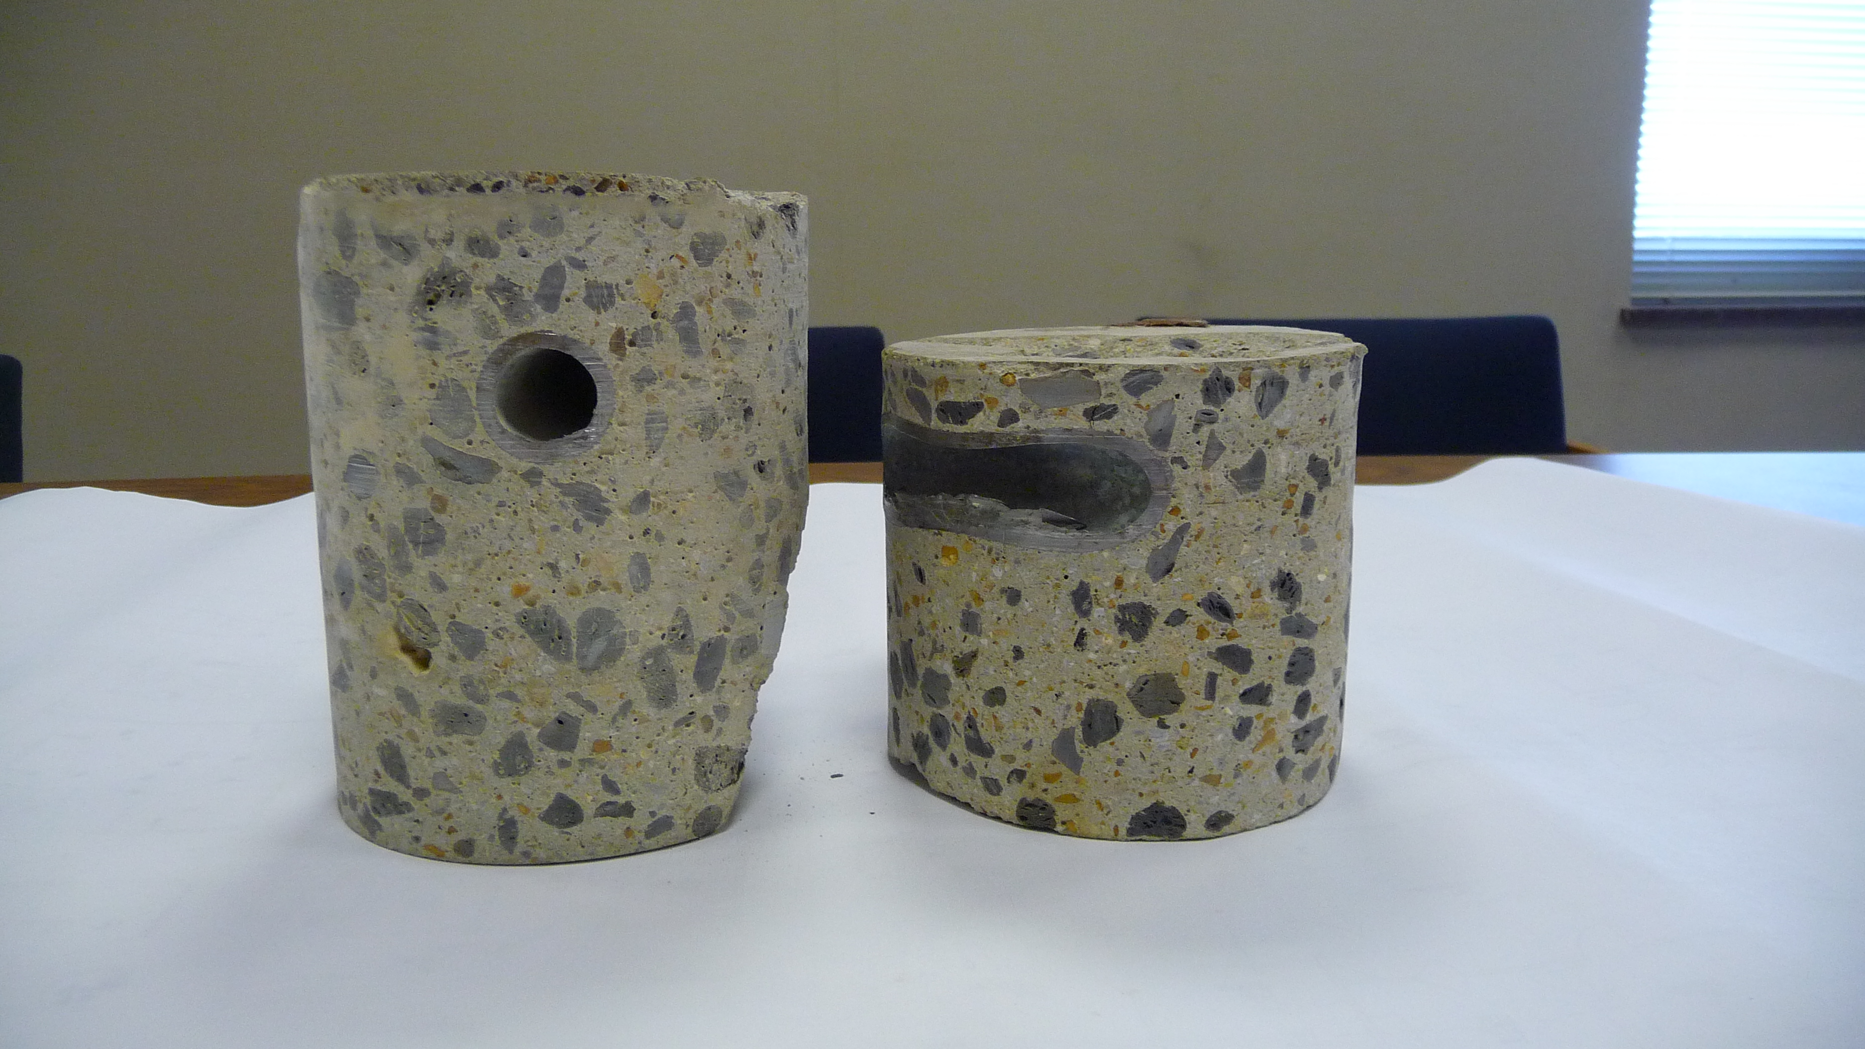
Lost in translation

Slide 35
Questions
Thank You for Attending

