Slide 1




Work Orderology
Alan Gresch
VP of Healthcare Strategy
Accruent
David Scott, CBET
Senior Biomedical Technician
UC Health

Slide 2


Right click gray area and select Change Picture > from File. Select your portrait and press Insert. Grab the corner of your image and drag to adjust size. To change the position of your image, grab the bounding edge of your picture and drag into position. If you accidentally select a different layer you can simply press tab until your image is reselected.
AL GRESCH
Vice President, Healthcare Strategy at Accruent
Right click gray area and select Change Picture > from File. Select your portrait and press Insert. Grab the corner of your image and drag to adjust size. To change the position of your image, grab the bounding edge of your picture and drag into position. If you accidentally select a different layer you can simply press tab until your image is reselected.

Slide 3
Why?
Staffing
Capital Planning
Benchmarking
Improved & More Efficient Operations
How?
Data Integrity
Data Standardization
What?
Potential Results

Slide 4
Why?
Staffing
Capital Planning
Benchmarking
Improved & More Efficient Operations
How?
Data Integrity
Data Standardization
What?
Potential Results

Slide 5


Slide 6
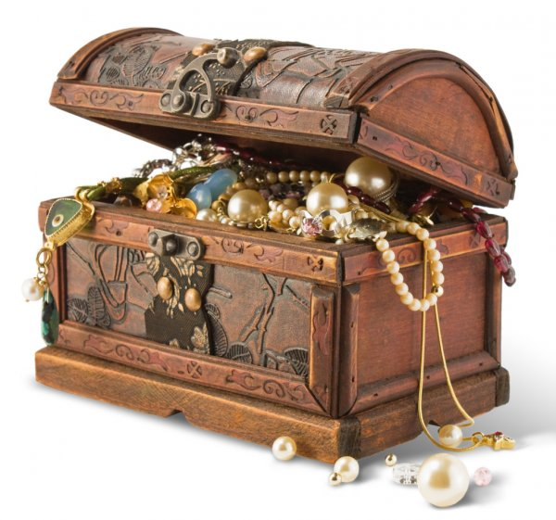

Slide 7
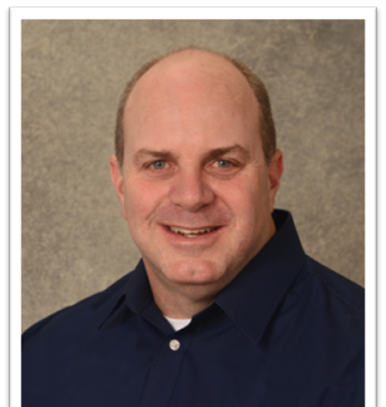
Right click gray area and select Change Picture > from File. Select your portrait and press Insert. Grab the corner of your image and drag to adjust size. To change the position of your image, grab the bounding edge of your picture and drag into position. If you accidentally select a different layer you can simply press tab until your image is reselected.
David Scott
Senior Biomedical Technician, UC Health
Right click gray area and select Change Picture > from File. Select your portrait and press Insert. Grab the corner of your image and drag to adjust size. To change the position of your image, grab the bounding edge of your picture and drag into position. If you accidentally select a different layer you can simply press tab until your image is reselected.

Slide 8
Work Orderology
Definition: ology- a subject of study; a branch of knowledge.

Slide 9
Work Orders
Types:
Repair or On Demand
PM or maintenance
Training
Customer Service/Rounds
Meetings

Slide 10
Work Orders
Contains:
Work done
Parts used
Time to complete each task

Slide 11
Work Orders
What kind of work should have a work order?
Anything that you work on even small things
Example: patient monitor in room needing alarms adjusted.

Slide 12
Work Orders- Tasks/Time
Time to complete- each task
Pick up from user/department/customer
Open Work Order- in CMMS (computerized maintenance management system)
Problem solve/Troubleshoot
Get Return Materials Authorization (RMA)- Pack and ship for repair
Parts ordering
Parts install
Receive back from repair
Calibration/configuration
Performance testing
Close Work Order
Return to user/department/customer
Travel Time

Slide 13
Work Orders- Repair
Wording for repair work orders (comments)
What should be included?
Performance tested
Function tested
Meets performance specs
No further action needed
Ready to use
Return to Service

Slide 14
Work Orders- PM
Wording for PM work orders
Completed PM procedure to ensure normal system operation
Installed parts/PM kit as required
The system is functioning normally, and no further action is required
Operational/Functional check – passed
Ready to use
Return to service

Slide 15
Work Orders- No Problem Found
Operational/Functional check out
Review service history for similar problems
No problems found- note in work order
Unable to duplicate described problem/failure
Possible intermittent problem
Possible operator use problem
Return to service
Ready to use- no further action needed/required

Slide 16
Work Orders- Abuse/Preventable Harm
Operational/Functional check out
Failure is due to physical harm/abuse/preventable harm
Return to manufacturer for repair
Return to third party repair service company
Replace broken pieces/parts
Configuration- example – drug library
Calibration
Performance/Operation tested
No further action required
Return to Service

Slide 17
Work Orders- Outside Service
Attach any documentation given by an outside service
This includes manufacturer repair
Third party service documentation
This is in addition to any work you did on the work order such as:
Initial check out
Calling for RMA
Labeling, packing and shipping
Check out upon return
Etc. See previous notes

Slide 18
Work Orders- timing
Close/complete work orders AS SOON AS POSSIBLE!
Try to do CMMS entry daily or even as you go by the minute
There is a clock ticking whether it is evident to you or not.
This counts toward completed PMs and total repair time.
If you wait to close/complete, then it will be difficult to accurately document what work you did.
Management wants work orders closed to accurately reflect of the department's “dashboard”

Slide 19
HTM Measurement Metrics
PM Completion Percentage
Time Management
Average Repair Time
Total Time to Repair
Cost of repairs- labor and parts
Work Order Analysis

Slide 20
PM Completion Percentage
How many of your PMs you get done in the period they are assigned
Factors-
Cannot locate
In use
Salvaged
Storage

Slide 21

Time Management
This tells management what you are doing throughout your day
Time to complete PMs
Time to complete repairs
Time for meetings
Time for professional development
Time for whatever else you do during the day
Usually, management will be looking at how many hours out of a day you have “booked” or accounted for.
You might have a department goal?
Usually, management will want you to account for most of your 8-hour day on workorders

Slide 22

Time Management
PMs
Divide up time for PMs completed
Some PMs take longer to do than others
Does your workplace have standard times for PMs? If so use them
Time for ordering PM parts
Time for looking for PMs that are due even though they weren’t completed.
If PM is done by vendor count the time to set up the call with vendor
Time to meet the vendor and show them to the equipment.
Time to get the PM report from vendor and post it and complete PM

Slide 23

Time Management
This is an area where a lot of techs get in trouble!!!
If everyone is doing this correctly it can make management’s job easier
This can help factor into adding staffing
Look at time consuming tasks and look for solutions to reduce

Slide 24
Average Repair Time or Average Work Order Time
Measured in hours or ¼ hours
Gives management an idea of how much time is being spent on repairs on average.
Depending on the area techs work average repair times can vary
Sometimes used to compare repair times among techs
Used to determine techs needed to complete the workloads and department staffing

Slide 25
Total Time to Repair
This is usually measured in days time to complete
Gives management an idea of how long it takes to turn over repairs
Can factor into department staffing levels
Can also point out areas that need more investigation
Such as parts availability or backorders for parts
Time it’s taking a vendor to complete work sent to them
Measurement of department efficiency

Slide 26
Cost of Repairs
Cost of Service Ratio (COSR)
Purchase cost of equipment inventory
Factors:
Shop hourly labor rate
Cost of parts
Cost of vendor repairs
Cost of services expenses- such as mileage reimbursement or transportation cost
Cost of service contracts
Operational Costs- example: office supplies, printer paper, etc.
All of these factor into a ratio (COSR)
Measured in a percentage

Slide 27
Cost of Repairs
Cost of repairs can help identify equipment with high repair costs
Can look at history of the equipment and how much has been spent to repair it over its lifetime.
Once the equipment reaches a threshold it can be added to a list of equipment needing to be replaced with new equipment.
Can help identify “lemons”
Helps equipment planning

Slide 28
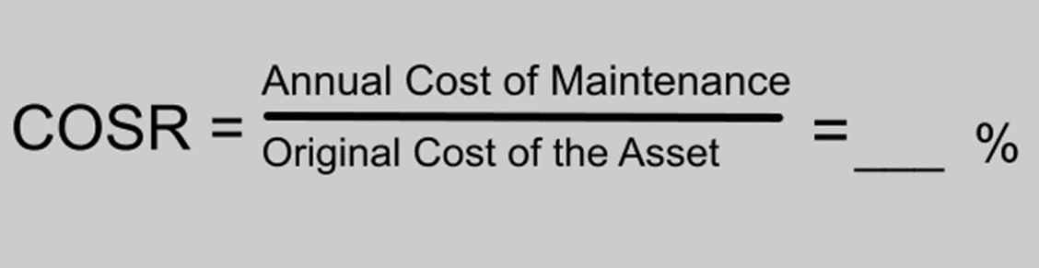
Cost of Repairs
COSR – Cost of Service Ratio is a measurement of department efficiency
COSR can help in looking at areas to cut costs and service contracts
Your medical equipment requires PM labor, PM parts, repairs, some user errors, service calls, maybe a service contract.

Slide 29
AEM Analysis
PM and CM work orders are analyzed to determine whether an AEM can be done
AEM is Alternate Equipment Maintenance
This maintenance differs from the manufacturer recommended interval or PM steps.
If PMs are routinely completed on a certain piece of equipment with no adjustments necessary, then maybe an AEM can be considered.
Equipment with no previous service history are not eligible for AEM

Slide 30
AEM Analysis
It is important to code PM work orders correctly.
If a PM passes with no adjustments the work order should be closed noting no adjustments needed.
If minor adjustments are needed, then close it that way.
If repairs are needed at PM close with completed- repairs needed and open a corrective maintenance work order.
All these closing codes play into the AEM determination.

Slide 31
Right click gray area and select Change Picture > from File. Select your portrait and press Insert. Grab the corner of your image and drag to adjust size. To change the position of your image, grab the bounding edge of your picture and drag into position. If you accidentally select a different layer you can simply press tab until your image is reselected.
AL GRESCH
Vice President, Healthcare Strategy at Accruent
Right click gray area and select Change Picture > from File. Select your portrait and press Insert. Grab the corner of your image and drag to adjust size. To change the position of your image, grab the bounding edge of your picture and drag into position. If you accidentally select a different layer you can simply press tab until your image is reselected.

Slide 32
Why?
Staffing
Capital Planning
Benchmarking
Improved & More Efficient Operations
AEM
More balanced PM vs. CM workload
More Device Hrs. vs. Non-Device Hrs.

Slide 33
Device Hours vs. Non – Device Hours
Device Hours
PM
CM
Incoming Inspections
Incident Investigations
Hazard Alerts
Recalls
Average/Tech
1001 Dev. Hrs.
859 Non-Dev Hrs.
Non-Device Hours
Department Meetings
Compliance Training
Vendor Training
Administrative Work
Travel

Slide 34
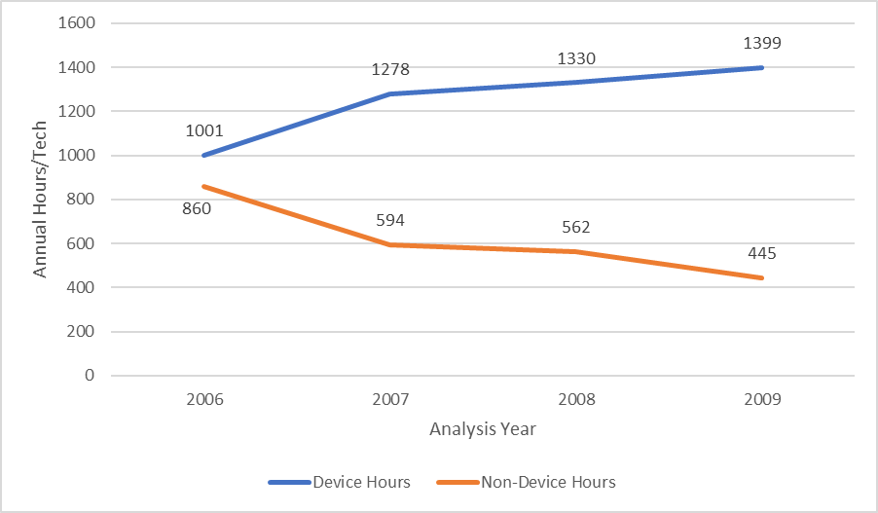
Device Hours Trend
Notes:
Yr. 4 = 1399/1844 X 100 % = 75.87% = The new 100% Productivity
Sends the message, “We have the same goals you do, Mr. or Mrs. Finance person!”

Slide 35
Why?
Staffing
Capital Planning
Benchmarking
Improved & More Efficient Operations
How?
Data Integrity
Data Standardization
What?
Potential Results

Slide 36
DATA INTEGRITY!

Slide 37
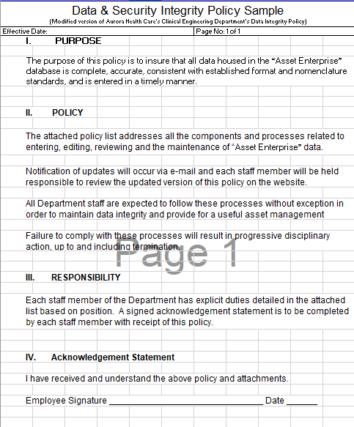
Data Integrity Policy

Slide 38
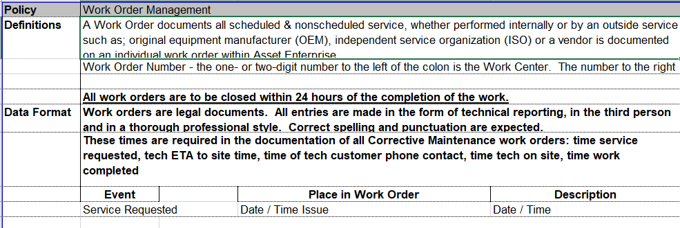
Data Integrity Policy

Slide 39
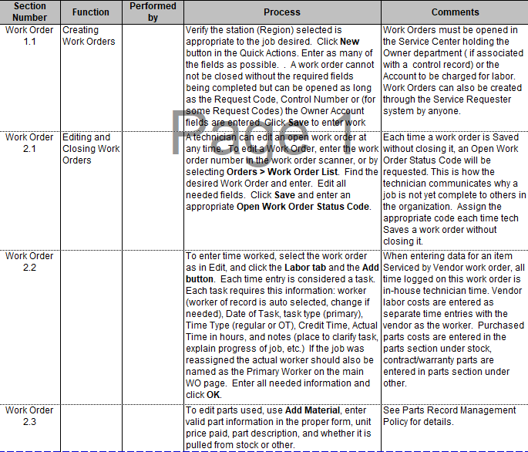
Data Integrity Policy

Slide 40
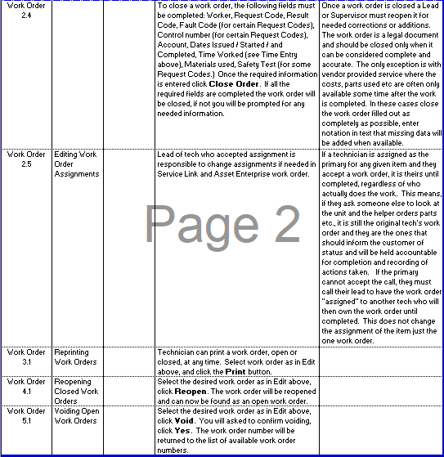
Data Integrity Policy

Slide 41
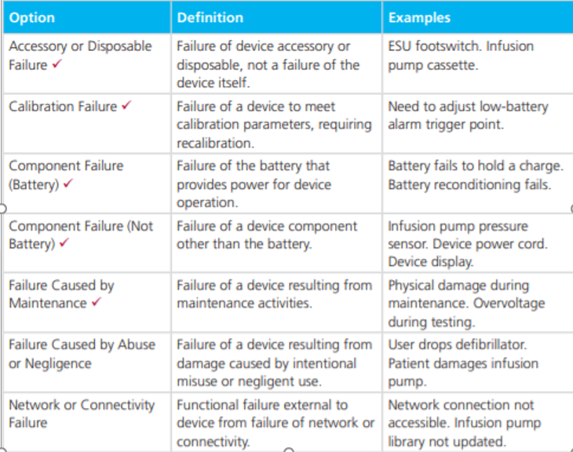
Failure Code Field Options - CMMS Collaborative

Slide 42
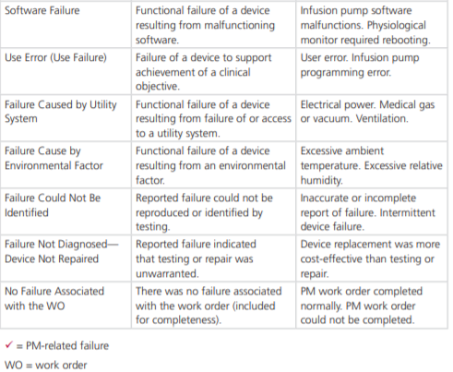
Failure Code Field Options -
CMMS Collaborative

Slide 43
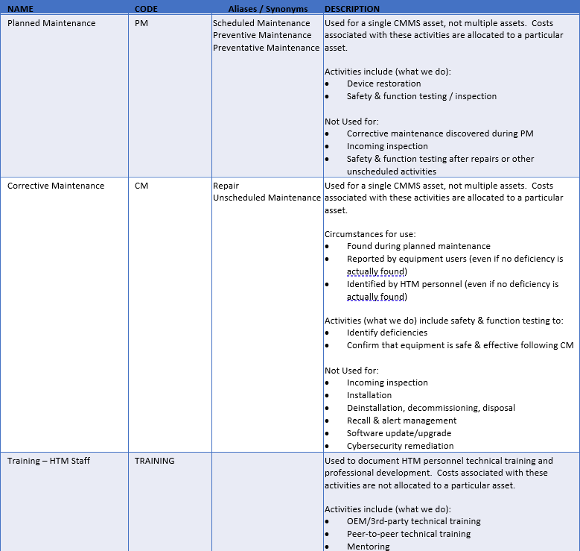
Work Order Type Options -
CMMS Collaborative

Slide 44
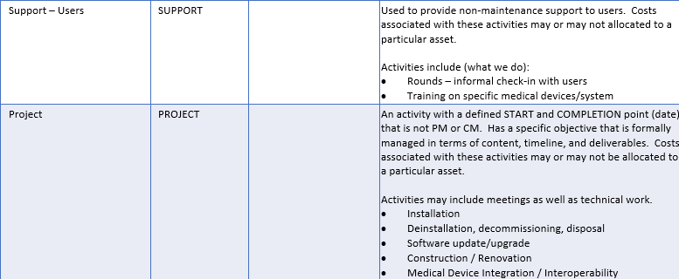
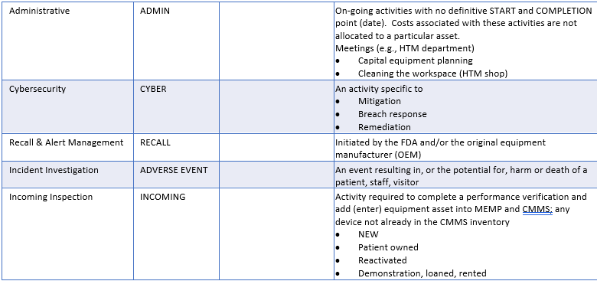
Work Order Type Options –
CMMS Collaborative

Slide 45
Manning Data
Device Category | Active Inventory | Rich's Hours per device | Rich's Total Device Hours
Aerator, Ethylene Oxide | 6 | 1.90 | 11.40
Air Cleaner, Particulate, Germicidal, UV | 3 | 1.00 | 3.00
Air Cleaner, Particulate, High-Efficiency Filter | 4 | 0.00 | 0.00
Alarm, Occupancy, Bed | 928 | 0.75 | 696.00
Amalgamator | 5 | 1.00 | 5.00
Analyzer, Lab, Hematology, Platelet Aggregation | 4 | 0.30 | 1.20
Analyzer, Lab, Hemo,Erythrocyte Sedimentation Rate | 96 | 0.30 | 28.80
Analyzer, Lab, Immunoassay, Chemiluminescent | 2 | 0.80 | 1.60
Analyzer, Lab, Immunoassay, Photometric, Microplat | 14 | 0.74 | 10.36
Analyzer, Lab, Microbiology, Susceptibility, Auto | 28 | 0.74 | 20.72
Analyzer, Laboratory, Blood Gas/pH | 22 | 0.76 | 16.72
Analyzer, Laboratory, Body Fluids, Glucose | 3 | 0.51 | 1.53
Analyzer, Laboratory, Breath, Carbon Dioxide | 3 | 0.51 | 1.53
Analyzer, Laboratory, Clinical Chemistry | 61 | 0.28 | 17.08
Analyzer, Laboratory, Hematology | 77 | 0.42 | 32.34
Analyzer, Laboratory, Hematology, Coagulation | 57 | 0.56 | 31.92
Analyzer, Laboratory, Hematology, Hemoglobin | 7 | 0.56 | 3.92
Analyzer, Laboratory, Immunoassay | 40 | 1.30 | 52.00
Analyzer, Laboratory, Urine | 109 | 1.03 | 112.27
Analyzer, Phys, Middle Ear, Impedance Tympanometry | 116 | 0.80 | 92.80
Analyzer, Phys, Neuro Musc Funct, Body Motion | 20 | 4.81 | 96.20
Analyzer, Phys, Neuromuscular Funct,Posturographic | 3 | 2.65 | 7.95
Analyzer, Phys, Peristaltic Motility, Esophageal | 7 | 0.75 | 5.25
Analyzer, Physiologic, Body Composition | 4 | 1.00 | 4.00
Analyzer, Physiologic, Joint Laxity | 1 | 1.00 | 1.00
Analyzer, Physiologic, Metabolic Rate, O2 Based | 1 | 2.77 | 2.77
Analyzer, Physiologic, Pulmonary Function | 27 | 4.78 | 129.06

Slide 46
Code Definitions

Slide 47
Code Definitions

Slide 48
Code Definitions

Slide 49
Why?
Staffing
Capital Planning
Benchmarking
Improved & More Efficient Operations
How?
Data Integrity
Data Standardization
What?
Potential Results

Slide 50
Annual Manning Analysis
Productivity = 100.8%

Slide 51
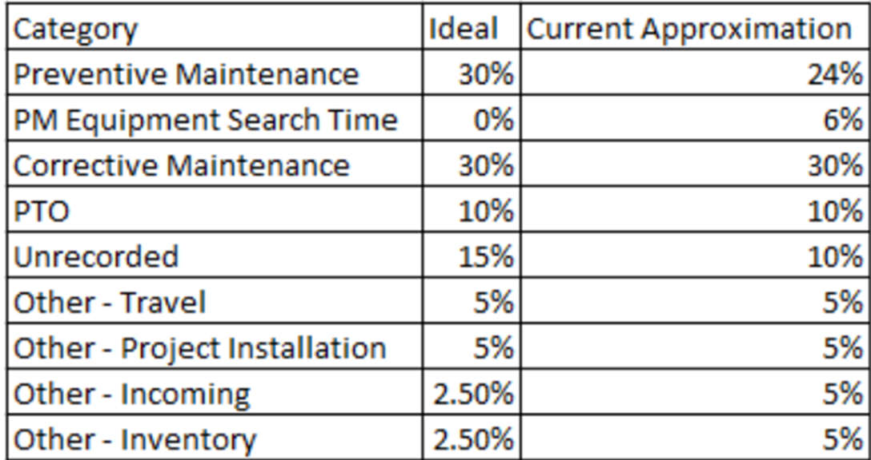
Staff Documentation

Slide 52
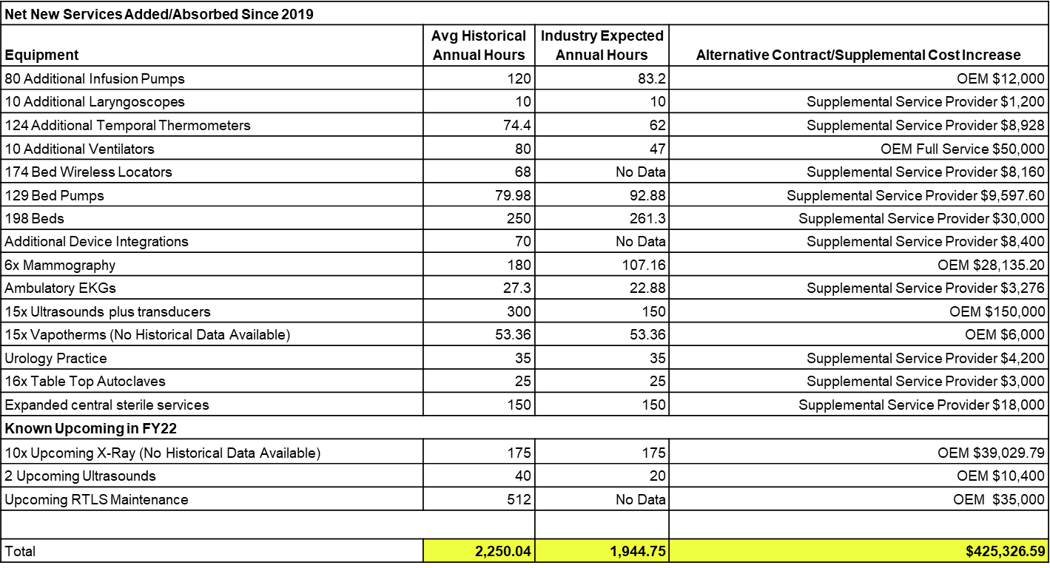

Slide 53
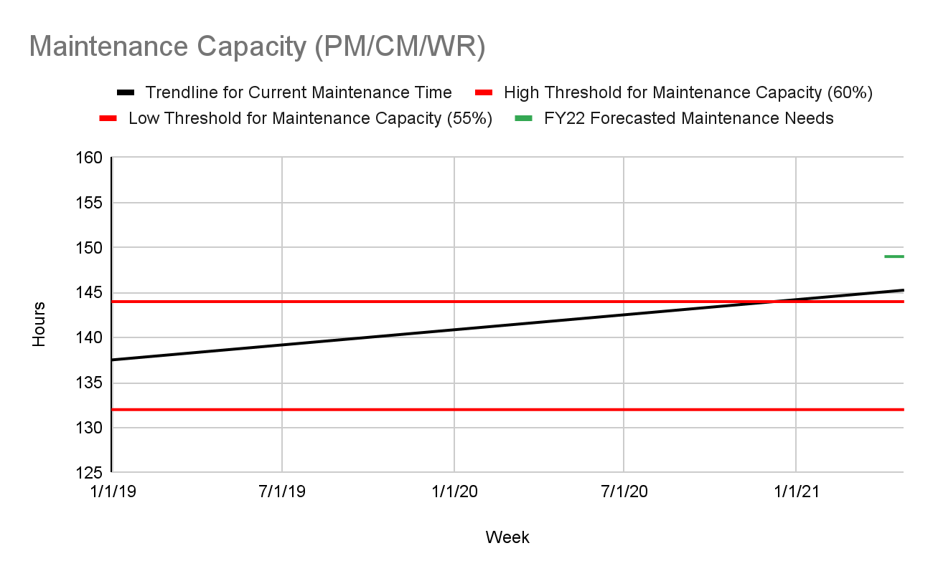

Slide 54
Future Strategy
Upon capital request or contract renewal, review service options for device comparing contract, T&M, and In-House using best available data.
For every capital or contract renewal request that will result in In-House support show the current capacity, expected change in capacity, and budget growth.
Example: (Numbers below are for example purposes only)
Purchase 10 Defibrillators
Current Annual Maintenance Capacity: 400 Hours
Expected Annual Maintenance Capacity Growth: 80 Hours resulting in 320 Hours remaining
Expected Cost of Service Ratio In-House: 6% ($20,300.23)
Expected Cost of Service Ratio Lowest Contract: 24% ($81,200.92)
Expected Annual Operational Budget Growth: $20,300.23 (Savings of $60,900.69)

Slide 60

david.scott2@uchealth.org
agresch@accruent.com

