Slide 2


Mark R. Cooksey
ISO 13485 Leader
Norton Healthcare, Clinical Engineering
BSME, MBA, CLSSBB

Slide 3












Mark’s 30 Year Journey Comes Full Circle
2010s
2000s
Service Industries & Healthcare
Expand Lean 6 Sigma
GE and key Suppliers
Introduce Lean 6 Sigma
Quality Improvement
Manufacturing / Services/
Healthcare
My
Quality
Journey
3 of my kids born at Norton
2020
+
Norton Clinical Engineering
Integrate Lean 6 Sigma
and ISO 13485
1990s
Consumer
GE Supply Chain - Outsourcing
Vetting new suppliers through ISO
Provider
3 of my kids Work at Norton
ISO 13485
CERTIFIED
Regional CE Consortium ISO Expert

Slide 4


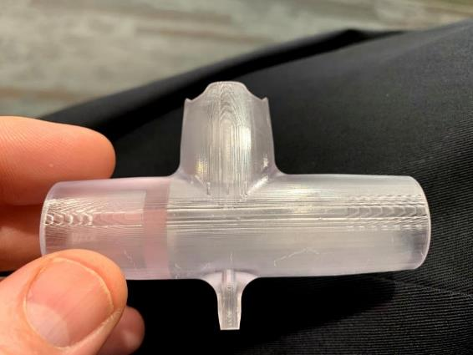
CE connections leveraged during Covid-19
Partnered with former GE colleagues to
produce ventilator adapter prototype

Slide 5

NORTON HEALTHCARE
#1 PROVIDER
IN THE LOUISVILLE
METRO AREA
-17,000 Employees
-5 Hospitals
-1,000s of Providers
Depend on HTM

Slide 6
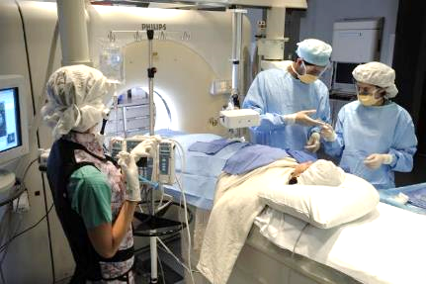



CE Team supports 44,000 HT devices and
the patients and clinicians that need them

Slide 7

Norton is all in for ISO!

Slide 8

What you will get from today
Connect ISO 13485 to your “Right to Repair”
Learn from Norton’s ISO journey
Be all in for ISO and QMS
Notes:
Hook (story)
Transition to topic – I tell you this story because…
Self Introduction
Audience benefit

Slide 9
Key Questions to Answer…
What is it?
Why do we need it?
Who leads and implements ISO?
How did we do it?
What are some benefits?

Slide 10


The question is: Why do we need ISO 13485?

Slide 11
It’s a living
Secret Sauce
To Infinity and Beyond
Employ management structure with defined processes
100
100
Promote Continuous Improvement
Service, Maintain, Install Medical Devices that require training
100
200
200
Demonstrate performance excellence through audits
Have customers and want to grow
Use Software, Keep Documents & Records
200
300
300
Desire a sustainable business
Accountable to regulatory agencies
300
Manage Supply Chain: Contracts, Purchasing, Receiving, Storage

Slide 12





Special Thanks to…
Sponsoring ISO
Training Lean 6 Sigma
Consulting Advocacy
ISO Certification
Quality Evangelism

Slide 13
WHAT IS
ISO 13485?

Slide 14

WHAT IS QUALITY?

Slide 15

Supplier
Provider
Customer
Patient
Quality is where Provider Care meets Patient Experience:
Exchange of Value: “Deed meets the Need”

Slide 16


Quality Improvement Tools
Quality Management System
What
Needs
To
Be
Improved?
How
Well
Is
It
Working?
Without Both, Quality Fails

Slide 17
Challenge: Managing Multiple Stakeholder Expectations for Medical Devices
Risk Management
Safe and Effective Use of MDs
Regulatory Compliance with FDA, MDD, or CE
Improved Processes
New Business Opportunities

Slide 18
ISO 13485 is …more than a piece of paper
Outline for Quality Management System (QMS)
Management Philosophy
Supply Chain
Risk Control
Continuous Improvement
Hierarchy of “Living” QMS documentation
QM
QSP
Quality System Procedures
SWI
Standard Work Instructions
Records
Organized Specifically for Medical Device
Manufacturers Service Providers

Slide 19
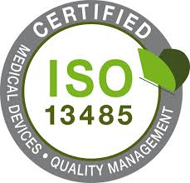
Document It
Create QSPs, SWIs, Records
Do It
Follow the QMS processes as documented
Plan
Do
Improve It
Analyze, Correct, Prevent, Change
Prove It
Measure, Audit, Trend, Report
Act
Check

Slide 20

WHAT- LESSONS LEARNED / NEW PRACTICES
All processes are actively linked
Policies→QSPs→SWIs→Forms→Records
Assess risk to triage ISO improvement efforts
CAPAs, CRs, Vendor Management
Plan the Work, work the Plan

Slide 21

WHY did CE
Pursue ISO 13485?

Slide 22
DNV’s accreditation approach incorporates (NIAHO®) standards with the ISO structure
Norton Corporate moved from TJC to DNV (ISO)
TJC
FOCUS: ORGANIZATION OF QUALITY
DNV
FOCUS: QUALITY OF THE ORGANIZATION
*National Integrated Accreditation for Healthcare Organizations

Slide 23



Limitations of TJC approach to quality
Rules seem arbitrary and punitive
“Cram-for-the-Exam” audit mentality
Fear for the hospital staff
“Just Fix it” thinking
Improvements not sustainable
An effective QMS must improve quality, patient safety, and customer satisfaction…and be sustainable

Slide 24
SBAR: WHY CE CHOSE ISO 13485
Situation
NHC Clinical Engineering (CE) does not have a Quality Management System (QMS)
As such, the ongoing monitoring and improvement of medical device quality is very limited
Background
The FDA has emphasized that those who service medical equipment adopt a QMS
The Joint Commission (TJC) itself mandates using a quality improvement framework
Analysis
The International Organization for Standardization (ISO) is a well-respected purveyor of standards across multiple industries (e.g., ISO 9001 for manufacturing)
ISO 13485:2016 is an existing robust QMS specifically for medical devices
NHC CE is an aftermarket servicer
Multiple other aftermarket servicers have achieved ISO 13485:2016 certification (Agiliti Health, Crothall Healthcare, MedEquip Biomedical, PartsSource, Summit Imaging, and various manufacturers)
No one in NHC CE has QMS experience
ISO 13485:2016 would be complementary to existing TJC-related work
Recommendation
Proceed with ISO 13485:2016 implementation
Re-purpose an existing FTE to now focus around quality as their primary function
Partner with a proven consultant (Emergo) to implement by June 2020
Notes:
Source: Scott Skinner

Slide 25
QMS - Built “On Purpose”
Clinical Engineering maintains and supports Norton Healthcare’s clinical technology to ensure the best possible patient outcomes through risk reduction, continuous quality improvement, stewardship of resources, compliance with regulatory requirements, and exceptional customer service.
Clinical Engineering Purpose Statement

Slide 26
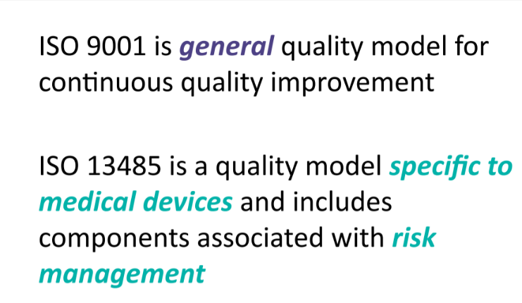
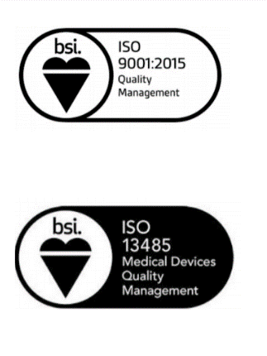


ISO 9001 vs. ISO 13485

Slide 27
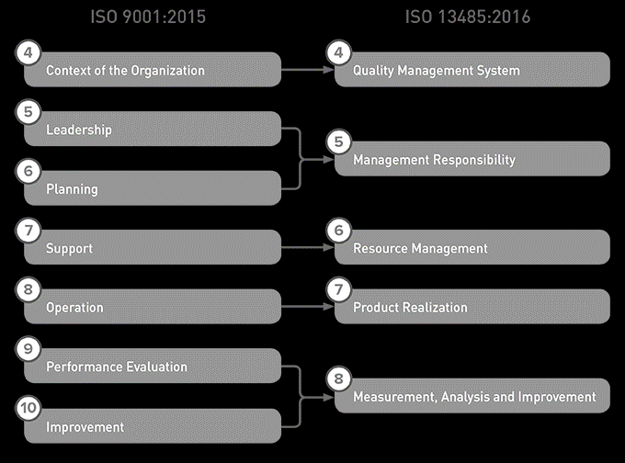
Clause Structure Derived From ISO 9001
Norton
Clinical
Engineering

Slide 28




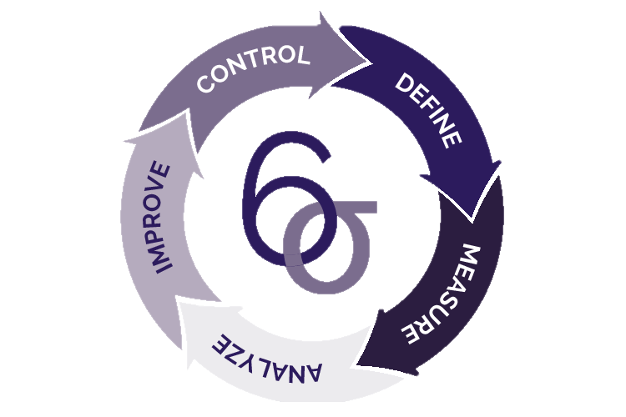

How Does an ISO 13485 QMS Work?
MANAGEMENT
RESPONSIBILITY
QUALITY
MANUAL
DOCUMENT
CONTROL
HUMAN
RESOURCES
CLINICAL ENGINEERING
DMAIC
IMPROVEMENT
PRODUCT / SERVICE
DEVELOPMENT
QMS

Slide 29
Forms
Clinical Engineering
Before ISO 13485
Policies
Standard Work Instructions

Slide 30




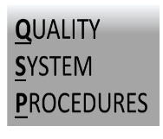

Slide 31
WHO leads
ISO 13485?

Slide 32
WHO - LESSONS LEARNED / NEW PRACTICES
Realign Resources for ISO
Hire Proven Change Agent Quality Leader
Use ISO Consultant as developer and advocate
Develop Senior Leadership Champions
Include All Staff in Training and Roll out

Slide 33
Realign Structure to Support ISO
System Director, Clinical Engineering
Scott Skinner
Admin
Anne Jefferson
Admin
Admin, ISO Support
Jackie Kininmonth
Admin, ISO Support
Director, Biomedical
Engineering
Neil Feldmeier
ISO Management
Mark Cooksey
Director, Imaging & Med Device Security
Doug Elmore

Slide 34



Add Temporary External Support to Prepare for ISO
ISO Management
Mark Cooksey
INDUSTRIAL ENGINEERING
BIOMEDICAL ENGINEERING
2020 Summer Intern
Rachel Blanton
2021 Summer Intern
Katya Kovatsenko
QMS
Development
Jim Craig
ISO Preparation
Jackie Kininmonth
Audit/Accreditation
Zamir Bar-David

Slide 35
HOW did we
Do it?

Slide 36


JOB 1: OVERCOME INERTIA
“IF IT AIN’T BROKE
DON’T FIX IT”

Slide 37
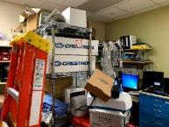
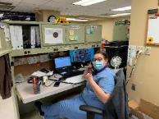
HOW - LESSONS LEARNED / NEW PRACTICES
Assess the current state
Build QMS from ISO Foundation
Introduce Quality Leadership / Team Skills
Spread Quality Leadership to entire staff
Seek early adopters and promote early “wins”
Use QMS to make things easier
K.I.S.S

Slide 38

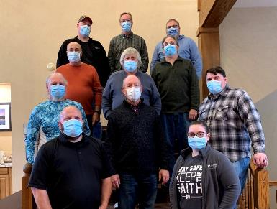
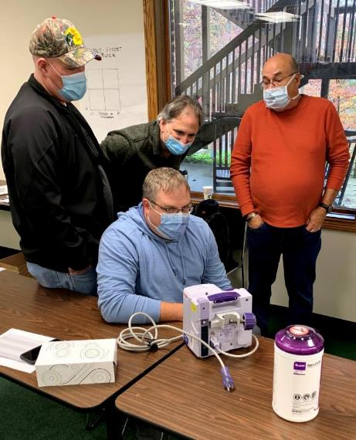
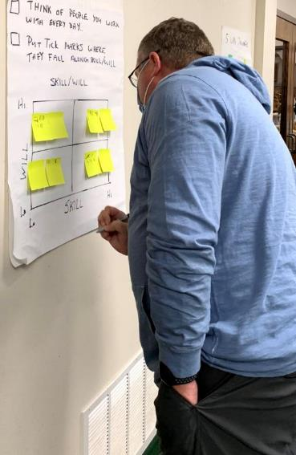

QUALITY LEADERSHIP CONFERENCES ARE KEY TO ISO ROLLOUT

Slide 39

Why is Change so Difficult to Accept? Meet S.A.R.A.H
Surprise
Anger
Rejection
Acceptance
Help
Notes:
[TRANSITION]: We started the session with PROCESS MANAGEMENT with the previous exercises, Now let’s discuss CHANGE MANAGEMENT
OK. You redesigned a great process that can create consistent, measurable results. You created standard work to make things easier. So why don’t they want to follow the process?
Why is change so difficult? It’s like the 5 stages of death.
It’s natural to experience these emotions:
1st SURPRISE,
then ANGER,
then REJECTION,
then ACCEPTANCE,
Then asking for HELP.
PI tools are organized to reduces surprises (standard work), to reduce anger and rejection (addressing skill, will, seeking consensus), to increase acceptance (pilot run, alpha units), and to identify problem areas and provide help when its needed (by monitoring process measurements)
As the leader you must understand that resistance to change is normal and that you must guide your team through the phases from surprise through help.
Addressing “SARAH” leads to successful, sustainable change. It’s called the “EAR” model

Slide 40
Q
E
must be..
M
Quality
Management
System
A
Effective
Accepted
Rigor
S
R

Slide 41





APPLYING THE “EAR” CHANGE MODEL TO ISO
QMS
Effective Solution
Buy-in: Team understands the “why”
Leader supported
Aligned to vision, strategy, and values
E A R
It Works
Makes sense
Evidence based
Voice of all stakeholders considered
Acceptance
Rigorous Process
QMS
Quality System Procedures
with Records
CAPA
Identify Issues
For Improvement
Communication, education, and standard work plans in place
Solid measures of success with accountability (control plan)
Easy to do the right thing
Notes:
Note: used the final version from training but changed the font size and background color--mrc
Tell: Successful, long-lasting change requires an effective solution that is accepted by everyone. It also requires rigor around the process (i.e. launched well with excellent communication (Who needs to know? How will this info be delivered?), training, and education along with solid measurements and controls. Just as you experience in the group juggle exercise, the final solution was easiest to follow and product a consistent result.
The EAR acronym stands for E effective solution, A for acceptance, and R for rigorous process fits as a model for change. Your “ears” never stop working. They pick up feedback in all direction.
The cultural side of change is often more difficult because you have to get everyone onboard. As a leader, you must make sure “why” the change is needed and to show how it aligns with Norton values, goals, and strategies.
Use your ears to assess readiness for change. You might hear the following type of phrases as resistance to change.

Slide 42

What is the #1 Goal of a QMS for Norton?
Challenge: Separate the
Hazard from the Patient
To control risk:
-Identify
-Assess
-Contain
-Reduce
-Eliminate

Slide 43
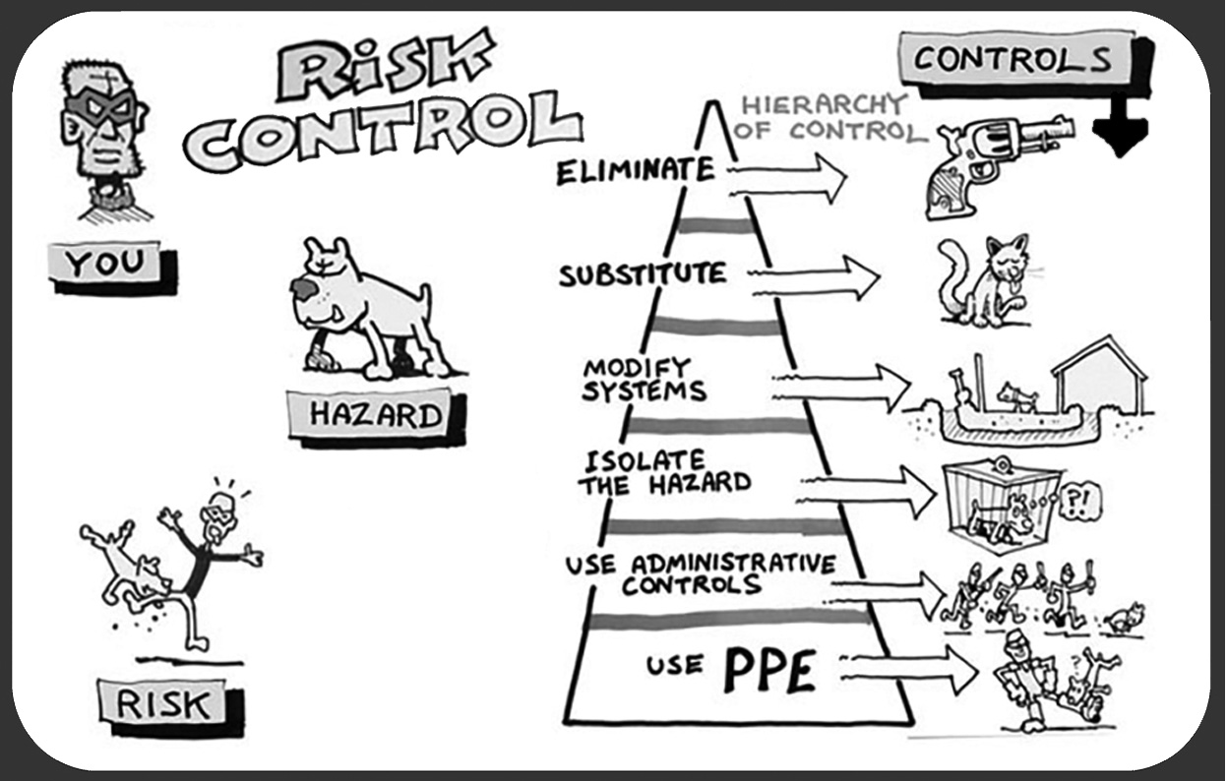

Slide 44

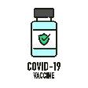




RESTAURANT RISK RESPONSE HIERARCHY - COVID
Engineering Controls
Administrative Controls
PPE
Low Effort
High Effectiveness
VACCINE
Elimination
EFFECTIVE
CARRY OUT
ONLY
Substitution
HAND
SANITIZERS
SOCIAL
DISTANCING
Hi Effort
Low Effectiveness
MASKS

Slide 45


Quality Leadership Take Aways
Treat audits/complaints as opportunities for improvement (OFIs)
No Excuses to addressing non-conformities
Train in New Quality Tools: Root Cause Analysis
ISO Power tool: Corrective and Preventative Action (CAPA)
Major – Impact Patient Care
Minor- Impact Efficiency/Effectiveness of QMS
OFI – Proactive improvements (What if?)
75% of the staff and leadership became certified Lean 6 Sigma White Belts

Slide 46
HOW- GETTING READY FOR ISO
Gap Analysis – Identify ISO Clauses and QSPs to include and exclude from scope
Quality Manual – Compile resulting ISO 13485 Quality Management System Manual
QM
Policy
Procedures
Work Instructions
Records
Policy – Supplement Legacy Corporate / CE Policies with new ISO 13485 QMS Policies
Procedures – Create new ISO Quality System Procedures (QSPs) as needed
Work Instructions – Add Work Instructions to QSPs and train team in new Standard Work Instructions (SWIs)
Records – Link records to show evidence of QSP compliance (CMMS, Training Logs, etc.)

Slide 47
HOW – KEEP IT SIMPLE SYSTEM
Build ISO 13485 from the ground up
Quality Manual
Quality Systems Procedures
Forms
Records
Leverage & Link Existing Infrastructure to ISO
“N Site” – Norton intranet file sharing platform
CMS – Computerized Maintenance System
Environment of Care (EOC)

Slide 48
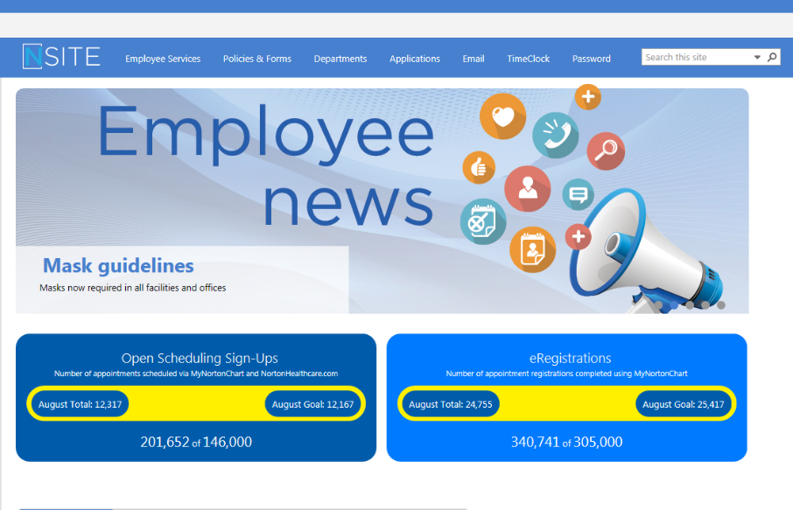

HOW – KEEP IT SIMPLE SYSTEM
All 17,000 Norton Employees Access SharePoint

Slide 49
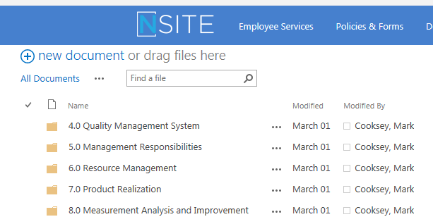
HOW – KEEP IT SIMPLE SYSTEM
Simple Folder Structure Organized
around ISO 13485 Clauses

Slide 50
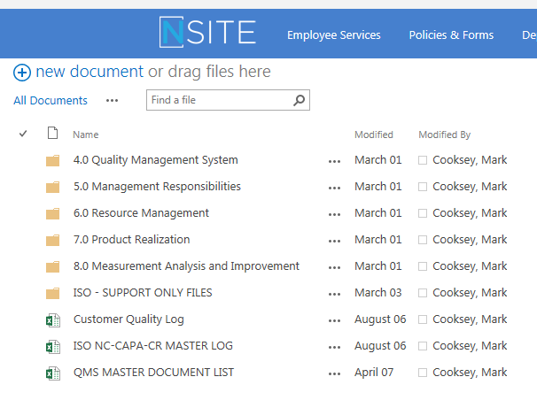
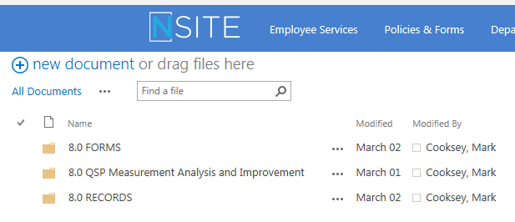
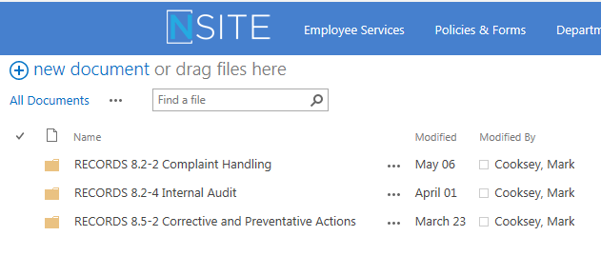
HOW – KEEP IT SIMPLE SYSTEM
Clauses
Documents
Records

Slide 51
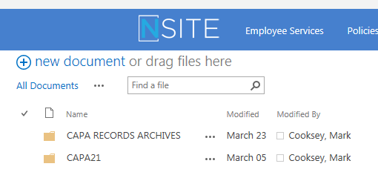
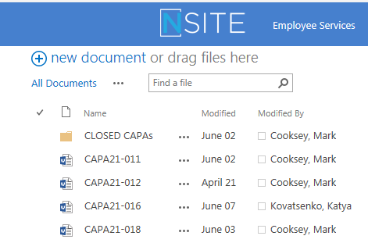
HOW – KEEP IT SIMPLE SYSTEM

Slide 52
CAPA IS HOW WE ADDRESS ISSUES
Create Record of the Issue
Sign off & Close Record
CAPA
Assign for Investigation
Validate / Verify Solution
Identify Short and Long Term Solutions

Slide 53

HOW - LESSONS LEARNED / NEW PRACTICES
Establish aggressive timeline
Collaborate with ISO consultant
Mentor, Coach, Partner, Advocate
Get “Audit Ready” :
Prepare, Practice, Pre-Audit
Notes:
The Effective ISO 13485 Audit Checklist to Ensures Readiness
ISO 13485:2016 requires Stage 1 and Stage 2 audits. The best ISO 13485 audit checklist can help you prepare for both stages and an internal audit prior to certification or recertification. Stage 1 and Stage 2 audits differ in duration, depth, and scope.
Stage 1 ISO 13485 Audits: An ISO auditor from your certifying body will provide a report of positive and negative findings to determine whether your company is ready to proceed to stage 2.
Stage 2 ISO 13485 Audits: This is a comprehensive evaluation of your organization’s compliance with ISO 13485:2016 standards. The auditor will review documentation, controls, internal audits and management review, and all relevant processes. The auditor may produce a list of non-conformances which have to be corrected before you can be certified or receive recertification.
The ISO 13485 Audit Checklist contains a series of questions and status updates to ensure that everything matches the plans defined in the organization’s QMS regarding internal activities, supplier evaluation, and an evaluation of the supplier audit reports.

Slide 54
Major Milestones - ISO 13485
Define
6 Months
Train
3 Months
Launch
3 Months
Audit
6 Months
Assess Current
ISO Gaps
Convert QSPs
Develop QSPs
Quality Tools Leadership & Staff
Lean 6 Sigma
ISO Basics
Use New QSPs
Integrate ISO tools
Transition to self sufficiency
Audit Prep
ISO Audit
Stage 1
Stage 2
2020
2021

Slide 55
What are some of the benefits?

Slide 56



How Has our NHC Benefited from ISO 13485?
Capability to evaluate the performance through a quality management system
Identify improvement opportunities
Increase the satisfaction of NHC stakeholders
Hospital operations
Clinical Staff
Patients
CE Staff

Slide 57
How Has CE Benefited from ISO 13485?
Changed the Culture
Strengthened our Brand
Elevated Technicians to be Problem Solvers
Promoted as a Quality Center of Excellence
Norton Healthcare
Regional Hospitals CE Consortium

Slide 58
WHERE - LESSONS LEARNED / NEW PRACTICES
External: Use Customer Complaints to improve patient care.
Internal: Leverage “OFIs” to improve morale, cost, service, and patient care.
Use CAPA to formalize problem solving.
- Validate solution and verify long term improvement.

Slide 59
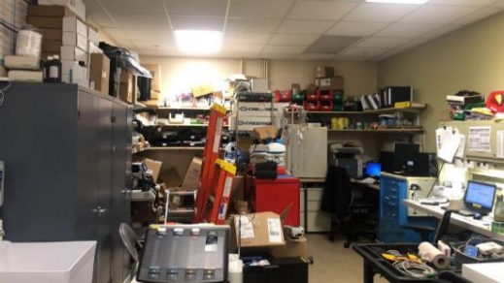
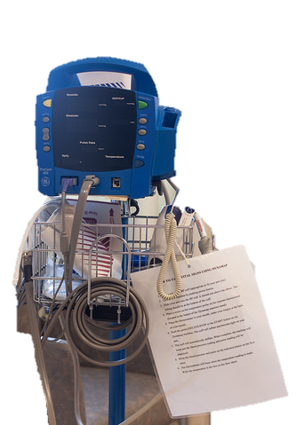
ISO IMPROVEMENT FOCUS
COMPLAINTS
OFIs
CUSTOMER
FOCUS
INTERNAL
FOCUS
MAKE
THINGS
EASIER
IMPROVE
ORGANIZATION AND
WORKFLOW
I

Slide 60
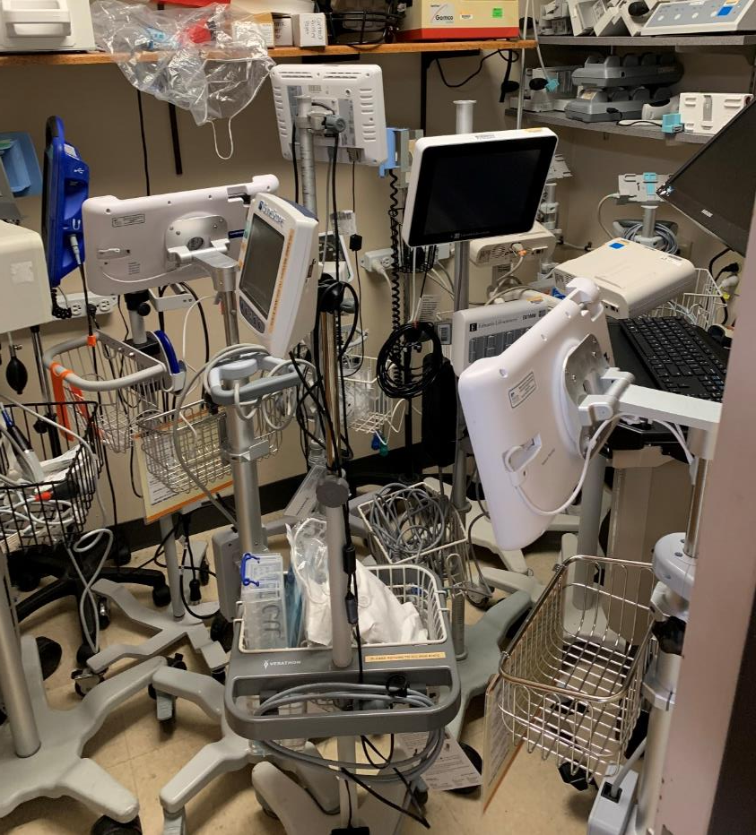
A CRY FOR HELP
Customer Complaints: CNO Request for Help
“Patient Care is impacted because Patient Monitors are unavailable. Entire staff is frustrated!”
CAPA: To investigate trends and to observe current state
RCA: Root Cause Analysis identified multiple causes for failure
Rapid Cycle Events: Multi-discipline Leader Champions asked CE to draft team and lead Rapid Cycle events to identify solution set.
C-Suite Leaders asked CE to help solve customer problem: Accessories!

Slide 61
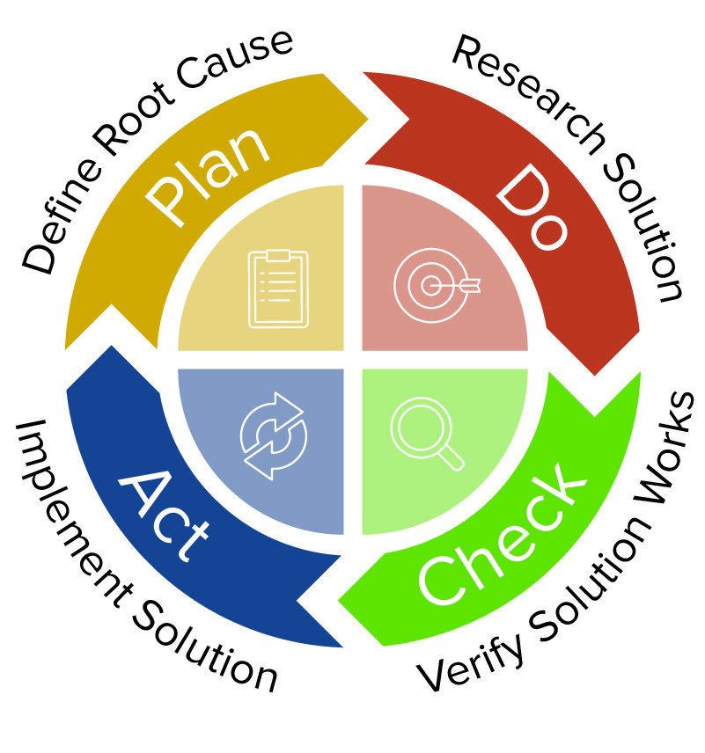
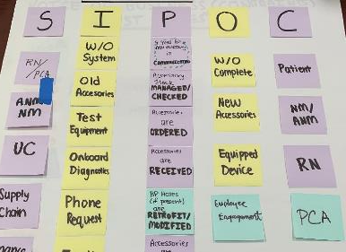
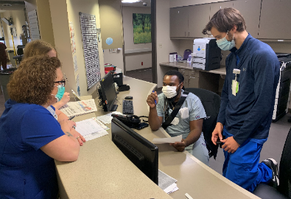
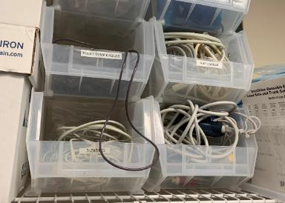
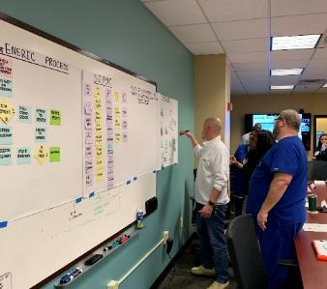
Gather Data
Rapid Cycle
Pilot Solution
Get Buy In

Slide 62
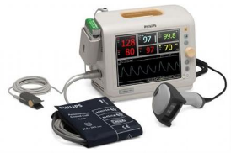


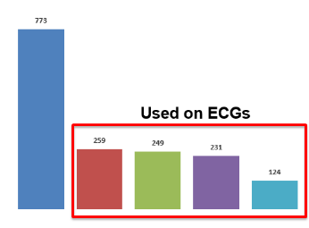

Vital Signs Accessories Management Optimization Katya Kovatsenko, University of Louisville, Bioengineering
Results
Simplified Replenishment Process
Centralized Visual Cost Control
Reduced Storage Locations by 94%
Reduced Supplies on hand by 98%
Improved Availability of Supplies
Vital Signs Accessories Management Optimization
DEFINE
MEASURE
>$500K Spent in Past 3 Years
ANALYZE
IMPROVE/CONTROL
Better Accessibility
Improved Tracking
Volume Ordered
Streamline
Potential Savings
Accessory Type
Notes:
*Achieving Targeted Operational Improvements and Creating Great Human Interactions (no wait)
*Sorting includes both sorting for un-batching and sorting when add-ons are needed.
**Numerous duties of processors (client phone calls, decants, sorting, delivery, refrigeration, frozen, etc.

Slide 63
ISO - INTERNAL IMPROVEMENT FOCUS
COMPLAINTS
OFIs
CUSTOMER
FOCUS
INTERNAL
FOCUS
MAKE
THINGS
EASIER
IMPROVE
ORGANIZATION AND
WORKFLOW
I

Slide 64

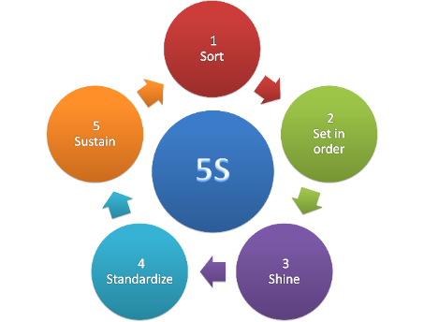
5S
Clinical Engineering
5S APPLIED TO THE ENTIRE IMAGING DEPARTMENT

Slide 65
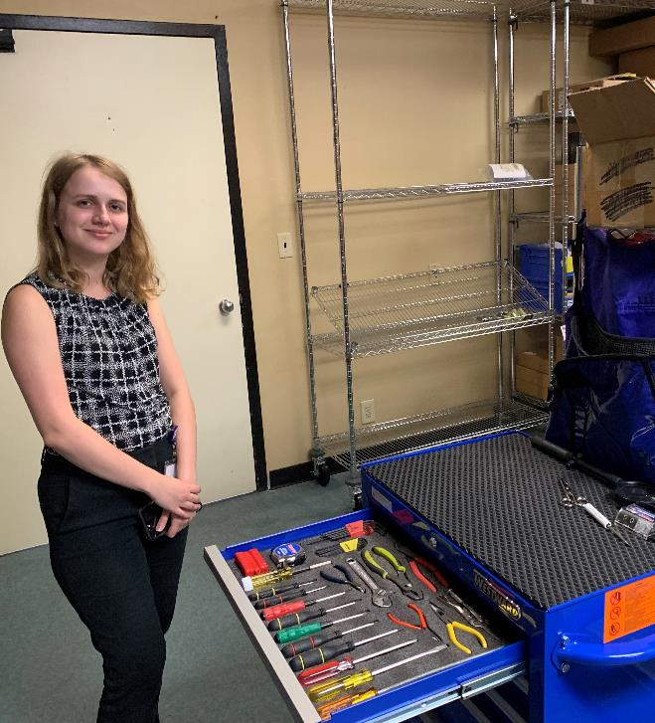

2021 Summer Intern
Katya Kovatsenko
U of L Biomedical Engineer, Pre-Med

Slide 66


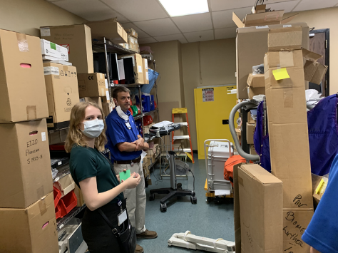
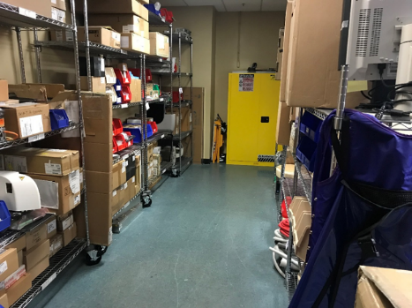
PARTS AREA
BEFORE
AFTER

Slide 67
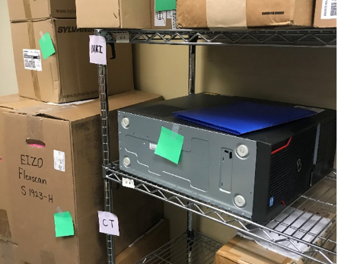
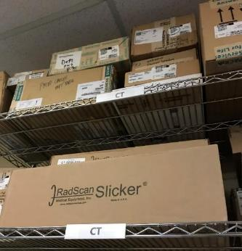
PARTS LABELING
BEFORE
AFTER

Slide 68
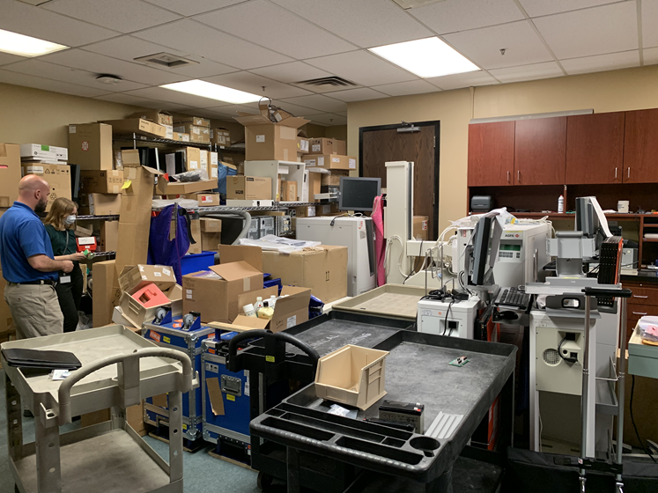
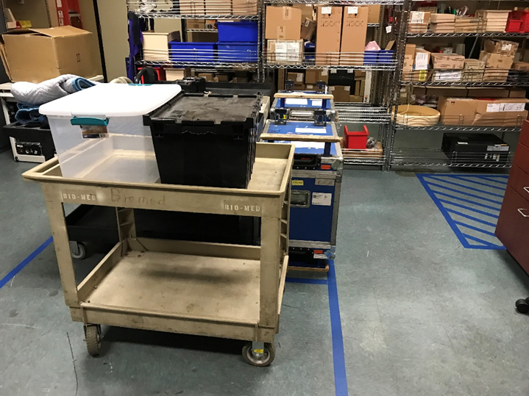
MIDDLE AREA
BEFORE
AFTER

Slide 69
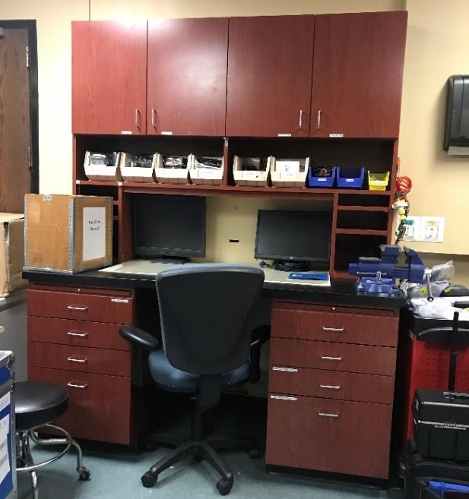
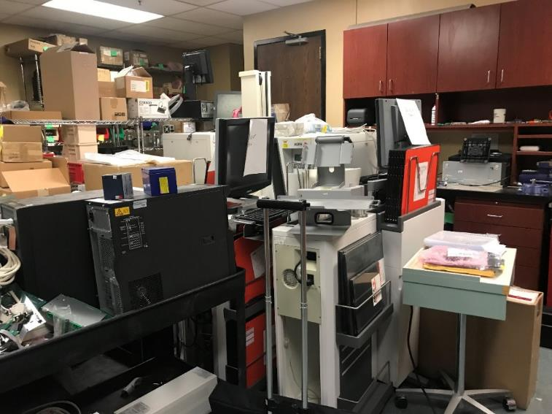
DISCOVERED A NEW WORKSTATION
BEFORE
AFTER

Slide 70
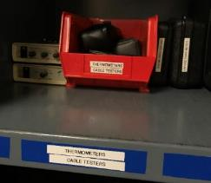
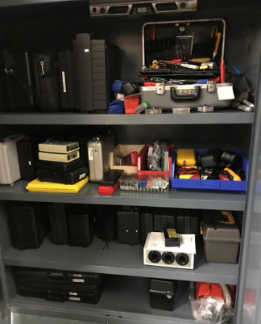
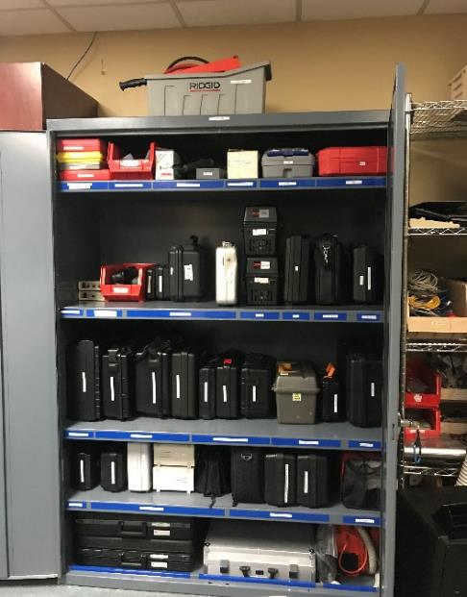
TOOL CABINET
BEFORE
AFTER

Slide 71
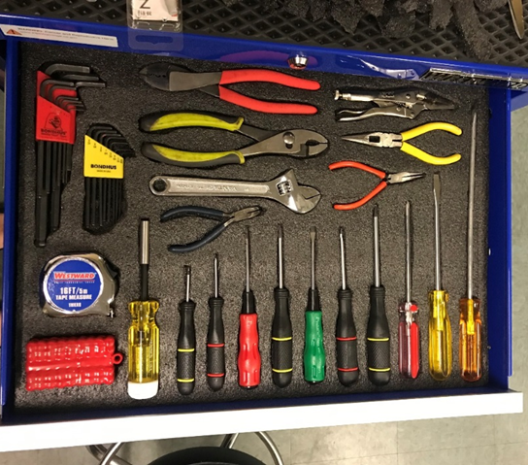
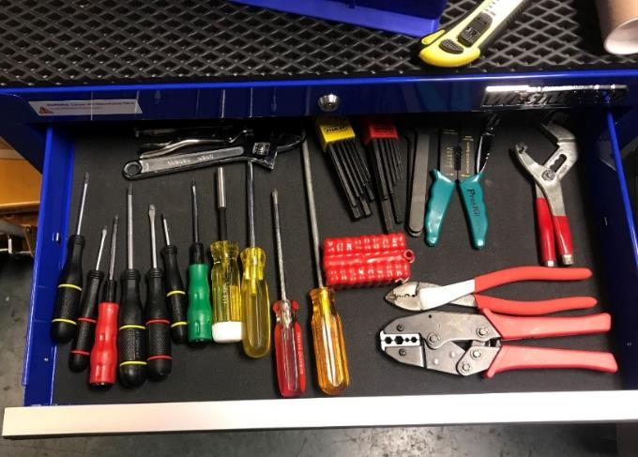
TOOL CART
BEFORE
AFTER

Slide 72
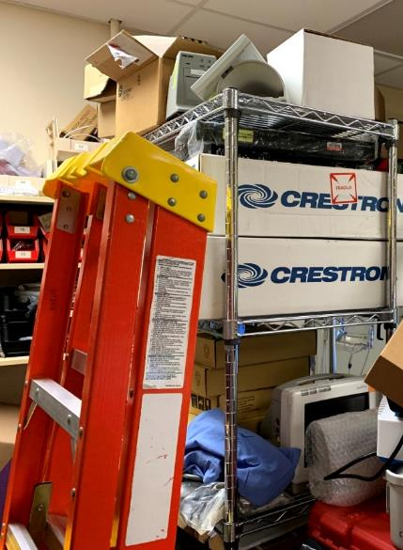
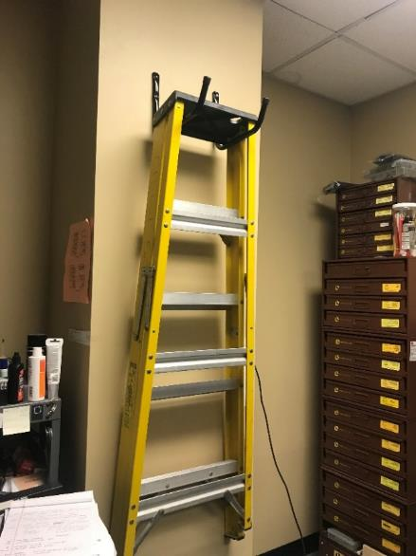
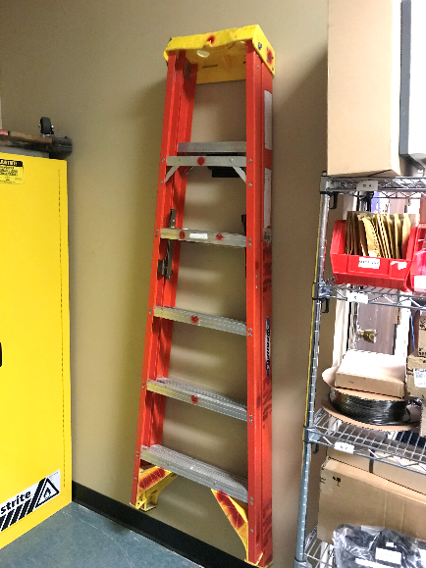
LADDERS
BEFORE
AFTER

Slide 73


LUNCH ROOM CABINETS
BEFORE
AFTER

Slide 74


CLEANING SUPPLIES
BEFORE
AFTER

Slide 75

MANUAL SHELFING

Slide 76
KEYS TO SUCCESS

Slide 77





Remember: It’s all about:
The Patient
Notes:
Discuss the diversity in the CE department. We have nurses, radiology techs, physical therapists and engineers. But we are all bound by the desire to make processes better for our patients.
This diversity helps us look at problems from different perspectives and helps to bounce ideas off each other.

Slide 78

What Will I Take Back?

Slide 79



ISO 13485 Drives Quality Improvement

Slide 80

ISO 13485 Promotes Performance Excellence
Clinical Engineering 5S example added to Norton Corporate Lean 6 Sigma Training

Slide 81

ISO 13485 Promotes Teamwork

Slide 82
What to take back to your company
What is ISO 13485?
Why your company needs it?
Who leads and implements ISO?
How can it be deployed?
What are some benefits?

Slide 83
THANK YOU!
mcooksey6@gmail.com
502.554.5206

