Slide 1


KEYNOTE ADDRESS:
Duty, Honor, Country:
The story of Sammy L. Davis, inspiration for the war scenes in ‘Forrest Gump’
Presented by:

Slide 2
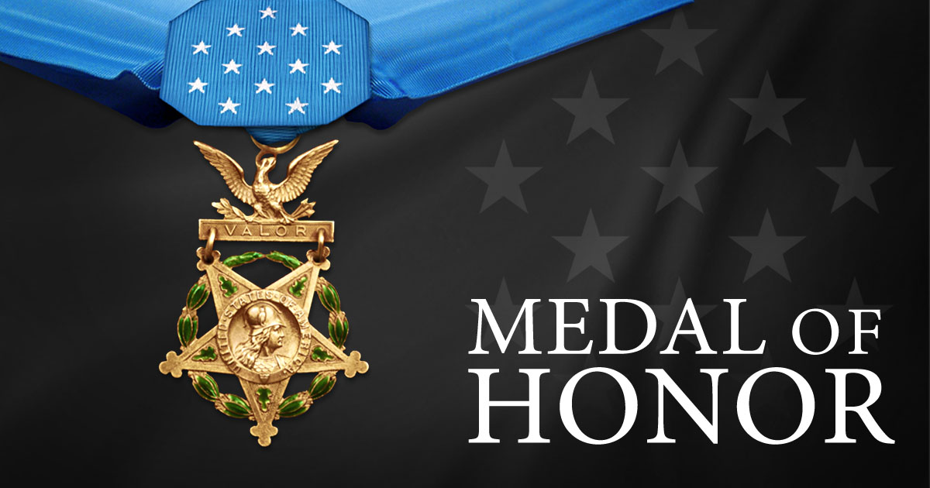
Notes:
Video: https://vimeo.com/397484159

Slide 3
Vietnam War – U.S. Army
SAMMY LEE DAVIS
Details
RANK: PRIVATE FIRST CLASS MILITARY SERVICE BRANCH: U.S. ARMY
(HIGHEST RANK: SERGEANT FIRST CLASS)
CONFLICT/ERA: VIETNAM WAR MEDAL OF HONOR ACTION DATE: NOVEMBER 18,1967
UNIT/COMMAND: MEDAL OF HONOR ACTION PLACE:
BATTERY C, 2D BATTALION, 4TH ARTILLERY, FIREBASE CUDGIL, WEST OF CAILAY, REPUBLIC OF VIETNAM
9TH INFANTRY DIVITION
Notes:
For conspicuous gallantry and intrepidity in action at the risk of his life above and beyond the call of duty. Sgt. Davis (then Pfc.) distinguished himself during the early morning hours while serving as a cannoneer with Battery C, at a remote fire support base. At approximately 0200 hours the fire support base was under heavy enemy mortar attack. Simultaneously, an estimated reinforced Viet Cong battalion launched a fierce ground assault upon the fire support base. The attacking enemy drove to within 25 meters of the friendly positions. Only a river separated the Viet Cong from the fire support base. Detecting a nearby enemy position, Sgt. Davis seized a machine gun and provided covering fire for his gun crew, as they attempted to bring direct artillery fire on the enemy. Despite his efforts, an enemy recoilless-rifle round scored a direct hit upon the artillery piece. The resultant blast hurled the gun crew from their weapon and blew Sgt. Davis into a foxhole. He struggled to his feet and returned to the howitzer, which was burning furiously. Ignoring repeated warnings to seek cover, Sgt. Davis rammed a shell into the gun. Disregarding a withering hail of enemy fire directed against his position, he aimed and fired the howitzer which rolled backward, knocking Sgt. Davis violently to the ground. Undaunted, he returned to the weapon to fire again when an enemy mortar round exploded within 20 meters of his position, injuring him painfully. Nevertheless, Sgt. Davis loaded the artillery piece, aimed, and fired. Again he was knocked down by the recoil. In complete disregard for his safety, Sgt. Davis loaded and fired three more shells into the enemy. Disregarding his extensive injuries and his inability to swim, Sgt. Davis picked up an air mattress and struck out across the deep river to rescue three wounded comrades on the far side. Upon reaching the three wounded men, he stood upright and fired into the dense vegetation to prevent the Viet Cong from advancing. While the most seriously wounded soldier was helped across the river, Sgt. Davis protected the two remaining casualties until he could pull them across the river to the fire support base. Though suffering from painful wounds, he refused medical attention, joining another howitzer crew which fired at the large Viet Cong force until it broke contact and fled. Sgt. Davis' extraordinary heroism, at the risk of his life, is in keeping with the highest traditions of the military service and reflect great credit upon himself and the U.S. Army.

Slide 4
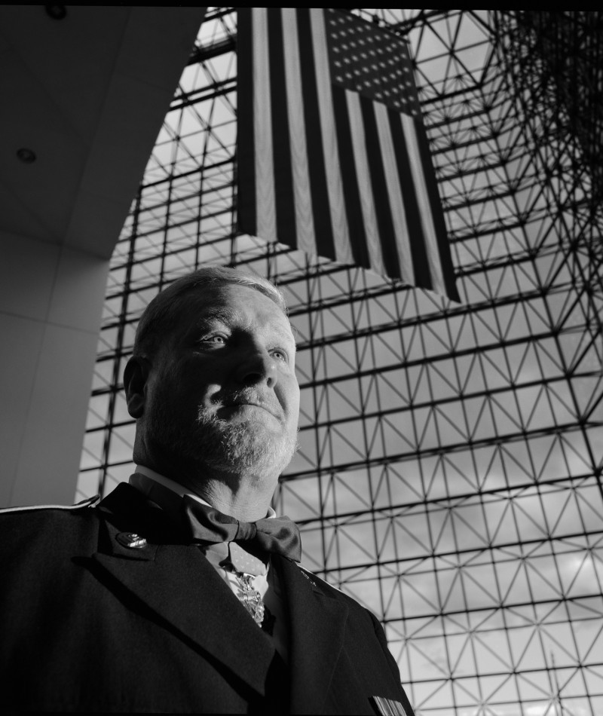
For conspicuous gallantry and intrepidity in action at the risk of his life above and beyond the call of duty. Sgt. Davis (then Pfc.) distinguished himself during the early morning hours while serving as a cannoneer with Battery C, at a remote fire support base. At approximately 0200 hours the fire support base was under heavy enemy mortar attack. Simultaneously, an estimated reinforced Viet Cong battalion launched a fierce ground assault upon the fire support base. The attacking enemy drove to within 25 meters of the friendly positions. Only a river separated the Viet Cong from the fire support base. Detecting a nearby enemy position, Sgt. Davis seized a machine gun and provided covering fire for his gun crew, as they attempted to bring direct artillery fire on the enemy. Despite his efforts, an enemy recoilless-rifle round scored a direct hit upon the artillery piece. The resultant blast hurled the gun crew from their weapon and blew Sgt. Davis into a foxhole. He struggled to his feet and returned to the howitzer, which was burning furiously. Ignoring repeated warnings to seek cover, Sgt. Davis rammed a shell into the gun. Disregarding a withering hail of enemy fire directed against his position, he aimed and fired the howitzer which rolled backward, knocking Sgt. Davis violently to the ground. Undaunted, he returned to the weapon to fire again when an enemy mortar round exploded within 20 meters of his position, injuring him painfully. Nevertheless, Sgt. Davis loaded the artillery piece, aimed, and fired. Again, he was knocked down by the recoil. In complete disregard for his safety, Sgt. Davis loaded and fired three more shells into the enemy. Disregarding his extensive injuries and his inability to swim, Sgt. Davis picked up an air mattress and struck out across the deep river to rescue three wounded comrades on the far side. Upon reaching the three wounded men, he stood upright and fired into the dense vegetation to prevent the Viet Cong from advancing. While the most seriously wounded soldier was helped across the river, Sgt. Davis protected the two remaining casualties until he could pull them across the river to the fire support base. Though suffering from painful wounds, he refused medical attention, joining another howitzer crew which fired at the large Viet Cong force until it broke contact and fled. Sgt. Davis' extraordinary heroism, at the risk of his life, is in keeping with the highest traditions of the military service and reflect great credit upon himself and the U.S. Army.
“For conspicuous gallantry and intrepidity in action…”
Notes:
For conspicuous gallantry and intrepidity in action at the risk of his life above and beyond the call of duty. Sgt. Davis (then Pfc.) distinguished himself during the early morning hours while serving as a cannoneer with Battery C, at a remote fire support base. At approximately 0200 hours the fire support base was under heavy enemy mortar attack. Simultaneously, an estimated reinforced Viet Cong battalion launched a fierce ground assault upon the fire support base. The attacking enemy drove to within 25 meters of the friendly positions. Only a river separated the Viet Cong from the fire support base. Detecting a nearby enemy position, Sgt. Davis seized a machine gun and provided covering fire for his gun crew, as they attempted to bring direct artillery fire on the enemy. Despite his efforts, an enemy recoilless-rifle round scored a direct hit upon the artillery piece. The resultant blast hurled the gun crew from their weapon and blew Sgt. Davis into a foxhole. He struggled to his feet and returned to the howitzer, which was burning furiously. Ignoring repeated warnings to seek cover, Sgt. Davis rammed a shell into the gun. Disregarding a withering hail of enemy fire directed against his position, he aimed and fired the howitzer which rolled backward, knocking Sgt. Davis violently to the ground. Undaunted, he returned to the weapon to fire again when an enemy mortar round exploded within 20 meters of his position, injuring him painfully. Nevertheless, Sgt. Davis loaded the artillery piece, aimed, and fired. Again he was knocked down by the recoil. In complete disregard for his safety, Sgt. Davis loaded and fired three more shells into the enemy. Disregarding his extensive injuries and his inability to swim, Sgt. Davis picked up an air mattress and struck out across the deep river to rescue three wounded comrades on the far side. Upon reaching the three wounded men, he stood upright and fired into the dense vegetation to prevent the Viet Cong from advancing. While the most seriously wounded soldier was helped across the river, Sgt. Davis protected the two remaining casualties until he could pull them across the river to the fire support base. Though suffering from painful wounds, he refused medical attention, joining another howitzer crew which fired at the large Viet Cong force until it broke contact and fled. Sgt. Davis' extraordinary heroism, at the risk of his life, is in keeping with the highest traditions of the military service and reflect great credit upon himself and the U.S. Army.

Slide 5
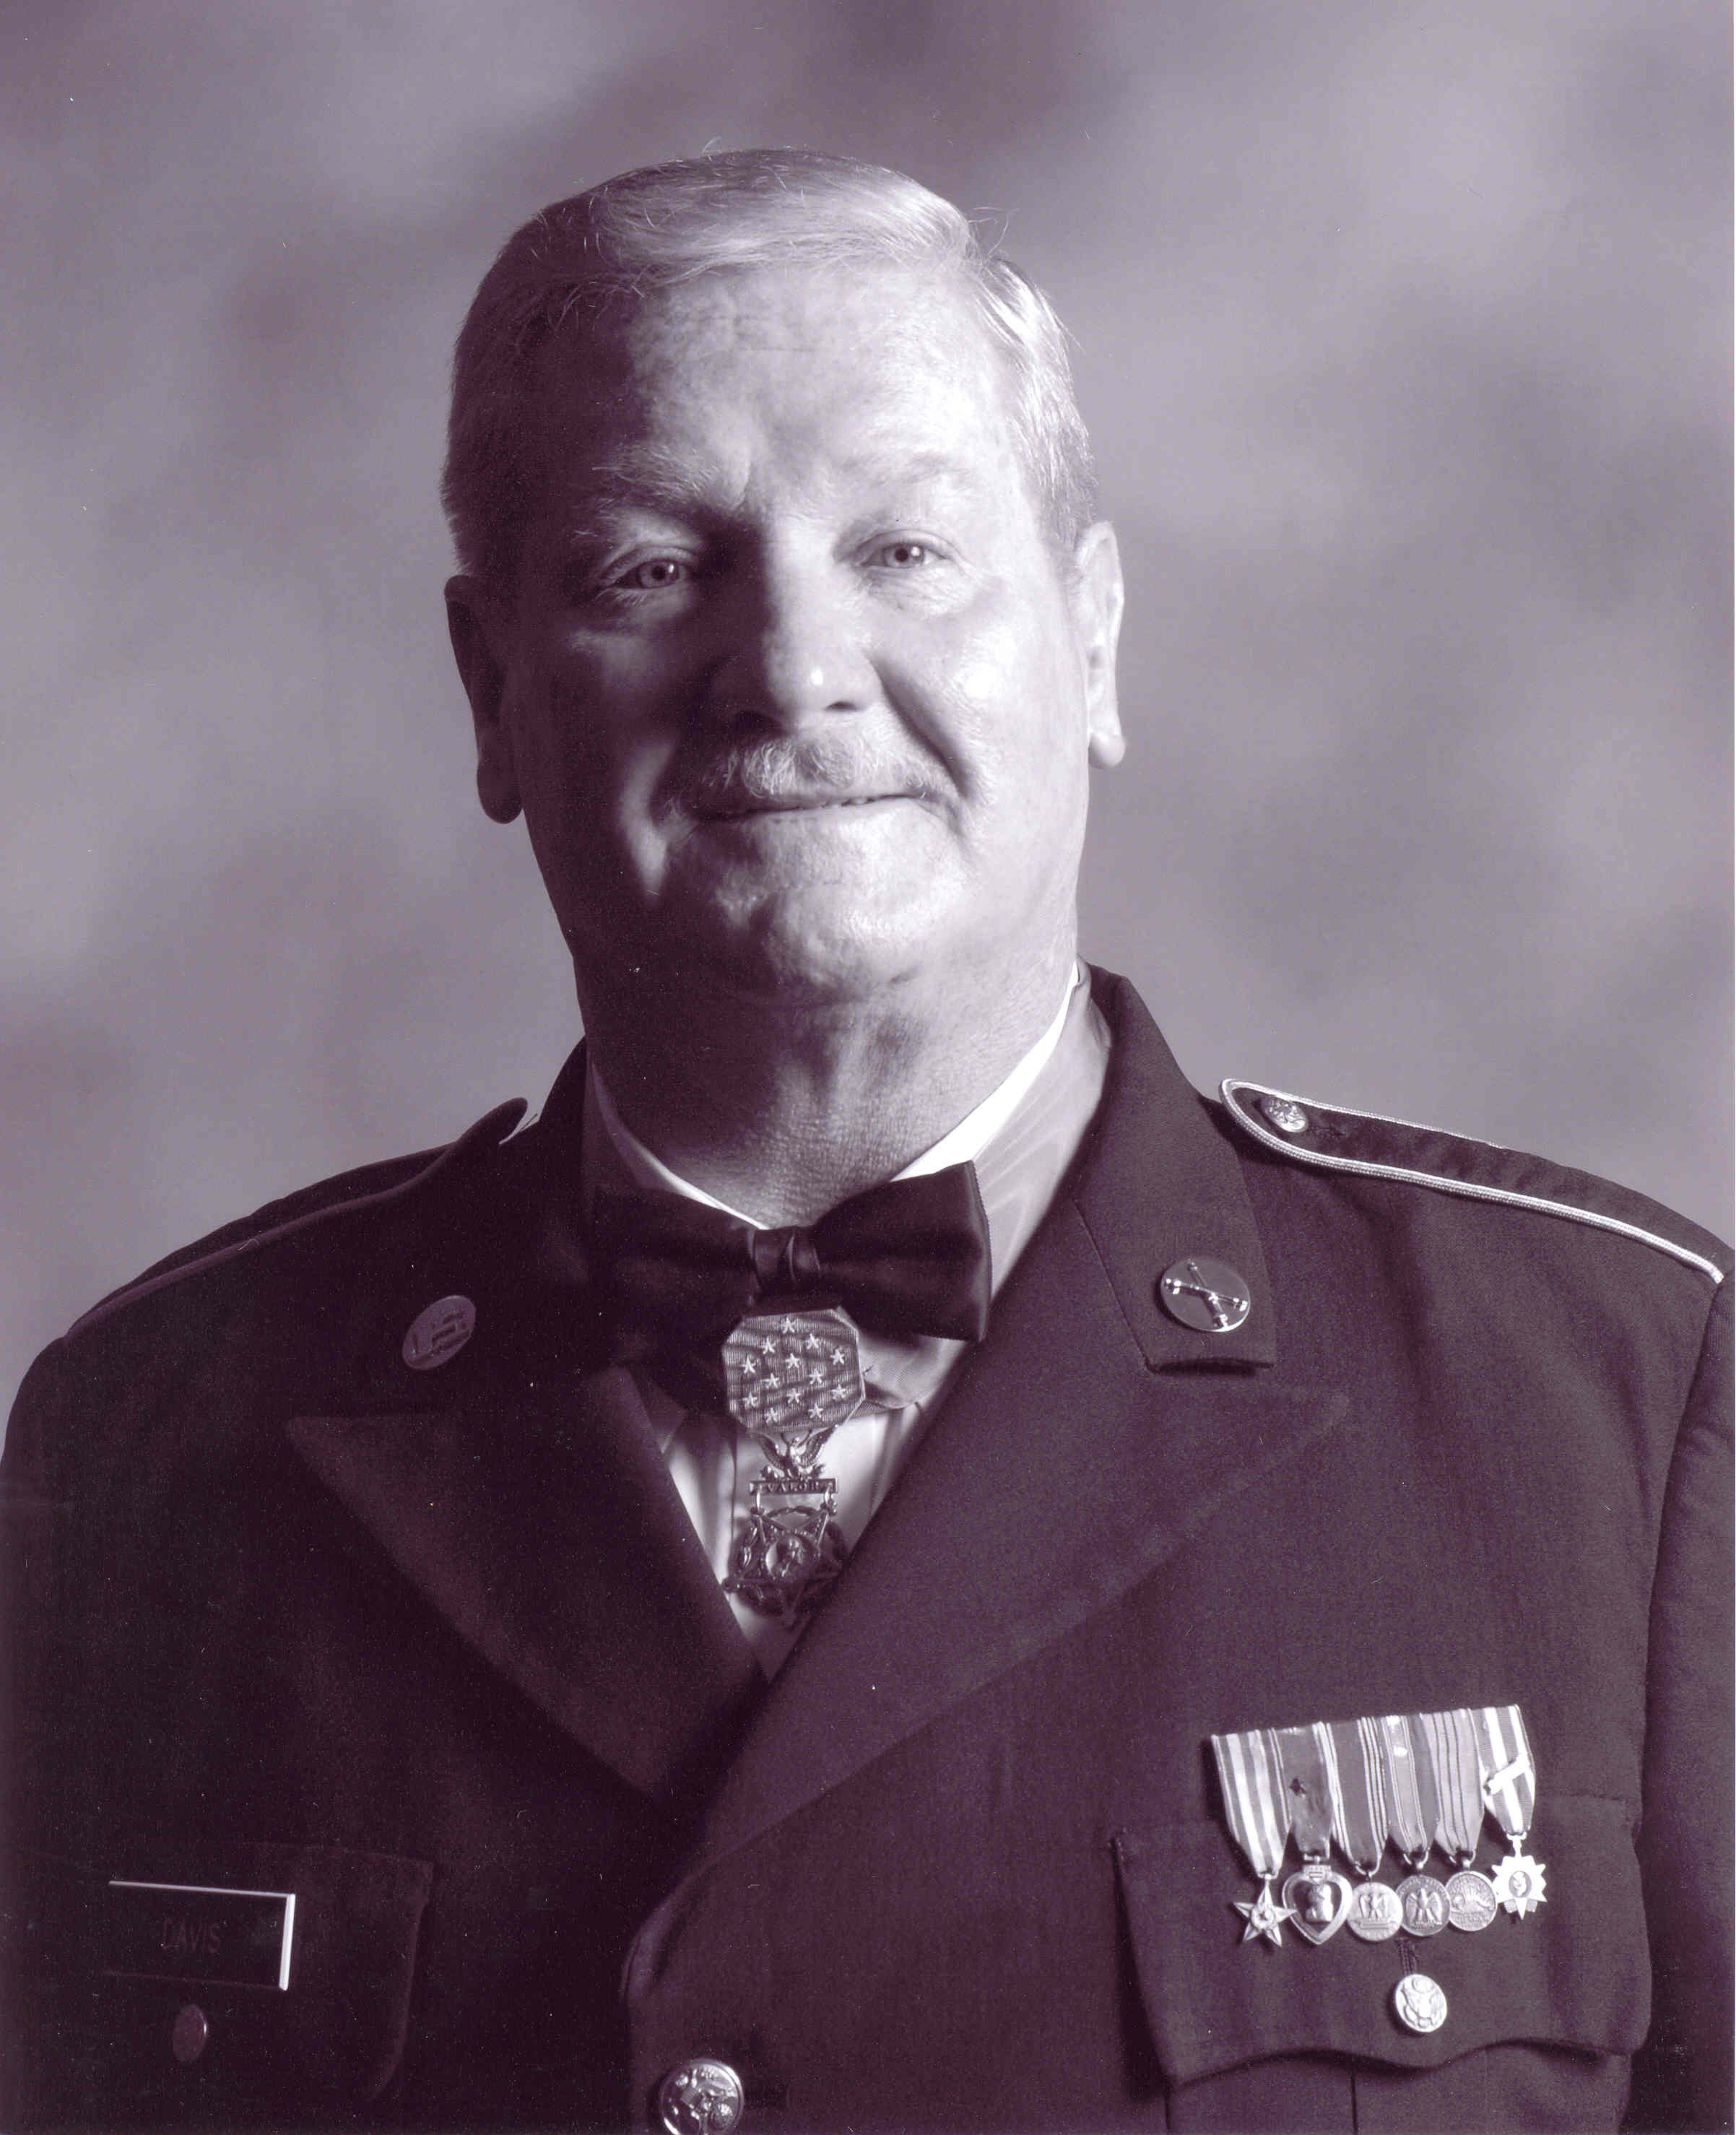
For conspicuous gallantry and intrepidity in action at the risk of his life above and beyond the call of duty. Sgt. Davis (then Pfc.) distinguished himself during the early morning hours while serving as a cannoneer with Battery C, at a remote fire support base. At approximately 0200 hours the fire support base was under heavy enemy mortar attack. Simultaneously, an estimated reinforced Viet Cong battalion launched a fierce ground assault upon the fire support base. The attacking enemy drove to within 25 meters of the friendly positions. Only a river separated the Viet Cong from the fire support base. Detecting a nearby enemy position, Sgt. Davis seized a machine gun and provided covering fire for his gun crew, as they attempted to bring direct artillery fire on the enemy. Despite his efforts, an enemy recoilless-rifle round scored a direct hit upon the artillery piece. The resultant blast hurled the gun crew from their weapon and blew Sgt. Davis into a foxhole. He struggled to his feet and returned to the howitzer, which was burning furiously. Ignoring repeated warnings to seek cover, Sgt. Davis rammed a shell into the gun. Disregarding a withering hail of enemy fire directed against his position, he aimed and fired the howitzer which rolled backward, knocking Sgt. Davis violently to the ground. Undaunted, he returned to the weapon to fire again when an enemy mortar round exploded within 20 meters of his position, injuring him painfully. Nevertheless, Sgt. Davis loaded the artillery piece, aimed, and fired. Again, he was knocked down by the recoil. In complete disregard for his safety, Sgt. Davis loaded and fired three more shells into the enemy. Disregarding his extensive injuries and his inability to swim, Sgt. Davis picked up an air mattress and struck out across the deep river to rescue three wounded comrades on the far side. Upon reaching the three wounded men, he stood upright and fired into the dense vegetation to prevent the Viet Cong from advancing. While the most seriously wounded soldier was helped across the river, Sgt. Davis protected the two remaining casualties until he could pull them across the river to the fire support base. Though suffering from painful wounds, he refused medical attention, joining another howitzer crew which fired at the large Viet Cong force until it broke contact and fled. Sgt. Davis' extraordinary heroism, at the risk of his life, is in keeping with the highest traditions of the military service and reflect great credit upon himself and the U.S. Army.
“…at the risk of his life above and beyond the call of duty… ”

Slide 6
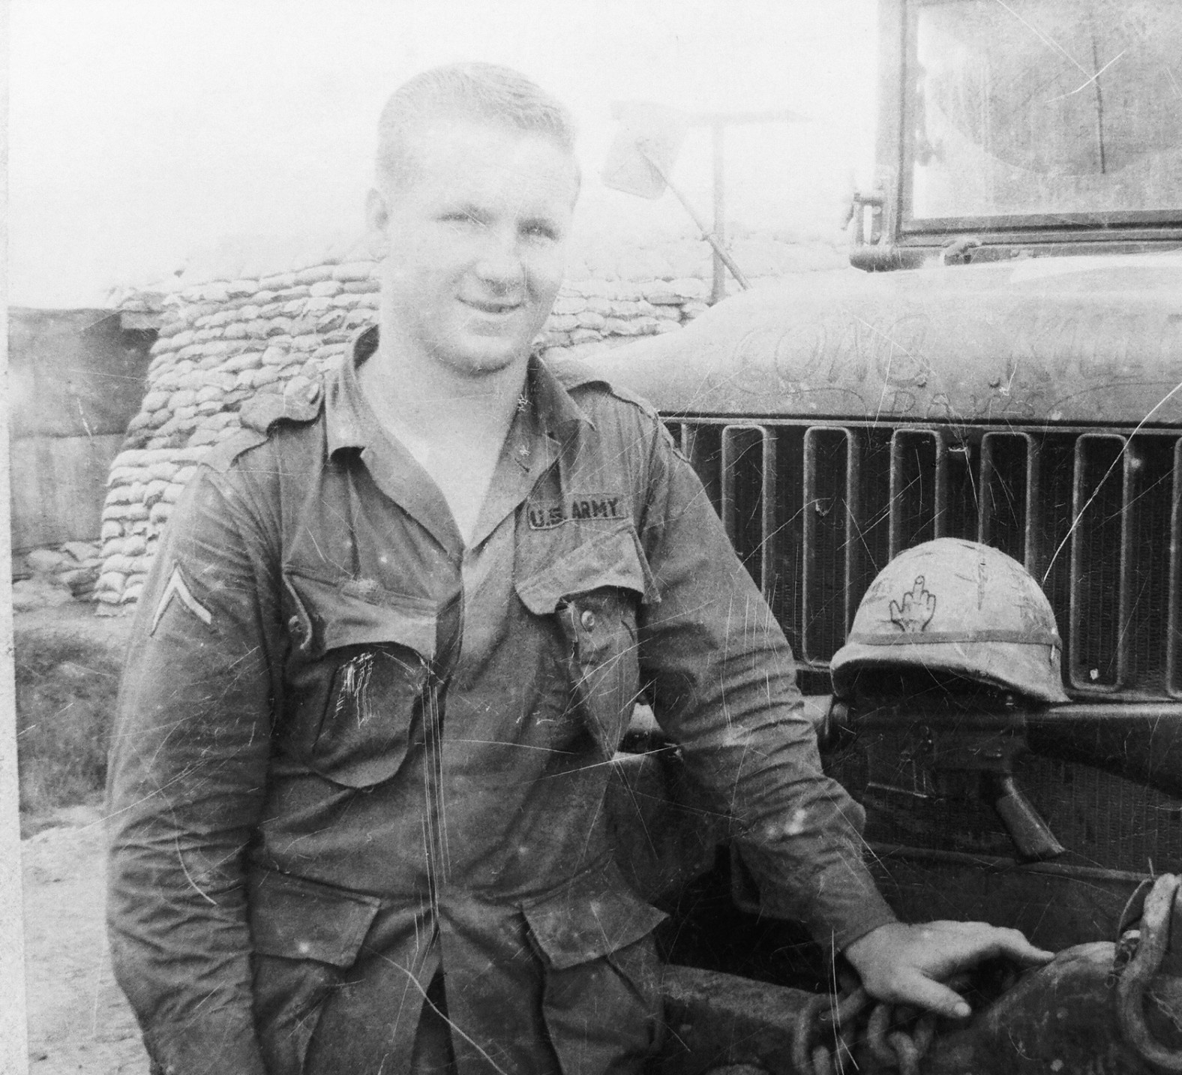
For conspicuous gallantry and intrepidity in action at the risk of his life above and beyond the call of duty. Sgt. Davis (then Pfc.) distinguished himself during the early morning hours while serving as a cannoneer with Battery C, at a remote fire support base. At approximately 0200 hours the fire support base was under heavy enemy mortar attack. Simultaneously, an estimated reinforced Viet Cong battalion launched a fierce ground assault upon the fire support base. The attacking enemy drove to within 25 meters of the friendly positions. Only a river separated the Viet Cong from the fire support base. Detecting a nearby enemy position, Sgt. Davis seized a machine gun and provided covering fire for his gun crew, as they attempted to bring direct artillery fire on the enemy. Despite his efforts, an enemy recoilless-rifle round scored a direct hit upon the artillery piece. The resultant blast hurled the gun crew from their weapon and blew Sgt. Davis into a foxhole. He struggled to his feet and returned to the howitzer, which was burning furiously. Ignoring repeated warnings to seek cover, Sgt. Davis rammed a shell into the gun. Disregarding a withering hail of enemy fire directed against his position, he aimed and fired the howitzer which rolled backward, knocking Sgt. Davis violently to the ground. Undaunted, he returned to the weapon to fire again when an enemy mortar round exploded within 20 meters of his position, injuring him painfully. Nevertheless, Sgt. Davis loaded the artillery piece, aimed, and fired. Again, he was knocked down by the recoil. In complete disregard for his safety, Sgt. Davis loaded and fired three more shells into the enemy. Disregarding his extensive injuries and his inability to swim, Sgt. Davis picked up an air mattress and struck out across the deep river to rescue three wounded comrades on the far side. Upon reaching the three wounded men, he stood upright and fired into the dense vegetation to prevent the Viet Cong from advancing. While the most seriously wounded soldier was helped across the river, Sgt. Davis protected the two remaining casualties until he could pull them across the river to the fire support base. Though suffering from painful wounds, he refused medical attention, joining another howitzer crew which fired at the large Viet Cong force until it broke contact and fled. Sgt. Davis' extraordinary heroism, at the risk of his life, is in keeping with the highest traditions of the military service and reflect great credit upon himself and the U.S. Army.
“distinguished himself during the early morning hours while serving as a cannoneer … at a remote fire support base.”

Slide 7
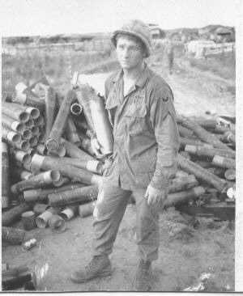
For conspicuous gallantry and intrepidity in action at the risk of his life above and beyond the call of duty. Sgt. Davis (then Pfc.) distinguished himself during the early morning hours while serving as a cannoneer with Battery C, at a remote fire support base. At approximately 0200 hours the fire support base was under heavy enemy mortar attack. Simultaneously, an estimated reinforced Viet Cong battalion launched a fierce ground assault upon the fire support base. The attacking enemy drove to within 25 meters of the friendly positions. Only a river separated the Viet Cong from the fire support base. Detecting a nearby enemy position, Sgt. Davis seized a machine gun and provided covering fire for his gun crew, as they attempted to bring direct artillery fire on the enemy. Despite his efforts, an enemy recoilless-rifle round scored a direct hit upon the artillery piece. The resultant blast hurled the gun crew from their weapon and blew Sgt. Davis into a foxhole. He struggled to his feet and returned to the howitzer, which was burning furiously. Ignoring repeated warnings to seek cover, Sgt. Davis rammed a shell into the gun. Disregarding a withering hail of enemy fire directed against his position, he aimed and fired the howitzer which rolled backward, knocking Sgt. Davis violently to the ground. Undaunted, he returned to the weapon to fire again when an enemy mortar round exploded within 20 meters of his position, injuring him painfully. Nevertheless, Sgt. Davis loaded the artillery piece, aimed, and fired. Again, he was knocked down by the recoil. In complete disregard for his safety, Sgt. Davis loaded and fired three more shells into the enemy. Disregarding his extensive injuries and his inability to swim, Sgt. Davis picked up an air mattress and struck out across the deep river to rescue three wounded comrades on the far side. Upon reaching the three wounded men, he stood upright and fired into the dense vegetation to prevent the Viet Cong from advancing. While the most seriously wounded soldier was helped across the river, Sgt. Davis protected the two remaining casualties until he could pull them across the river to the fire support base. Though suffering from painful wounds, he refused medical attention, joining another howitzer crew which fired at the large Viet Cong force until it broke contact and fled. Sgt. Davis' extraordinary heroism, at the risk of his life, is in keeping with the highest traditions of the military service and reflect great credit upon himself and the U.S. Army.
“…At approximately 0200 hours the fire support base was under heavy enemy mortar attack.

Slide 8
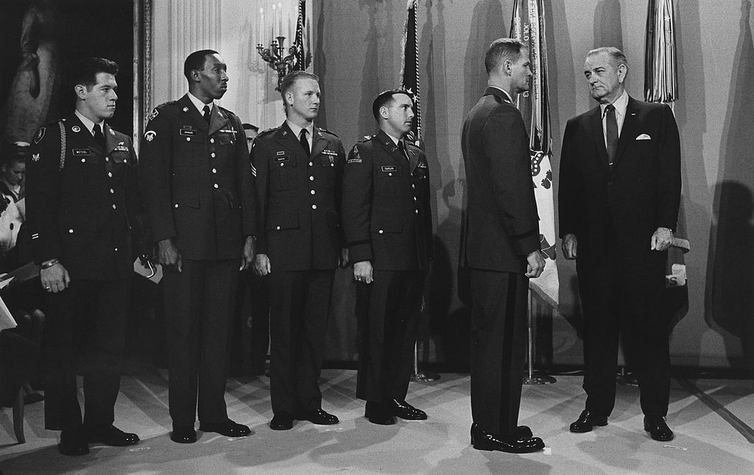
For conspicuous gallantry and intrepidity in action at the risk of his life above and beyond the call of duty. Sgt. Davis (then Pfc.) distinguished himself during the early morning hours while serving as a cannoneer with Battery C, at a remote fire support base. At approximately 0200 hours the fire support base was under heavy enemy mortar attack. Simultaneously, an estimated reinforced Viet Cong battalion launched a fierce ground assault upon the fire support base. The attacking enemy drove to within 25 meters of the friendly positions. Only a river separated the Viet Cong from the fire support base. Detecting a nearby enemy position, Sgt. Davis seized a machine gun and provided covering fire for his gun crew, as they attempted to bring direct artillery fire on the enemy. Despite his efforts, an enemy recoilless-rifle round scored a direct hit upon the artillery piece. The resultant blast hurled the gun crew from their weapon and blew Sgt. Davis into a foxhole. He struggled to his feet and returned to the howitzer, which was burning furiously. Ignoring repeated warnings to seek cover, Sgt. Davis rammed a shell into the gun. Disregarding a withering hail of enemy fire directed against his position, he aimed and fired the howitzer which rolled backward, knocking Sgt. Davis violently to the ground. Undaunted, he returned to the weapon to fire again when an enemy mortar round exploded within 20 meters of his position, injuring him painfully. Nevertheless, Sgt. Davis loaded the artillery piece, aimed, and fired. Again, he was knocked down by the recoil. In complete disregard for his safety, Sgt. Davis loaded and fired three more shells into the enemy. Disregarding his extensive injuries and his inability to swim, Sgt. Davis picked up an air mattress and struck out across the deep river to rescue three wounded comrades on the far side. Upon reaching the three wounded men, he stood upright and fired into the dense vegetation to prevent the Viet Cong from advancing. While the most seriously wounded soldier was helped across the river, Sgt. Davis protected the two remaining casualties until he could pull them across the river to the fire support base. Though suffering from painful wounds, he refused medical attention, joining another howitzer crew which fired at the large Viet Cong force until it broke contact and fled. Sgt. Davis' extraordinary heroism, at the risk of his life, is in keeping with the highest traditions of the military service and reflect great credit upon himself and the U.S. Army.
“Sgt. Davis seized a machine gun … provided covering fire for his gun crew… He struggled to his feet and returned to the howitzer, which was burning furiously..”

Slide 9
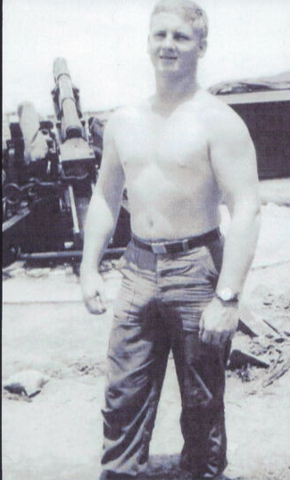
For conspicuous gallantry and intrepidity in action at the risk of his life above and beyond the call of duty. Sgt. Davis (then Pfc.) distinguished himself during the early morning hours while serving as a cannoneer with Battery C, at a remote fire support base. At approximately 0200 hours the fire support base was under heavy enemy mortar attack. Simultaneously, an estimated reinforced Viet Cong battalion launched a fierce ground assault upon the fire support base. The attacking enemy drove to within 25 meters of the friendly positions. Only a river separated the Viet Cong from the fire support base. Detecting a nearby enemy position, Sgt. Davis seized a machine gun and provided covering fire for his gun crew, as they attempted to bring direct artillery fire on the enemy. Despite his efforts, an enemy recoilless-rifle round scored a direct hit upon the artillery piece. The resultant blast hurled the gun crew from their weapon and blew Sgt. Davis into a foxhole. He struggled to his feet and returned to the howitzer, which was burning furiously. Ignoring repeated warnings to seek cover, Sgt. Davis rammed a shell into the gun. Disregarding a withering hail of enemy fire directed against his position, he aimed and fired the howitzer which rolled backward, knocking Sgt. Davis violently to the ground. Undaunted, he returned to the weapon to fire again when an enemy mortar round exploded within 20 meters of his position, injuring him painfully. Nevertheless, Sgt. Davis loaded the artillery piece, aimed, and fired. Again, he was knocked down by the recoil. In complete disregard for his safety, Sgt. Davis loaded and fired three more shells into the enemy. Disregarding his extensive injuries and his inability to swim, Sgt. Davis picked up an air mattress and struck out across the deep river to rescue three wounded comrades on the far side. Upon reaching the three wounded men, he stood upright and fired into the dense vegetation to prevent the Viet Cong from advancing. While the most seriously wounded soldier was helped across the river, Sgt. Davis protected the two remaining casualties until he could pull them across the river to the fire support base. Though suffering from painful wounds, he refused medical attention, joining another howitzer crew which fired at the large Viet Cong force until it broke contact and fled. Sgt. Davis' extraordinary heroism, at the risk of his life, is in keeping with the highest traditions of the military service and reflect great credit upon himself and the U.S. Army.
“…Ignoring repeated warnings……. Disregarding a withering hail of enemy fire ………he aimed and fired the howitzer … ”

Slide 10
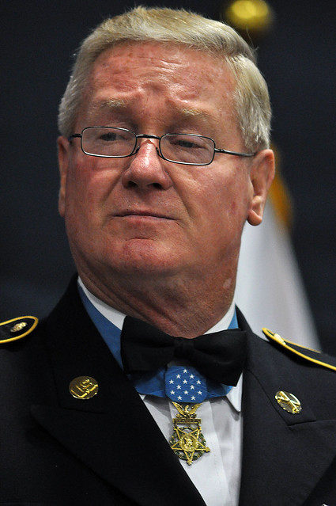
For conspicuous gallantry and intrepidity in action at the risk of his life above and beyond the call of duty. Sgt. Davis (then Pfc.) distinguished himself during the early morning hours while serving as a cannoneer with Battery C, at a remote fire support base. At approximately 0200 hours the fire support base was under heavy enemy mortar attack. Simultaneously, an estimated reinforced Viet Cong battalion launched a fierce ground assault upon the fire support base. The attacking enemy drove to within 25 meters of the friendly positions. Only a river separated the Viet Cong from the fire support base. Detecting a nearby enemy position, Sgt. Davis seized a machine gun and provided covering fire for his gun crew, as they attempted to bring direct artillery fire on the enemy. Despite his efforts, an enemy recoilless-rifle round scored a direct hit upon the artillery piece. The resultant blast hurled the gun crew from their weapon and blew Sgt. Davis into a foxhole. He struggled to his feet and returned to the howitzer, which was burning furiously. Ignoring repeated warnings to seek cover, Sgt. Davis rammed a shell into the gun. Disregarding a withering hail of enemy fire directed against his position, he aimed and fired the howitzer which rolled backward, knocking Sgt. Davis violently to the ground. Undaunted, he returned to the weapon to fire again when an enemy mortar round exploded within 20 meters of his position, injuring him painfully. Nevertheless, Sgt. Davis loaded the artillery piece, aimed, and fired. Again, he was knocked down by the recoil. In complete disregard for his safety, Sgt. Davis loaded and fired three more shells into the enemy. Disregarding his extensive injuries and his inability to swim, Sgt. Davis picked up an air mattress and struck out across the deep river to rescue three wounded comrades on the far side. Upon reaching the three wounded men, he stood upright and fired into the dense vegetation to prevent the Viet Cong from advancing. While the most seriously wounded soldier was helped across the river, Sgt. Davis protected the two remaining casualties until he could pull them across the river to the fire support base. Though suffering from painful wounds, he refused medical attention, joining another howitzer crew which fired at the large Viet Cong force until it broke contact and fled. Sgt. Davis' extraordinary heroism, at the risk of his life, is in keeping with the highest traditions of the military service and reflect great credit upon himself and the U.S. Army.
“Undaunted, he returned to the weapon to fire again when an enemy mortar round exploded within 20 meters of his position, injuring him painfully…”

Slide 11
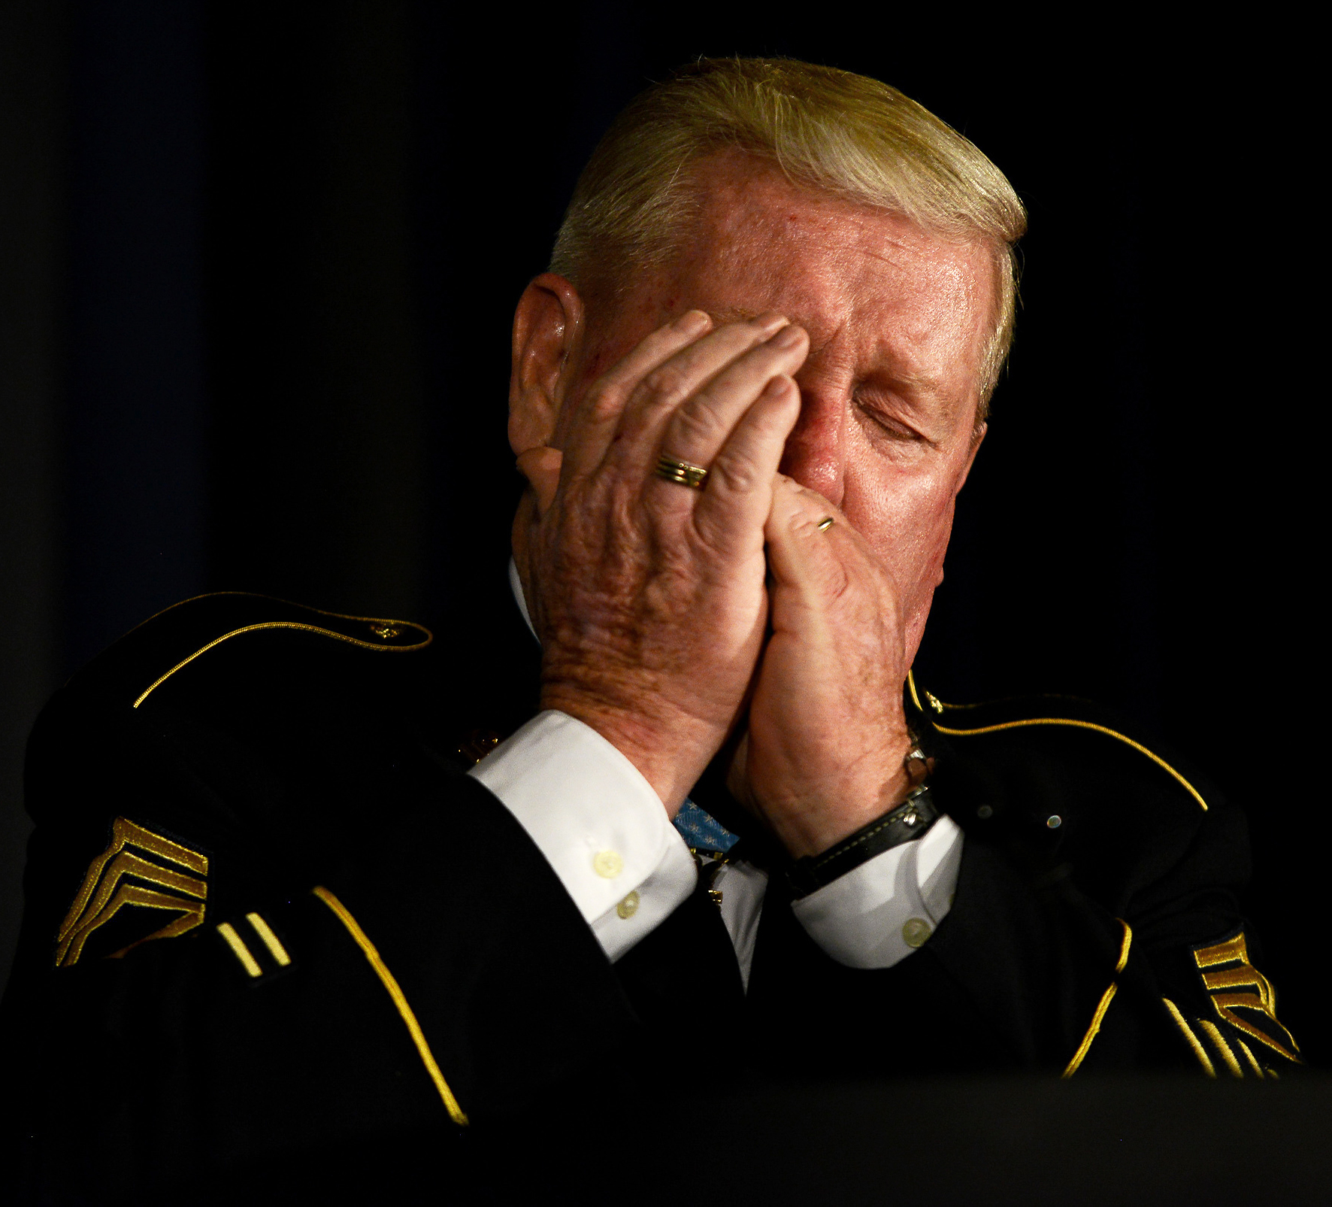
For conspicuous gallantry and intrepidity in action at the risk of his life above and beyond the call of duty. Sgt. Davis (then Pfc.) distinguished himself during the early morning hours while serving as a cannoneer with Battery C, at a remote fire support base. At approximately 0200 hours the fire support base was under heavy enemy mortar attack. Simultaneously, an estimated reinforced Viet Cong battalion launched a fierce ground assault upon the fire support base. The attacking enemy drove to within 25 meters of the friendly positions. Only a river separated the Viet Cong from the fire support base. Detecting a nearby enemy position, Sgt. Davis seized a machine gun and provided covering fire for his gun crew, as they attempted to bring direct artillery fire on the enemy. Despite his efforts, an enemy recoilless-rifle round scored a direct hit upon the artillery piece. The resultant blast hurled the gun crew from their weapon and blew Sgt. Davis into a foxhole. He struggled to his feet and returned to the howitzer, which was burning furiously. Ignoring repeated warnings to seek cover, Sgt. Davis rammed a shell into the gun. Disregarding a withering hail of enemy fire directed against his position, he aimed and fired the howitzer which rolled backward, knocking Sgt. Davis violently to the ground. Undaunted, he returned to the weapon to fire again when an enemy mortar round exploded within 20 meters of his position, injuring him painfully. Nevertheless, Sgt. Davis loaded the artillery piece, aimed, and fired. Again, he was knocked down by the recoil. In complete disregard for his safety, Sgt. Davis loaded and fired three more shells into the enemy. Disregarding his extensive injuries and his inability to swim, Sgt. Davis picked up an air mattress and struck out across the deep river to rescue three wounded comrades on the far side. Upon reaching the three wounded men, he stood upright and fired into the dense vegetation to prevent the Viet Cong from advancing. While the most seriously wounded soldier was helped across the river, Sgt. Davis protected the two remaining casualties until he could pull them across the river to the fire support base. Though suffering from painful wounds, he refused medical attention, joining another howitzer crew which fired at the large Viet Cong force until it broke contact and fled. Sgt. Davis' extraordinary heroism, at the risk of his life, is in keeping with the highest traditions of the military service and reflect great credit upon himself and the U.S. Army.
“…in complete disregard for his safety…Disregarding his extensive injuries … Sgt. Davis … struck out across the deep river to rescue three wounded comrades on the far side… ”

Slide 12
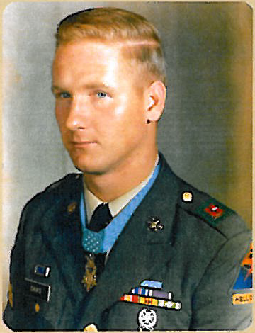
For conspicuous gallantry and intrepidity in action at the risk of his life above and beyond the call of duty. Sgt. Davis (then Pfc.) distinguished himself during the early morning hours while serving as a cannoneer with Battery C, at a remote fire support base. At approximately 0200 hours the fire support base was under heavy enemy mortar attack. Simultaneously, an estimated reinforced Viet Cong battalion launched a fierce ground assault upon the fire support base. The attacking enemy drove to within 25 meters of the friendly positions. Only a river separated the Viet Cong from the fire support base. Detecting a nearby enemy position, Sgt. Davis seized a machine gun and provided covering fire for his gun crew, as they attempted to bring direct artillery fire on the enemy. Despite his efforts, an enemy recoilless-rifle round scored a direct hit upon the artillery piece. The resultant blast hurled the gun crew from their weapon and blew Sgt. Davis into a foxhole. He struggled to his feet and returned to the howitzer, which was burning furiously. Ignoring repeated warnings to seek cover, Sgt. Davis rammed a shell into the gun. Disregarding a withering hail of enemy fire directed against his position, he aimed and fired the howitzer which rolled backward, knocking Sgt. Davis violently to the ground. Undaunted, he returned to the weapon to fire again when an enemy mortar round exploded within 20 meters of his position, injuring him painfully. Nevertheless, Sgt. Davis loaded the artillery piece, aimed, and fired. Again, he was knocked down by the recoil. In complete disregard for his safety, Sgt. Davis loaded and fired three more shells into the enemy. Disregarding his extensive injuries and his inability to swim, Sgt. Davis picked up an air mattress and struck out across the deep river to rescue three wounded comrades on the far side. Upon reaching the three wounded men, he stood upright and fired into the dense vegetation to prevent the Viet Cong from advancing. While the most seriously wounded soldier was helped across the river, Sgt. Davis protected the two remaining casualties until he could pull them across the river to the fire support base. Though suffering from painful wounds, he refused medical attention, joining another howitzer crew which fired at the large Viet Cong force until it broke contact and fled. Sgt. Davis' extraordinary heroism, at the risk of his life, is in keeping with the highest traditions of the military service and reflect great credit upon himself and the U.S. Army.
“…ipon reaching the three wounded men, he stood … fired into the dense vegetation to prevent the Viet Cong from advancing...Davis protected the two remaining casualties...”

Slide 13
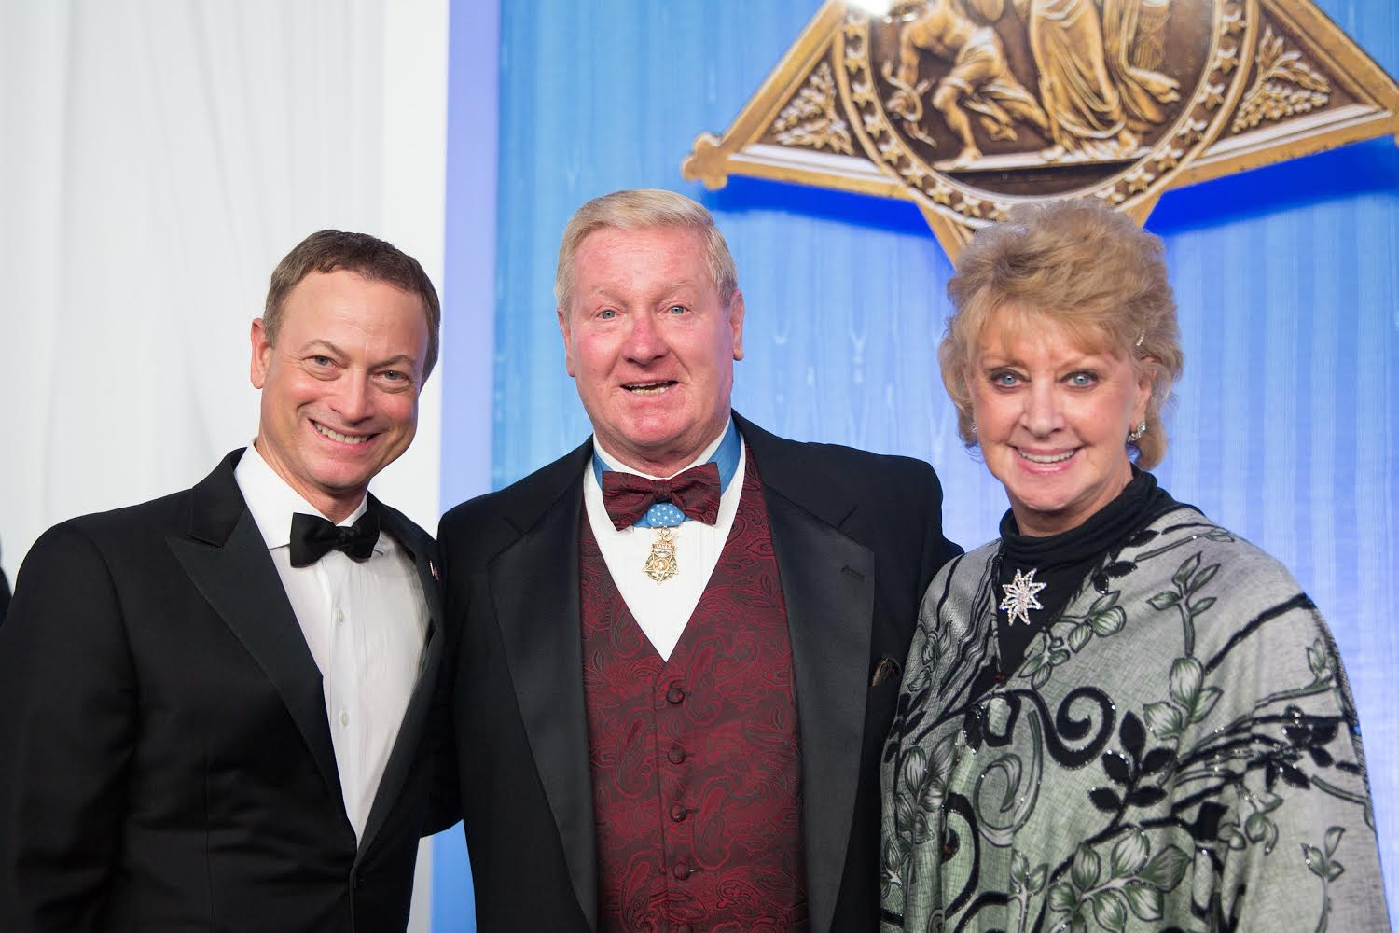
For conspicuous gallantry and intrepidity in action at the risk of his life above and beyond the call of duty. Sgt. Davis (then Pfc.) distinguished himself during the early morning hours while serving as a cannoneer with Battery C, at a remote fire support base. At approximately 0200 hours the fire support base was under heavy enemy mortar attack. Simultaneously, an estimated reinforced Viet Cong battalion launched a fierce ground assault upon the fire support base. The attacking enemy drove to within 25 meters of the friendly positions. Only a river separated the Viet Cong from the fire support base. Detecting a nearby enemy position, Sgt. Davis seized a machine gun and provided covering fire for his gun crew, as they attempted to bring direct artillery fire on the enemy. Despite his efforts, an enemy recoilless-rifle round scored a direct hit upon the artillery piece. The resultant blast hurled the gun crew from their weapon and blew Sgt. Davis into a foxhole. He struggled to his feet and returned to the howitzer, which was burning furiously. Ignoring repeated warnings to seek cover, Sgt. Davis rammed a shell into the gun. Disregarding a withering hail of enemy fire directed against his position, he aimed and fired the howitzer which rolled backward, knocking Sgt. Davis violently to the ground. Undaunted, he returned to the weapon to fire again when an enemy mortar round exploded within 20 meters of his position, injuring him painfully. Nevertheless, Sgt. Davis loaded the artillery piece, aimed, and fired. Again, he was knocked down by the recoil. In complete disregard for his safety, Sgt. Davis loaded and fired three more shells into the enemy. Disregarding his extensive injuries and his inability to swim, Sgt. Davis picked up an air mattress and struck out across the deep river to rescue three wounded comrades on the far side. Upon reaching the three wounded men, he stood upright and fired into the dense vegetation to prevent the Viet Cong from advancing. While the most seriously wounded soldier was helped across the river, Sgt. Davis protected the two remaining casualties until he could pull them across the river to the fire support base. Though suffering from painful wounds, he refused medical attention, joining another howitzer crew which fired at the large Viet Cong force until it broke contact and fled. Sgt. Davis' extraordinary heroism, at the risk of his life, is in keeping with the highest traditions of the military service and reflect great credit upon himself and the U.S. Army.
“…though suffering from painful wounds, he refused medical attention…”

Slide 14
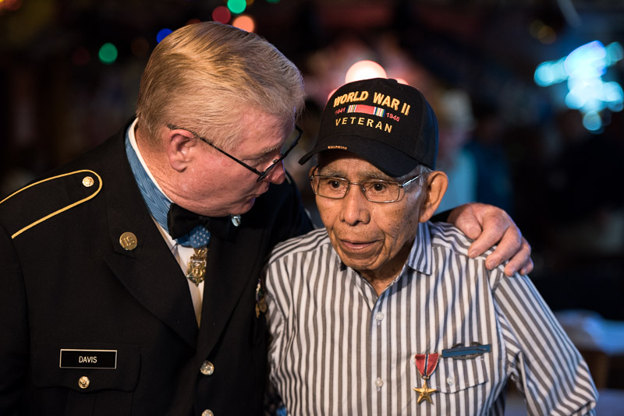
For conspicuous gallantry and intrepidity in action at the risk of his life above and beyond the call of duty. Sgt. Davis (then Pfc.) distinguished himself during the early morning hours while serving as a cannoneer with Battery C, at a remote fire support base. At approximately 0200 hours the fire support base was under heavy enemy mortar attack. Simultaneously, an estimated reinforced Viet Cong battalion launched a fierce ground assault upon the fire support base. The attacking enemy drove to within 25 meters of the friendly positions. Only a river separated the Viet Cong from the fire support base. Detecting a nearby enemy position, Sgt. Davis seized a machine gun and provided covering fire for his gun crew, as they attempted to bring direct artillery fire on the enemy. Despite his efforts, an enemy recoilless-rifle round scored a direct hit upon the artillery piece. The resultant blast hurled the gun crew from their weapon and blew Sgt. Davis into a foxhole. He struggled to his feet and returned to the howitzer, which was burning furiously. Ignoring repeated warnings to seek cover, Sgt. Davis rammed a shell into the gun. Disregarding a withering hail of enemy fire directed against his position, he aimed and fired the howitzer which rolled backward, knocking Sgt. Davis violently to the ground. Undaunted, he returned to the weapon to fire again when an enemy mortar round exploded within 20 meters of his position, injuring him painfully. Nevertheless, Sgt. Davis loaded the artillery piece, aimed, and fired. Again, he was knocked down by the recoil. In complete disregard for his safety, Sgt. Davis loaded and fired three more shells into the enemy. Disregarding his extensive injuries and his inability to swim, Sgt. Davis picked up an air mattress and struck out across the deep river to rescue three wounded comrades on the far side. Upon reaching the three wounded men, he stood upright and fired into the dense vegetation to prevent the Viet Cong from advancing. While the most seriously wounded soldier was helped across the river, Sgt. Davis protected the two remaining casualties until he could pull them across the river to the fire support base. Though suffering from painful wounds, he refused medical attention, joining another howitzer crew which fired at the large Viet Cong force until it broke contact and fled. Sgt. Davis' extraordinary heroism, at the risk of his life, is in keeping with the highest traditions of the military service and reflect great credit upon himself and the U.S. Army.
“…joining another howitzer crew which fired at the large Viet Cong force until it broke contact and fled...”

Slide 15
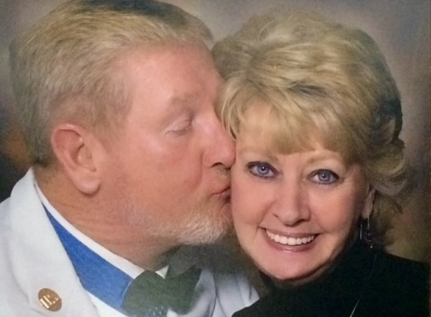
For conspicuous gallantry and intrepidity in action at the risk of his life above and beyond the call of duty. Sgt. Davis (then Pfc.) distinguished himself during the early morning hours while serving as a cannoneer with Battery C, at a remote fire support base. At approximately 0200 hours the fire support base was under heavy enemy mortar attack. Simultaneously, an estimated reinforced Viet Cong battalion launched a fierce ground assault upon the fire support base. The attacking enemy drove to within 25 meters of the friendly positions. Only a river separated the Viet Cong from the fire support base. Detecting a nearby enemy position, Sgt. Davis seized a machine gun and provided covering fire for his gun crew, as they attempted to bring direct artillery fire on the enemy. Despite his efforts, an enemy recoilless-rifle round scored a direct hit upon the artillery piece. The resultant blast hurled the gun crew from their weapon and blew Sgt. Davis into a foxhole. He struggled to his feet and returned to the howitzer, which was burning furiously. Ignoring repeated warnings to seek cover, Sgt. Davis rammed a shell into the gun. Disregarding a withering hail of enemy fire directed against his position, he aimed and fired the howitzer which rolled backward, knocking Sgt. Davis violently to the ground. Undaunted, he returned to the weapon to fire again when an enemy mortar round exploded within 20 meters of his position, injuring him painfully. Nevertheless, Sgt. Davis loaded the artillery piece, aimed, and fired. Again, he was knocked down by the recoil. In complete disregard for his safety, Sgt. Davis loaded and fired three more shells into the enemy. Disregarding his extensive injuries and his inability to swim, Sgt. Davis picked up an air mattress and struck out across the deep river to rescue three wounded comrades on the far side. Upon reaching the three wounded men, he stood upright and fired into the dense vegetation to prevent the Viet Cong from advancing. While the most seriously wounded soldier was helped across the river, Sgt. Davis protected the two remaining casualties until he could pull them across the river to the fire support base. Though suffering from painful wounds, he refused medical attention, joining another howitzer crew which fired at the large Viet Cong force until it broke contact and fled. Sgt. Davis' extraordinary heroism, at the risk of his life, is in keeping with the highest traditions of the military service and reflect great credit upon himself and the U.S. Army.
“…Sgt. Davis' extraordinary heroism, at the risk of his life…”

Slide 16
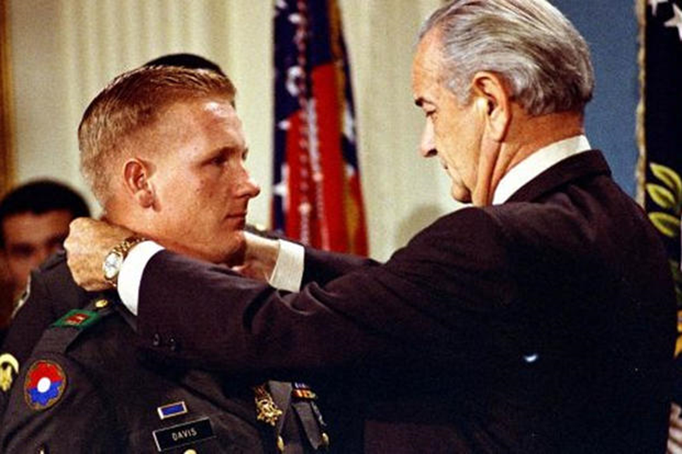
For conspicuous gallantry and intrepidity in action at the risk of his life above and beyond the call of duty. Sgt. Davis (then Pfc.) distinguished himself during the early morning hours while serving as a cannoneer with Battery C, at a remote fire support base. At approximately 0200 hours the fire support base was under heavy enemy mortar attack. Simultaneously, an estimated reinforced Viet Cong battalion launched a fierce ground assault upon the fire support base. The attacking enemy drove to within 25 meters of the friendly positions. Only a river separated the Viet Cong from the fire support base. Detecting a nearby enemy position, Sgt. Davis seized a machine gun and provided covering fire for his gun crew, as they attempted to bring direct artillery fire on the enemy. Despite his efforts, an enemy recoilless-rifle round scored a direct hit upon the artillery piece. The resultant blast hurled the gun crew from their weapon and blew Sgt. Davis into a foxhole. He struggled to his feet and returned to the howitzer, which was burning furiously. Ignoring repeated warnings to seek cover, Sgt. Davis rammed a shell into the gun. Disregarding a withering hail of enemy fire directed against his position, he aimed and fired the howitzer which rolled backward, knocking Sgt. Davis violently to the ground. Undaunted, he returned to the weapon to fire again when an enemy mortar round exploded within 20 meters of his position, injuring him painfully. Nevertheless, Sgt. Davis loaded the artillery piece, aimed, and fired. Again, he was knocked down by the recoil. In complete disregard for his safety, Sgt. Davis loaded and fired three more shells into the enemy. Disregarding his extensive injuries and his inability to swim, Sgt. Davis picked up an air mattress and struck out across the deep river to rescue three wounded comrades on the far side. Upon reaching the three wounded men, he stood upright and fired into the dense vegetation to prevent the Viet Cong from advancing. While the most seriously wounded soldier was helped across the river, Sgt. Davis protected the two remaining casualties until he could pull them across the river to the fire support base. Though suffering from painful wounds, he refused medical attention, joining another howitzer crew which fired at the large Viet Cong force until it broke contact and fled. Sgt. Davis' extraordinary heroism, at the risk of his life, is in keeping with the highest traditions of the military service and reflect great credit upon himself and the U.S. Army.
“…extraordinary heroism…risk of his life…keeping with the highest traditions … reflect great credit upon himself and the U.S. Army...”

Slide 17
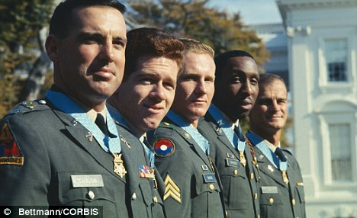
“You Don’t Lose ‘Til You Quit Trying.”
Sammy Lee Davis, CMoH, Vietnam

