Slide 1
DNV Medical Equipment and ISO 9001
Kelly Proctor CHFM, CHSP, CHOP
DNV Sector Lead
Bill Bassuk MBA, CHTM, CHOP
HTM Global Chairman

Slide 2
DNV- Accreditation
CMS Conditions of Participation (COP’s)
National Integrated Accreditation for Healthcare Organizations (NIAHO)
International Organization of Standardization (ISO)
ISO = A quality management program focused on risk based thinking and continual improvement

Slide 3


NIAHO® Physical Environment (PE) Management Systems
PE.1 Facility
PE.2 Life Safety Management System
PE.3 Safety Management System
PE.4 Security Management System
PE.5 Hazardous Material (Hazmat) Management System
PE.6 Emergency Management System
PE.7 Medical Equipment Management System
PE.8 Utility Management System
Notes:
3

Slide 4
CHOP B and A classes
What Does CHOP stand for?
How long are the classes?
What do they cost?
Do we get CEU’s for them?
What will we learn?
Benefits from the CHOP Classes
Who can take these classes?
Where can we take these classes?
Is there a test?
Do we have to take the test?

Slide 5
Key Features Open communication as a team vs fear
Feature of NIAHO®
Benefit to Hospital
Stable standards, infrequent change
Sustainable system
Annual Surveys
Constant readiness
ISO 9001 Gradual Introduction @ no additional staff
More value, lower $
Focus on sequence and interactions of processes throughout the hospital
Clear, traceable pathway to improve
Demeanor of the survey team
Collaboration, sharing of ideas
No survey findings “tipping” point
Fear becomes confidence

Slide 6
NIAHO® PE.7: MEDICAL EQUIPMENT MANAGEMENT SYSTEM REQUIREMENTS
SR.1 The organization shall establish a Medical Equipment Management System that provides processes for the acquisition, safe use, and the appropriate selection of equipment. (Your Shops business plan)
SR.2 The Medical Equipment Management System shall address issues related to the organization’s initial service inspection, the orientation, and the demonstration of use for rental or physician owned equipment. (policies for new equipment)
SR.3. The Medical Equipment Management System shall address criteria for the selection of equipment. (capital committee)
SR.4.The Medical Equipment Management System shall address incidents related to serious injury or illness or death (See SMDA 1990).(Process for injury by device)

Slide 7
NIAHO® PE.7 MEDICAL EQUIPMENT MANAGEMENT SYSTEM
SR.5 The Medical Equipment Management System shall have a process for reporting and investigating equipment management problems, failures, and user errors.(database, EOC committee, and policies)
SR.6 The Medical Equipment Management System shall address a process for determining timing and complexity of medical equipment maintenance.
(Risk ranking)
SR.7 The Medical Equipment Management System shall address the process of receiving and responding to recalls and alerts.(policy for reporting National recalls and alerts)

Slide 8
Alternative Equipment Maintenance Program
(Alternative Equipment Maintenance – requirements found in the NIAHO IG’s)
Decision to Place Equipment in an AEM Program
Maintenance requirements of the equipment
Equipment not Eligible for Placement in the AEM Program
radiologic equipment
medical laser device
New equipment (new Technology)
Risk Assessment – History of failure for the equipment
Consequences of altering the frequency of the maintenance
Make sure Leadership is aware***

Slide 9
ISO 9001:2015
ISO 9001:2015 – Quality Management System, Risk Based Thinking and Continual Improvement.
Ensures the hospital considers risks
Ensures consistency
Ensures continual improvement
Ensures that data is analyzed
Ensures effective correction plans
All of the above relates to SR1-7

Slide 10
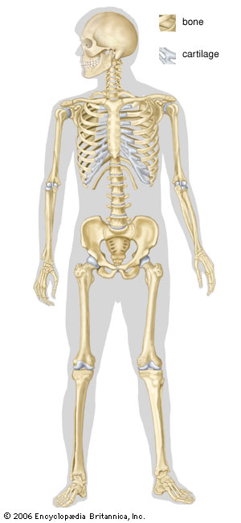
ISO System Structure
Operational-Business Practices-Regulatory
ISO 9001 Systems

Slide 11
ISO 9001 Resource Management Concepts
7.1.6 Organizational knowledge
7.2 Competence
7.3 Awareness
Part of SR codes and MEMP documentation
Personnel performing work affecting conformity to product requirements shall be competent on the basis of appropriate education, training, skills and experience.
The organization determines the necessary competence for personnel performing work affecting conformity to product requirements, provides training or take other actions to achieve the necessary competence, evaluates the effectiveness of the actions taken, ensures that its personnel are aware of the relevance and importance of their activities and how they contribute to the achievement of the quality objectives, and maintains appropriate records of education, training, skills and experience.

Slide 12
ISO 9001 Infrastructure and Work Environment
7.1.3 Infrastructure
The organization determines, provides and maintains the infrastructure needed to achieve conformity to product requirements. Infrastructure includes, as applicable,
a) buildings, workspace and associated utilities,
b) process equipment (both hardware and software), and
c) supporting services (such as transport, communication or information systems).
You can visually see infrastructure
7.1.4 Environment for the operation of processes
The organization determines and manages the work environment needed to achieve conformity to product requirements.
Not Necessarily seen. This can be delegated from leadership.

Slide 13
ISO 9001 Control of Monitoring and Measuring Equipment
Control of Monitoring and Measuring Equipment is one of the major differences between DNV and our competition.
Right people, right place, and right things.

Slide 14
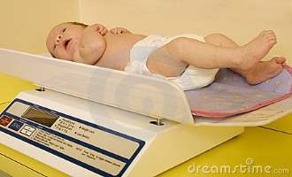
7.1.5 Monitoring and measuring resources
The organization shall determine and provide the resources needed to ensure valid and reliable results when monitoring or measuring is used to verify the conformity of products and services to requirements.
The organization shall ensure that the resources provided:
a) are suitable for the specific type of monitoring and measurement activities being undertaken;
b) are maintained to ensure their continuing fitness for their purpose.
Monitoring test equipment.
The organization shall retain appropriate documented information as evidence of fitness for purpose of the monitoring and measurement resources.

Slide 15



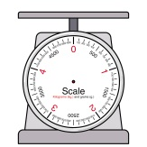

7.1.5 Monitoring and measuring equipment
God of Weights
NIST
National Institute of Standards & Technology
Calibration Lab
C
Traceability
B
Hospital
Record
A

Slide 16
ISO 9001 Top Management Responsibilities: Communication
7.4 Communication
The organization ensures that responsibilities and authorities are defined and communicated within the organization.
The organization ensures that appropriate communication processes are established within the organization and that communication takes place regarding the effectiveness of the quality management system
Everybody’s part are equal and important. IE..Housekeeping

Slide 17
ISO 9001 Control
8.4 Control of externally provided products and services
8.4.1 General
The organization shall ensure that externally provided processes, products and services conform to requirements. Policy for outsourced labor
The organization shall determine the controls to be applied to externally provided processes, products and services You decide how they are to be controlled and measured for success.
8.4.2 Type and extent of control of external provision
The organization shall ensure that externally provided processes, products and services do not adversely affect the organization’s ability to consistently deliver conforming products and services to its customers. Communication with OEM etc

Slide 18
ISO 9001 Information/SR Code policy
8.4.3 Information for external providers
The organization ensures that purchased product conforms to specified purchase requirements. The type and extent of control applied to the supplier and the purchased product is dependent upon the effect of the purchased product on subsequent product realization or the final product.
Purchasing information describes the product to be purchased
The organization establishes and implements the inspection or other activities necessary for ensuring that purchased product meets specified purchase requirements.
Where the organization or its customer intends to perform verification at the supplier's premises, the organization states the intended verification arrangements and method of product release in the purchasing information.
Not leaving work orders with Biomed department

Slide 19
ISO 9001 Control of Nonconforming Product
8.7 Control of nonconforming process ,outputs, products and services
The organization ensures that product which does not conform to product requirements is identified and controlled to prevent its unintended use or delivery. A documented procedure shall be established to define the controls and related responsibilities and authorities for dealing with nonconforming product.
Where applicable, the organization deals with nonconforming product by one or more of the following ways:
by taking action to eliminate the detected nonconformity
by taking action to preclude its original intended use or application.
Policy improvement indicators

Slide 20
Analysis and Evaluation /Evaluation of the MEMP
ISO 9001 9.1.3 Analysis and evaluation
The organization shall analyze and evaluate appropriate data and information arising from monitoring and measurement.
The results of analysis shall be used to evaluate:
a) conformity of products and services;
b) the degree of customer satisfaction;
c) the performance and effectiveness of the quality management system;
d) if planning has been implemented effectively;
e) the effectiveness of actions taken to address risks and opportunities;
f) the performance of external providers;
g) the need for improvements to the quality management system.
Its ok not achieve 100% but have a process developed to get there.
Things happen that cannot be controlled. PM completions…what to do

Slide 21
NIAHO® PE.7 Common NC’s
No process for “Out of Tolerance “ certificates
Reports not accurate
AEM programs not proper
Failure to analyze data
Defective equipment not properly removed from service

Slide 22

Any questions about DNV?

