Slide 1
HTM Department
Business Continuity
Effective Operations in a Time of Crisis
Mike Busdicker, MBA, CHTM - CE System Director

Slide 2

MIKE BUSDICKER
Mike Busdicker is the System Director of Clinical Engineering Support Services at Intermountain Healthcare. Mike started his healthcare career with the United States Air Force as a 1983 graduate of the DoD Biomedical Equipment Repair School. His total military service included seven years of active duty and 20 years with the Wisconsin Air National Guard. During his military time he served as a Biomedical Technician, First Sergeant, and Human Resource Advisor, completed an operational deployment to Iraq, and achieved the highest enlisted rank of Chief Master Sergeant.
Mike received his Bachelor's and Master’s Degree in Business from Baker College in Flint, Michigan. Prior to his employment with Intermountain he has held leadership positions with ServiceMaster Management Services, Aramark Clinical Technology Services, TriMedx Healthcare Services, and Alexian Brothers Healthcare System. Mike is an active member of AAMI, ACHE, UHE, HIMSS, NH-ISAC, MDSISC, and is a member of the AAMI Technology Management Council.

Slide 3
DISCLAIMER
“The slides in this presentation were prepared as talking points by the presenter. It is compiled from data, experiences, and processes at Intermountain Healthcare and are for information sharing purposes only.”

Slide 4
Agenda
Objectives
Introduction to Intermountain Healthcare
Quick Look at Early Emergency Preparedness
Emergency Preparedness Over the Years
2020 Introduces a New Challenge for HTM
Current State of HTM Emergency Preparedness
Emergency Preparedness Into the Future

Slide 5
Objectives:
1. Understand the early stages of emergency and disaster preparedness in Healthcare
2. Look at disasters and incidents that have shaped and molded HTM Emergency Preparedness
3. Review updates and data implemented by Intermountain Healthcare in 2020
4. How HTM should prepare and be involved with Emergency Preparedness into the future

Slide 6
About Intermountain Healthcare

Slide 7









About Intermountain Healthcare
An Integrated Delivery Network with a Tradition of Innovation
Helping people live the healthiest lives possible TM
40,000 Caregivers
Coverage in Eight States
Based in Salt Lake City, Utah
HTM Department
108 Caregivers
110,000 Medical Devices
Hospitals
Medical Group
Saltzer Health
Continuum of Care
Gifted to Community in 1974
24 Hospitals
2,900 Licensed Beds
Started in1994
1,400 employed physicians
4,000 affiliated physicians
185+ clinics
Acquired in 2020
80 Physicians
300 Caregivers
Over 100,000 Patients Served
TeleHealth
Homecare
Life Flight
Central lab
Central pharmacy
Health Plan
Castell Health
HCP Nevada
Classic Air Medical
Started in 1983
SelectHealth
1M plus members
25% of Utah market
Established in July 2019
Re-imagined Primary Care Model
Analytics and Technology Platform
Digital Tools for Virtual Care
Utilization of Clinical Best Practices
Acquired in 2019
340 Providers
1500 Caregivers
55 Clinics
Acquired in 2021
16 Rotary Wing Aircraft
12 Fixed Wing Aircraft
Serves Eight Western States
Notes:
A little about who we are and what we do and ongoing organizational initiatives keeping up with current trends in healthcare

Slide 8

CLINICAL ENGINEERING SUPPORT SERVICES STRUCTURE
Central Support Services and Management
  System Director
  CE Equipment Security/Compliance
  CE Central Manager
  Service Coordination Center
  Office Coordinator
  Parts and Inventory Coordinator
    Central Parts Stock
  Data Analysts
CE Hospital Operations
  Three CE Area Directors
  In-house CE Departments
  Local CE Managers and Supervisors
Field Service Operations
  CE Program Director
  CE Program Manager
  Regional Sterilizer Service Team
  Central Depot Repair
  System Dialysis Service Team
  Homecare Clinical Engineering
  Regional Laboratory Service
  Regional Hospital Bed Service
Notes:
CESS structure and roles/ responsibilities

Slide 9
Healthcare Technology Management
Emergency Preparedness
The Past
The Present
The Future
Notes:
CESS structure and roles/ responsibilities

Slide 10
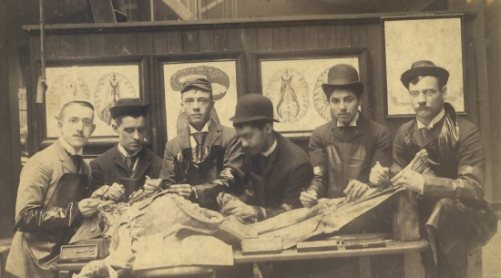
Consolidated History of Emergency Management
1803 – First Federal Government involvement – fire in Portsmouth, NH
1899 – First major response of the American Red Cross – flood in Johnstown, PA
1950 – Federal Disaster Relief Program – assist state and local governments
1961 – Federal Emergency Preparedness – MT 7.3 earthquake, hurricanes Donna and Carla
1968 – 911 Emergency System implemented in Alabama and Alaska
1974 – Disaster Relief Act passed allowing Presidential disaster declaration process
1979 – FEMA established to centralize disaster efforts
2001 – First activation of the Federal Response Plan
2002 – Homeland Security Act established
2003 – Presidential Directive establishing requirements for public health and medical preparedness
2016 – CMS published the Emergency Preparedness Final Rule – Covers participating providers
2017 – The Joint Commission publishes their final Emergency Management Standards
Early Contributors to HTM Emergency Management (L-R)
Malcolm Ridgway
Dave Francoeur
Stephen Grimes
Binseng Wang
Al Gresch
John Krieg
Notes:
CESS structure and roles/ responsibilities

Slide 11

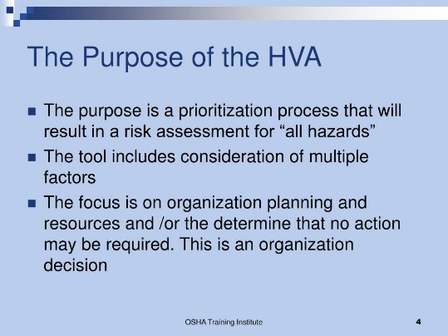
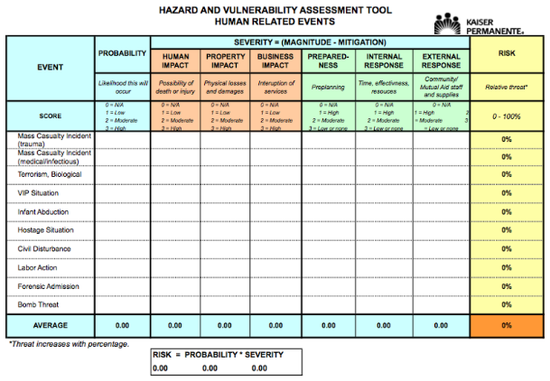
HTM Emergency Management Over the Years
What did HTM Emergency Management look like in the 1990s?
  Nationally we had major events including the Deseret Storm
  Standard HTM emergency prep for hospitals
  Hazard Vulnerability Assessment (HVA) – local area, state, and regional
Notes:
CESS structure and roles/ responsibilities

Slide 12


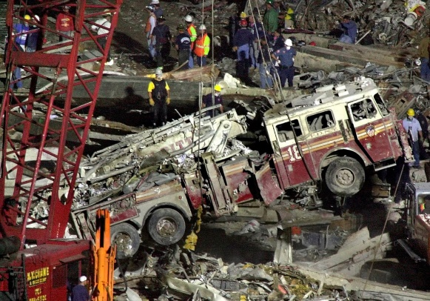
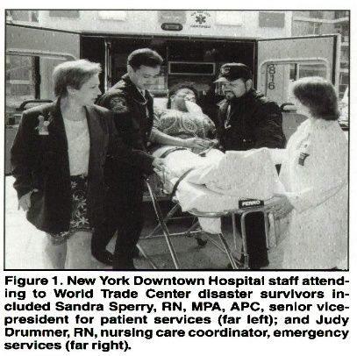
HTM Emergency Management Over the Years
What did HTM Emergency Management look like between 1999 – 2001?
  Y2K the world is coming to an end
  On January 1, 2000 - medical equipment will revolt
  World Trade Center Disaster in New York
Notes:
CESS structure and roles/ responsibilities

Slide 13
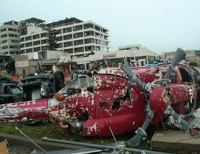
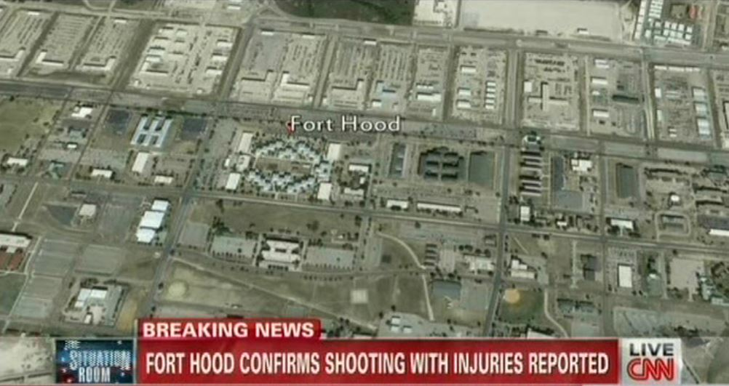
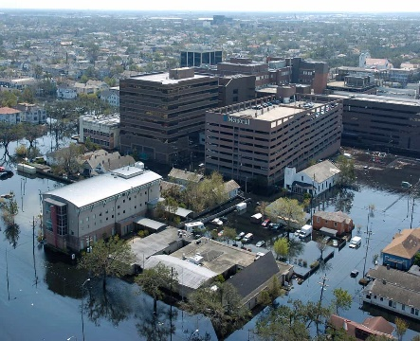
HTM Emergency Management Over the Years
Emergencies throughout 2005-2012 Impacting Healthcare Organizations
  Hurricane Katrina strikes New Orleans in 2006
  Fort Hood Active Shooter
  2011 Mercy Hospital in Joplin destroyed by an EF5 Tornado
Notes:
CESS structure and roles/ responsibilities

Slide 14
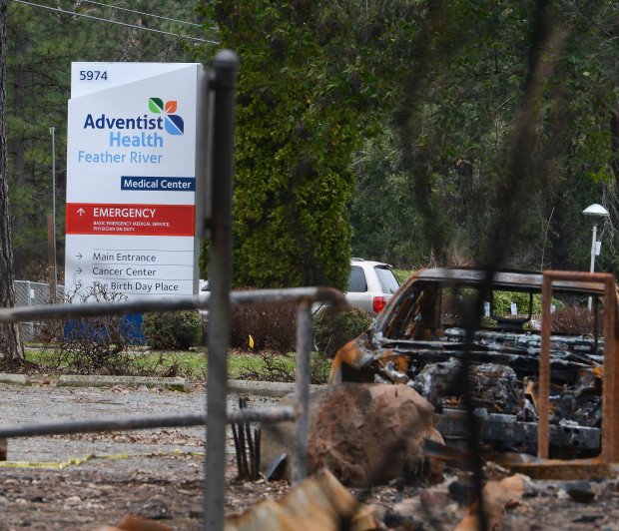
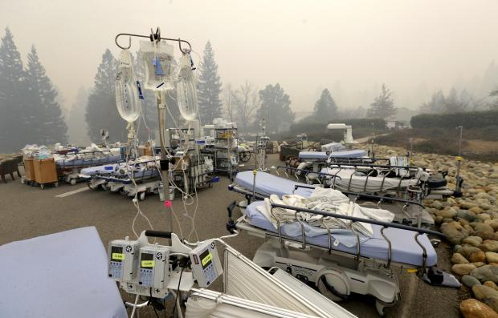
HTM Emergency Management Over the Years
2018 HTM Emergency Management in Paradise, California
https://youtu.be/xZECgAp0bDs
Notes:
CESS structure and roles/ responsibilities

Slide 15
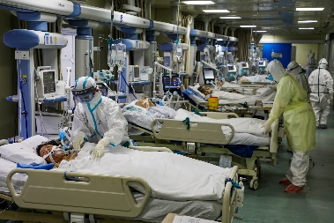

HTM Emergency Management – A New Challenge
In November 2019, the first case of COVID-19 Corona Virus in China
  January 2020 First COVID Case Reported in the United States
  Over 3M Cases Reported in July 2020 Including over 40K hospitalized
March 2020: Work conditions for healthcare staff takes a drastic change
  Remote work for non-essential caregivers
  Safety considerations for all caregivers and clinical staff
  Facility restrictions for visitors and suppliers
  Local, State, and Federal Command Centers
  Equipment and staff tracking, reporting, continued operations
Notes:
CESS structure and roles/ responsibilities

Slide 16
HTM Emergency Management – Current State
2020 COVID-19 Strategies and Outcomes
  Facility Level Incident Command System - Key Departments
  System Logistics Command Center – System Leadership
  State Command Center – Combined Data
Intermountain Healthcare HTM Reports
  Daily staffing reports
    Caregiver status
    Shift coverage
  Ventilator reports
    Usage stats locally, system, and state
    Types of units available for use
    Status of repairs
    Loaner ventilator availability
  Surge preparation
    Hospital and ICU occupancy
    Bed availability
    Overflow unit stand up status
    Repurpose equipment for surge
Notes:
CESS structure and roles/ responsibilities

Slide 17
HTM Emergency Management – Current State
Intermountain Healthcare HTM Caregivers
  Daily staff assessments
    Workloads
    Family status
    Personal health and well-being
  Data and information
    Evaluation of PM cycles and in-use equipment
    On-going review of CMS 1135 waiver use
    Local and state equipment shortages and request
    System level resource sharing to include staff
  Surge preparation
    3D printing of vent tubing parts
    Multi-patient use vent testing
    Repurpose patient care areas to COVID treatment
Notes:
CESS structure and roles/ responsibilities

Slide 18
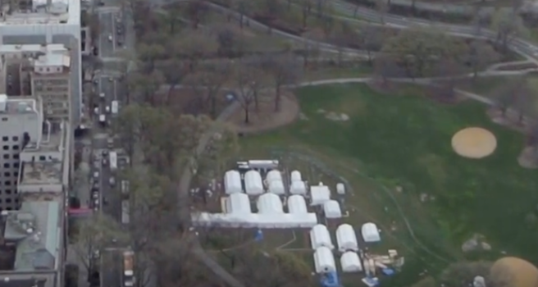
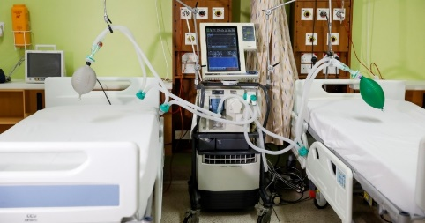
2020 HTM Emergency Management Updates
2020 a whole new Emergency Preparedness challenge for HTM
  COVID-19 unchartered territory for HTM
    Temperature checks for everyone
    Drive through testing sites
  Ventilator shortages and potential strategies
    Loaner vents from educational institutions
  PPE, disinfection, caregiver protection, supplier support
    PAPR unit repairs and maintenance
  Parts availability, 3D printing, FDA rapid approvals
    Net new devices into the organization
  Bed shortages, space limitations, and the list goes on!!
Notes:
CESS structure and roles/ responsibilities

Slide 19
2020 HTM Emergency Management Updates
Updates to the HTM Business Continuity Plan
  Purpose, Scope, and Objectives
  Risk Assessment
  Past, present, and potential future events
  Team Overview and Key Members
  Organizational structure and chain of command
  Greatest Threat Potential
  Communication, staff shortage, etc…
  Response
  Can operations continue as normal
  Responsibilities of staff across the system
  Recovery Phase and Record Keeping
    Software reloads, equipment resets
    Date, time, action, and potential expense
Notes:
CESS structure and roles/ responsibilities

Slide 20
2020 HTM Emergency Management Updates
Updates to the HTM Business Continuity Plan - Forms
  Critical Suppliers, Contact Info, and Names
  Mission critical devices
  Parts and Service Suppliers
  Business Continuity Plans – Local Support
  Home Locations of Critical Staff
  Ability to communicate and gauge response
  Potential need for personal caregiver assistance
  Damage Assessment and Documentation
  Location, condition, and recoverable
  Business Recovery Expense
  Facility, caregiver, cost, and payment method
  Post Emergency Tasks
  Asset inventory, staff debriefs, insurance, and movement
Notes:
CESS structure and roles/ responsibilities

Slide 21
2020 HTM Emergency Management into the Future
Self Assessment of HTM Emergency Readiness
  Work with the Healthcare Organization Emergency Manager
  HTM is a critical piece of the facility plan
  Patient safety is at risk without safe medical equipment
  Healthcare organization overview and profile
  Trauma designation and capabilities
  Beds – Type, negative flow rooms, and monitored
  Space and/or areas for surge and overflow
  Ventilators, portable x-ray, and lab services
  Logistics and Facilities
  Emergency power, water supply, and medical gases
  Caregiver preparedness training and resources
  Respiratory protection equipment and other PPE
  HTM respiratory fit testing and training
  Incident Command System (ICS) and Communication
  HTM assigned a spot with ICS
  Caregivers trained and participate in exercises
  Forms and plans complete with standard reviews
Notes:
CESS structure and roles/ responsibilities

Slide 22
2020 HTM Emergency Management into the Future
Self Assessment of HTM Emergency Readiness
  Local, State, and Federal Assistance Agreements
  Memorandums of Understanding (MOU)
  Equipment rental agreements and/or suppliers
  Participate in organizational committees
  Collaboration with other organizations
  Organizational Service Offerings
  Isolation bed capacity
  Pharmacy services and equipment
  Laboratory services at individual locations
  Logistics and Supplies
  Consumables for critical equipment
  Accessibility to disaster equipment and supplies
  Functionality of stored and excess equipment
  Expiration dates of consumable supplies
  Disinfection and sanitization of equipment
  Communication and Information Management
  Identification of critical systems
  Contact information for department leaders
Notes:
CESS structure and roles/ responsibilities

Slide 23

Questions?

