Slide 1
Hospital Beds and Nurse Call Systems: Should HTM Manage These?
Ryan Harris, CBET
Director of Healthcare Technology Management
Texoma Medical Center

Slide 2
HTM : Why Are We Here?
To ensure that:
Medical equipment is functional and properly maintained
  Essential for patient care
Medical equipment is properly utilized
  Improves patient care
Medical equipment is maintained with financial awareness

Slide 3
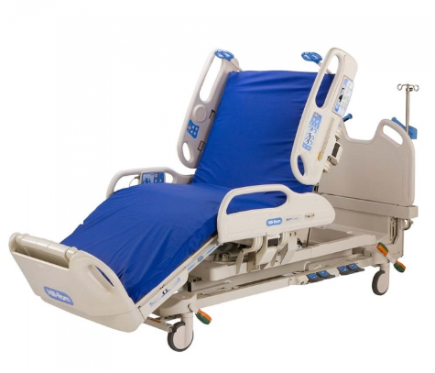
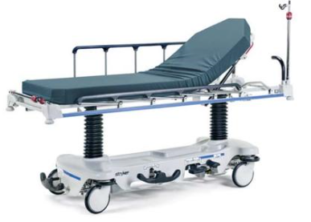
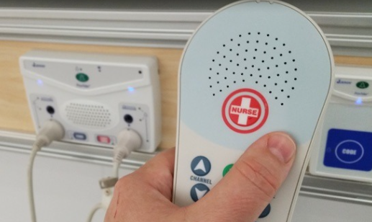
What Medical Devices are Used on Almost Every Patient that Enters the Hospital?

Slide 4
Who Should Service These?
HTM… Of Course!
Help nursing and improve patient care
Justify, solidify, and increase your staff size
Hospital beds and nurse call systems have become technologically advanced
  We should be the technical experts to help caregivers navigate problems
Save money

Slide 5
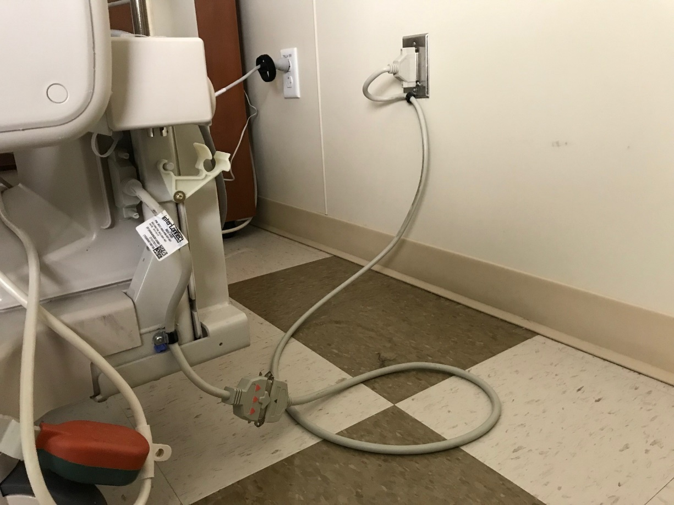
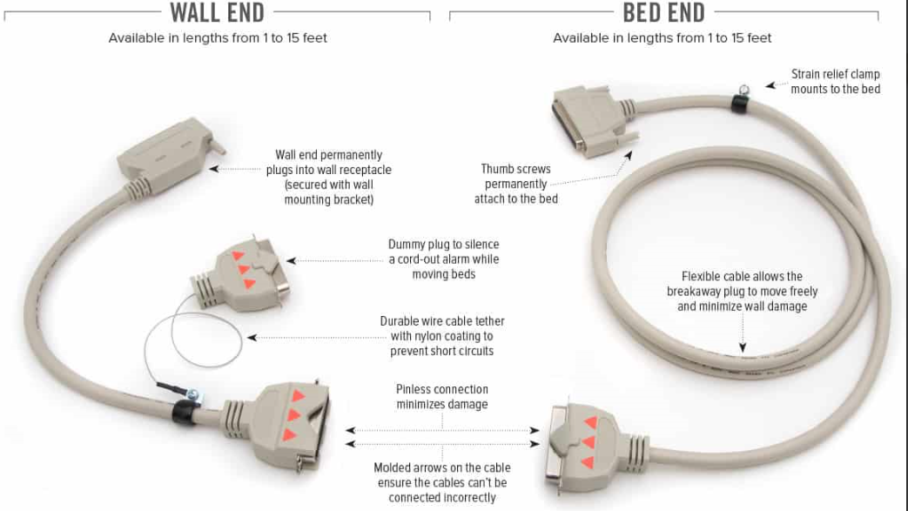
Bed Alarms for Patients with High Fall Risk
Bed integration to the nurse call system
HTM assistance with implementation and ongoing education

Slide 6
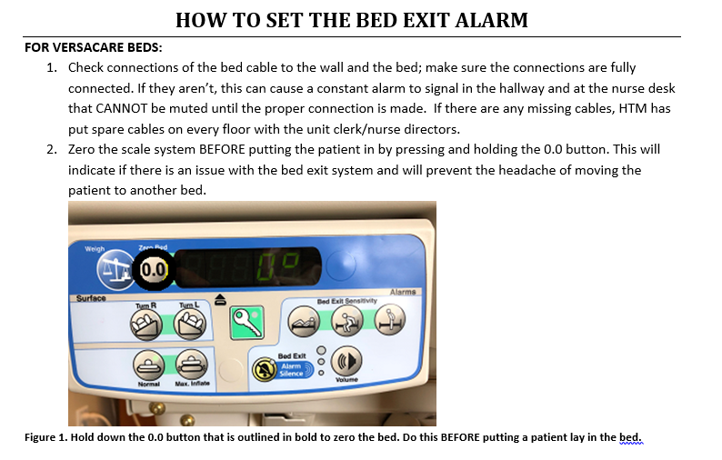
Bed Exit Cable and Alarm Implementation
On the spot education
Developed instructional documents for nursing

Slide 7
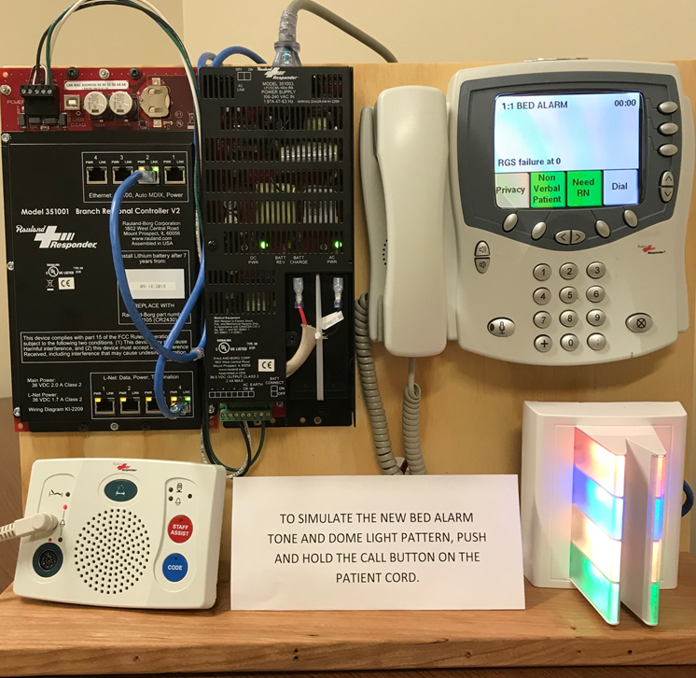
Nurse Call Alarm Customization and Demo for Training
Take programming system into your own hands
Get changes made fast when they are urgent
Demonstrate new changes to staff before they are implemented

Slide 8
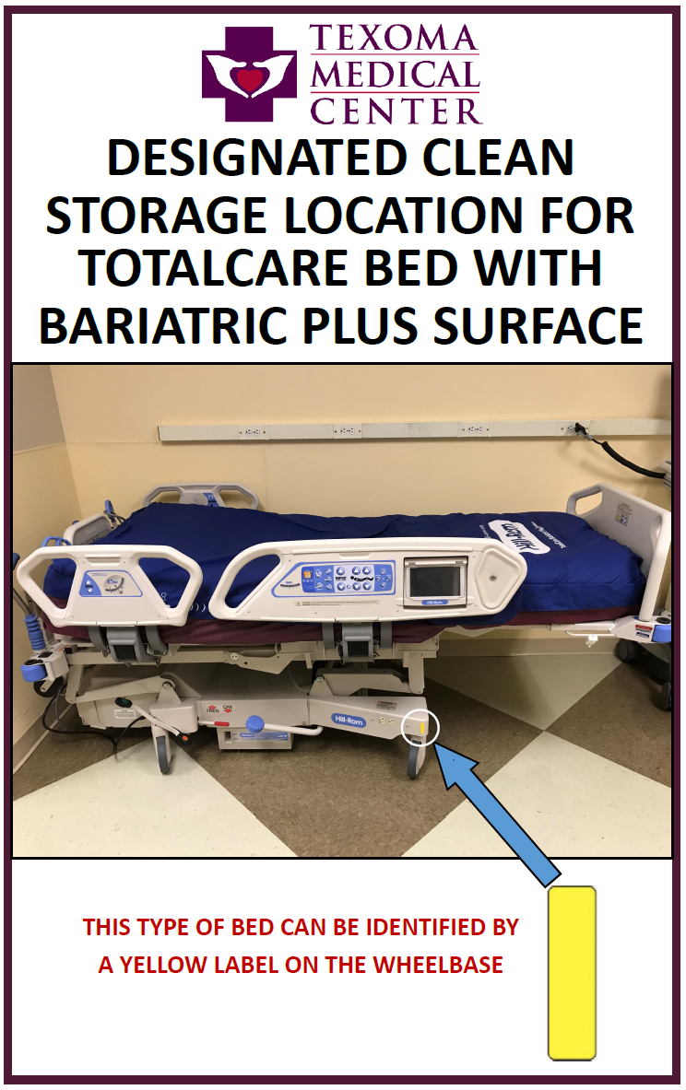
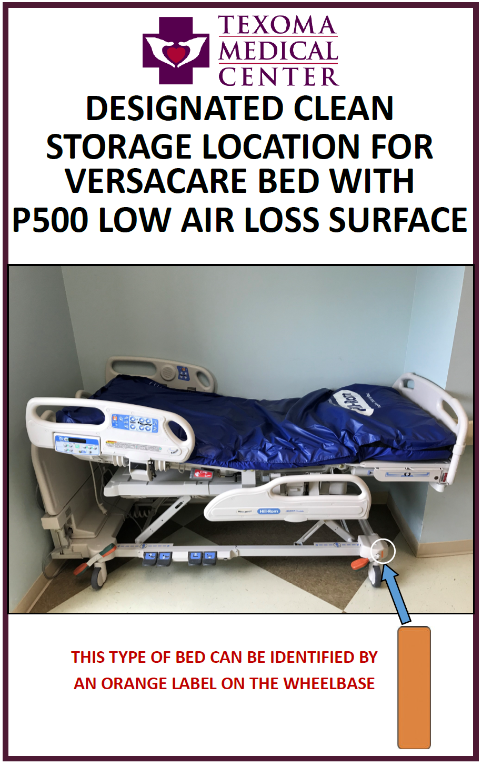
Bed Location Project
Does your facility have a process for bed storage, tracking, and logistics?
  Where are the beds?
  Where do we put the extras?
  How do we get the right bed for the patient?
  Who moves them?
We can help to develop a process
  Bed locations identified and designated
  Color coded labels
  Status of each location reported in morning leadership meeting
  Process for moving a bed and repair

Slide 9
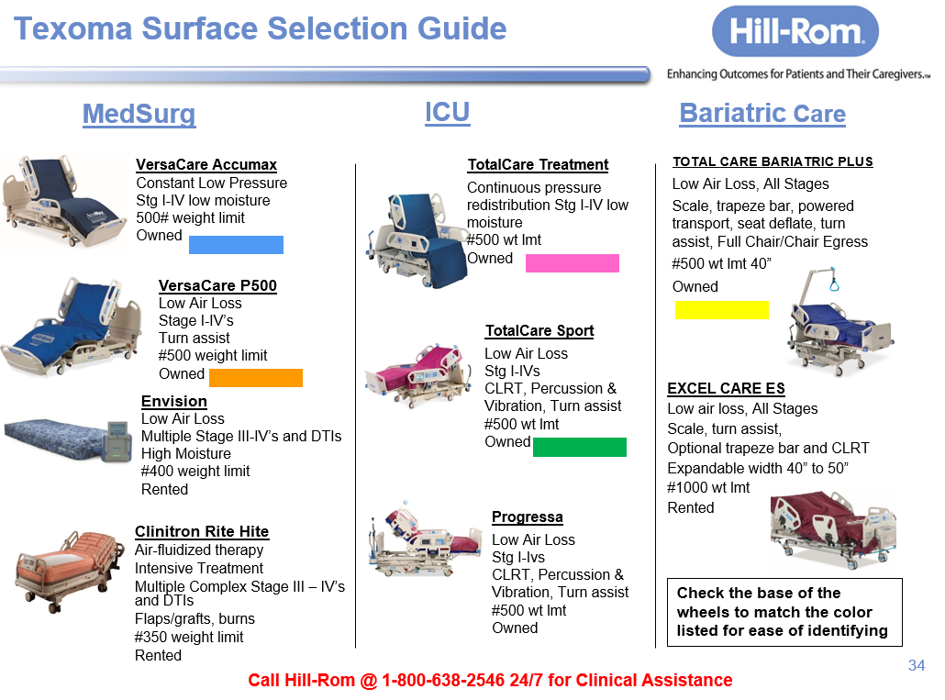
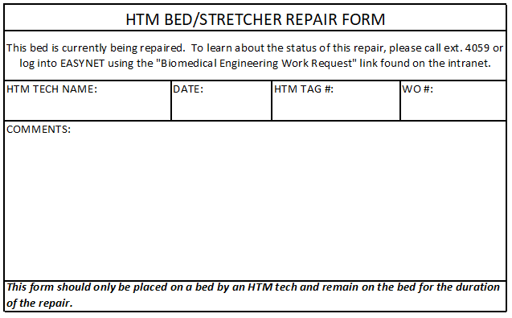
Bed Location Project

Slide 10
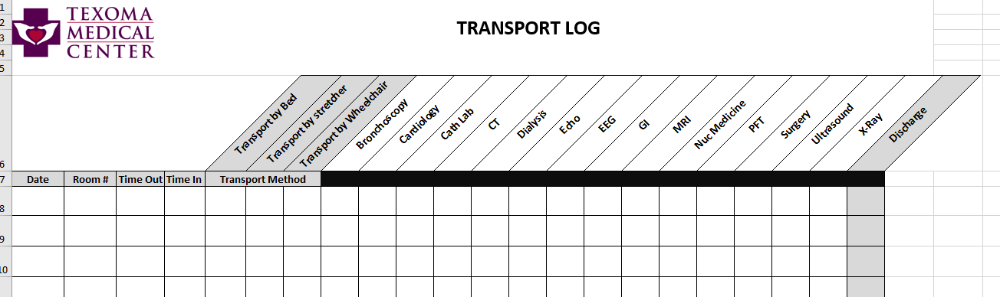
Bed Movement Tracking
Bed transfers in or out of rooms cause damage to:
  Bed power cords, siderails, etc…
  Nurse call system components
  Walls and doors
We added the “method” of transport to our transport log:
  Find out which areas were moving beds the most
  Identify and eliminate any unnecessary bed movement

Slide 11
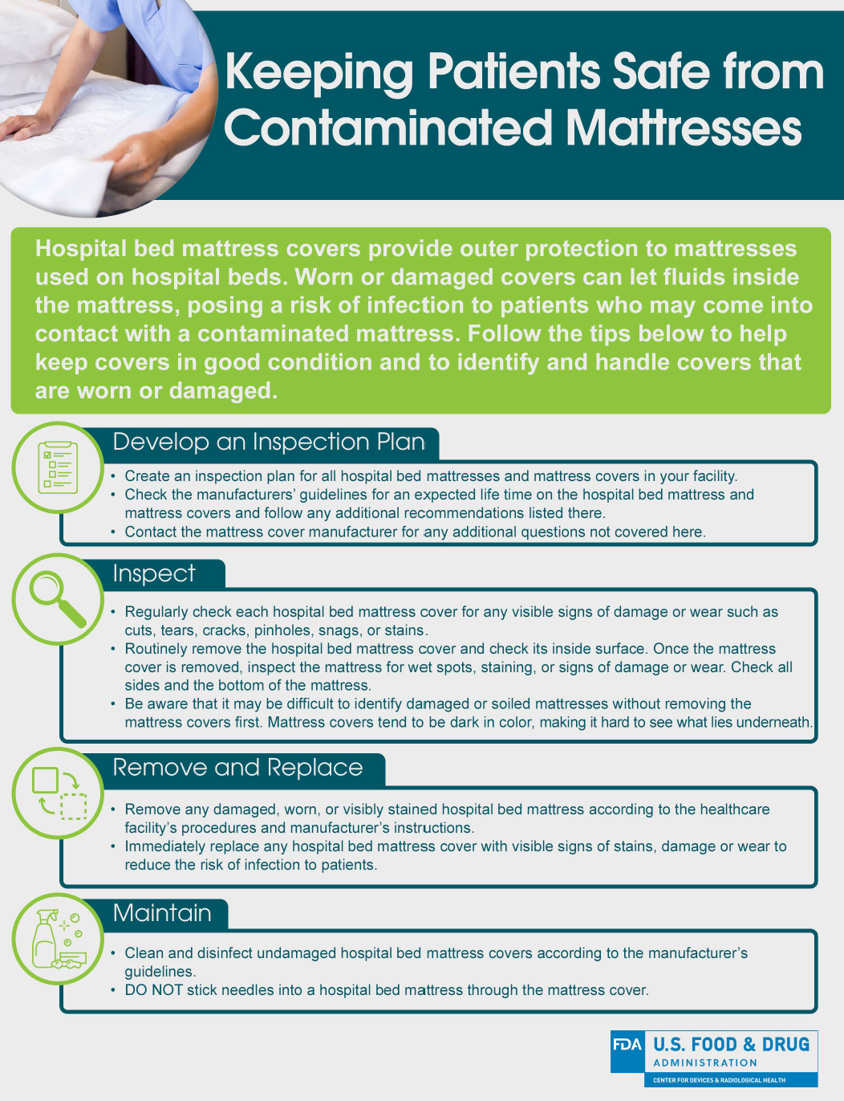
Bed Mattress Management
FDA Released a notice on mattress contamination in 2013 and 2017
ECRI Top 10 Health Technology Hazards for 2018
Is there a process at your facility?
Who replaces the mattress?
Who inspects the cover and inside the mattress?
Are they being replaced at the recommended interval?
Mattress breakdown = patient dissatisfaction

Slide 12
Looking at Work Orders to Highlight Training Needs
Air mattress problems
Air vs. foam
HTM recommended education tailored to nursing needs in 2020
Bed alarm issues per department reviewed in fall committee

Slide 13
Shift Priorities for Rapid Support
Patient census fluctuations
COVID-19
  All beds needed during COVID surge
In house support = immediate support

Slide 14
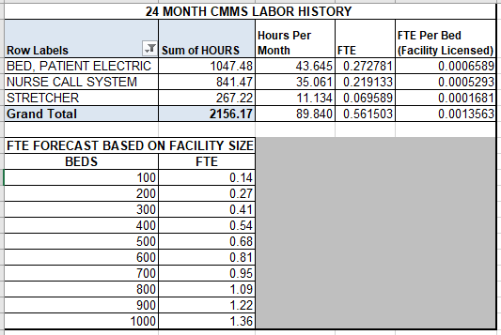
FTE Calculation (TMC = 414 Licensed Beds)

Slide 15
What About a Contract?
Saved approximately $250,000 since 10-2016 (beds only)
How often will they be at your facility?
Can they provide the same level support?

Slide 16

Questions?

Slide 17
References
U.S. Food & Drug Administration (2017). Covers for Hospital Bed Mattresses: Learn How to Keep Them Safe. Retrieved from https://www.fda.gov/medical-devices/hospital-beds/covers-hospital-bed-mattresses-learn-how-keep-them-safe
ECRI Institute (2017). Executive Brief: Top 10 Health Technology Hazards for 2018. Retrieved from https://www.ecri.org/Resources/Whitepapers_and_reports/Haz_18.pdf

