Slide 1

How to better diagnose ultrasound probe issues in today’s ever-changing environment.
“Challenges of Ultrasound Probe Technology in the 21st Century”

Slide 2
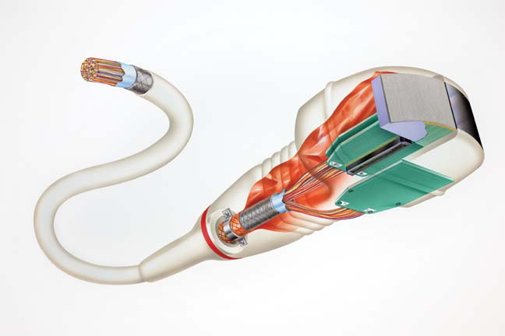
What we will cover
The probe of today
How transducer technology has and IS changing
New technologies
Single crystal arrays, new materials, probes, etc.
CMUT Technology
Matrix Array issues
Testing New Technologies
Probes in the U.S.
What do these new technologies mean for you?
Q&A

Slide 3
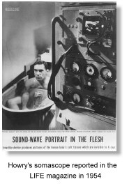
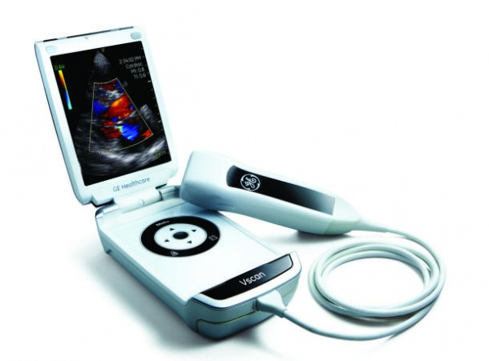
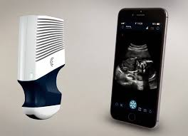
Yesterday and Today
Ultrasound System and Probe Design
50 Years of Development

Slide 4
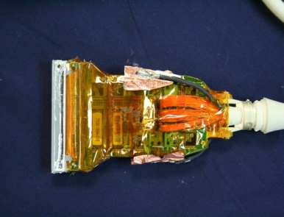
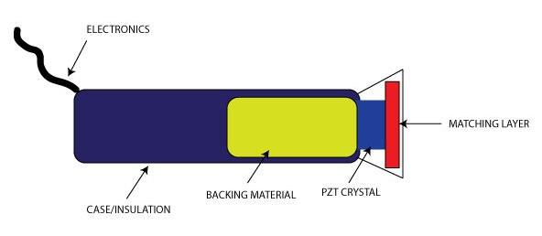
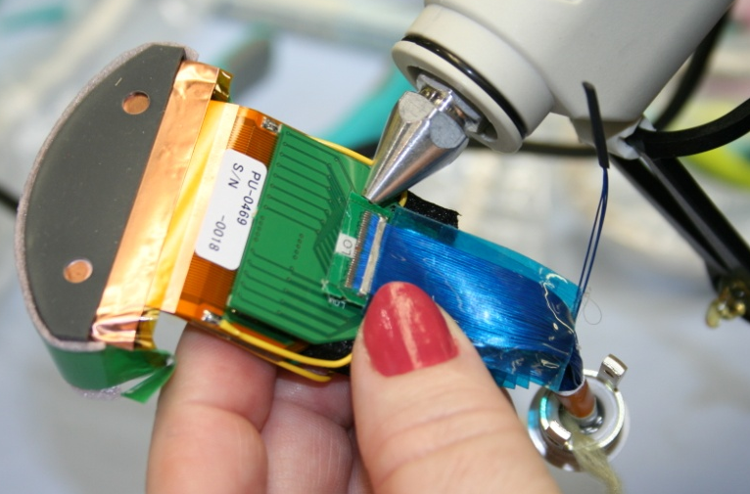
Probes of Today
Most ultrasound transducers today use PZT ceramic crystals
Easy to produce, cheap and a known performance level
PZT arrays are used in curved, linear, convex and TEE probes by all manufacturers around the world.
PZT arrays replaced the older annular and ring arrays of yesteryear
64 to 288 element arrays

Slide 5
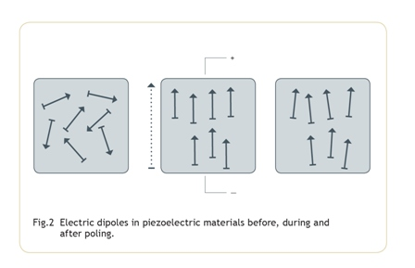
Element Characteristics PZT
The crystal (piezoelectric element) emits the sound beam & receives echoes.
Natural piezoelectric material such as quartz, tourmaline, & Rochelle salt
Man-made piezoelectric ceramic material: lead zirconate titanate (PZT), barium titanate, lead metaniobate, & polyvinylidene difluoride (PVF₂).
PVF₂ crystals are developed to have an acoustic impedance closer to that of soft tissue. These ceramics are not naturally piezoelectric – the heating process in a strong electrical field causes that effect (known as Poling).

Slide 6

How PZT Arrays are Made
Typical manufacturing Process
ＰＺＴ pillar
Automatic powder forming
Formed ＰＺＴ
Sintering
resin
Continuous forming
Automatic
alignment
Resin
filling

Slide 7
PZT Arrays
Dicing Slots
Filled with
Polymer & Lapped
To PZ Material
Diced
PZ Material
Ready for
Polymer
Dicing and filling the spaces with polymer allows the formation of arrays with individual elements mechanically and electrically isolated from one another.
Spine is
Lapped to
The Polymer Fill
Spine Holds
The Array
Together

Slide 8

How PZT Arrays are Made
Fine Pitch Dicing
For manufacture
1-3 composite and array type transducer
【1-3 composite example】
Dicing groove width
：0.025mm
Square pillar size：
0.072mm x 0.072mm
Work size：
13mm x 100mm

Slide 9
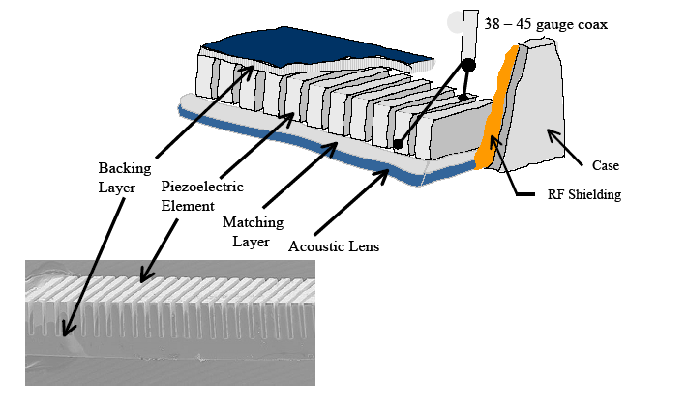
How PZT Arrays are Made

Slide 10
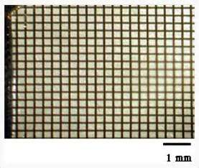
New Technologies
The new technologies encompass the use of single crystal array technology such as PMN-PT and PZN-PT single crystal materials
Dramatically improved image performance and quality
Elements counts from 1000 to 9000 diced elements
Allows for “Matrix” array development
High cost to manufacture
Very few array companies can produce
Prone to higher rate of failure due to temperature changes
Definitely the future of ultrasound probe and array manufacturing

Slide 11
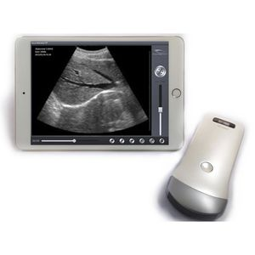
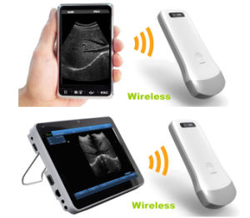
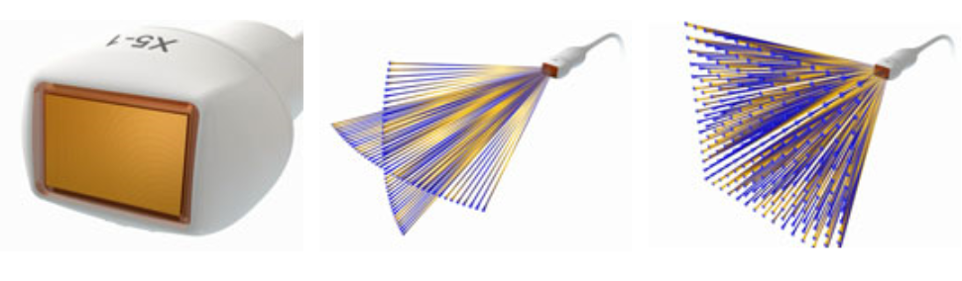
New Technologies
Wireless Probes
Probes used on Smartphones
CMUT technology
Matrix arrays

Slide 12
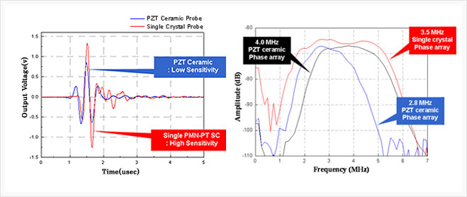
Definitions
PMN-PT - Lead Magnesium Niobate-Lead Titanate
PZN-PT - Lead zinc Niobate-lead Titanate

Slide 13
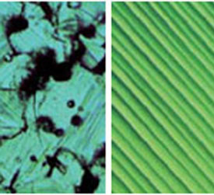
Single Crystal Arrays
PZT crystal
PMN single crystal

Slide 14
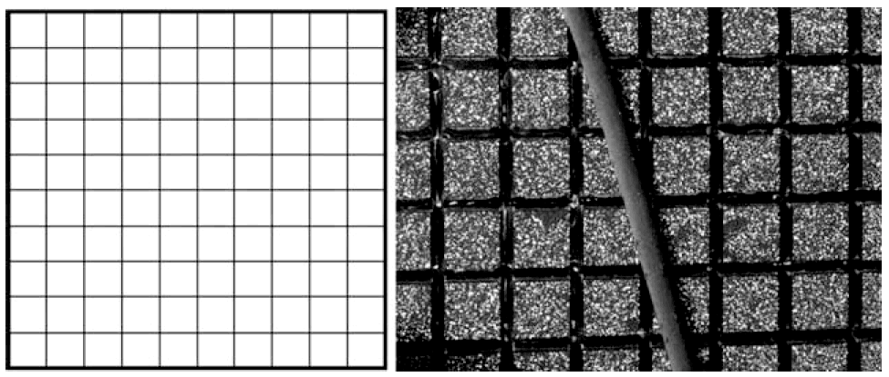
Matrix Array
2D Matrix array transducer (Left)The transducer crystal is equally divided into 3000 to 6000 elements that are arrayed in a matrix composed of many longitudinal and horizontal lines. (Right) The elements of the transducer crystal are as minute as a hair in diameter (courtesy of Philips Medical Systems, Bothell, Washington).

Slide 15
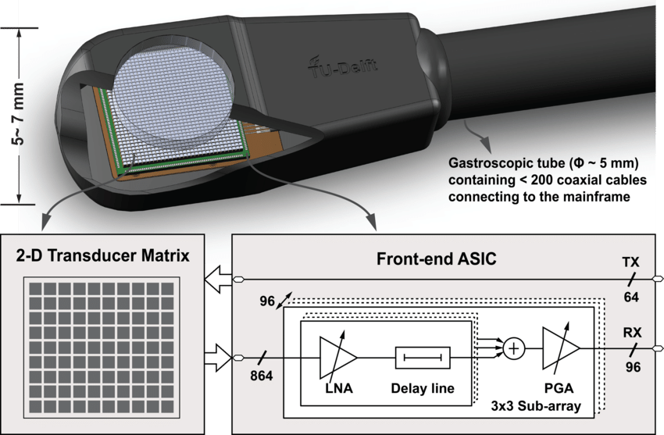
Matrix Array
Inside the X7-2t

Slide 16
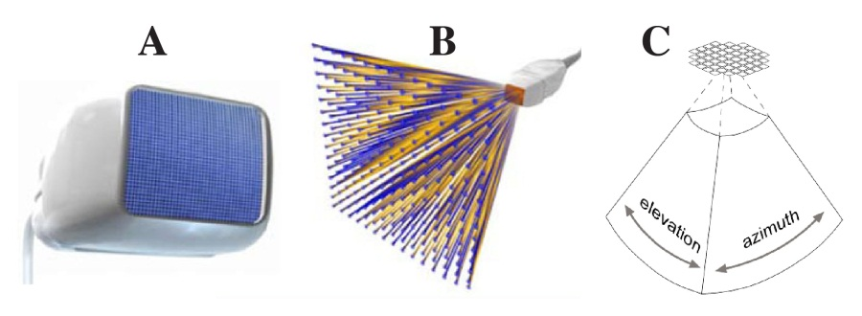
Matrix Array
“Grid” pattern of array aperture

Slide 17
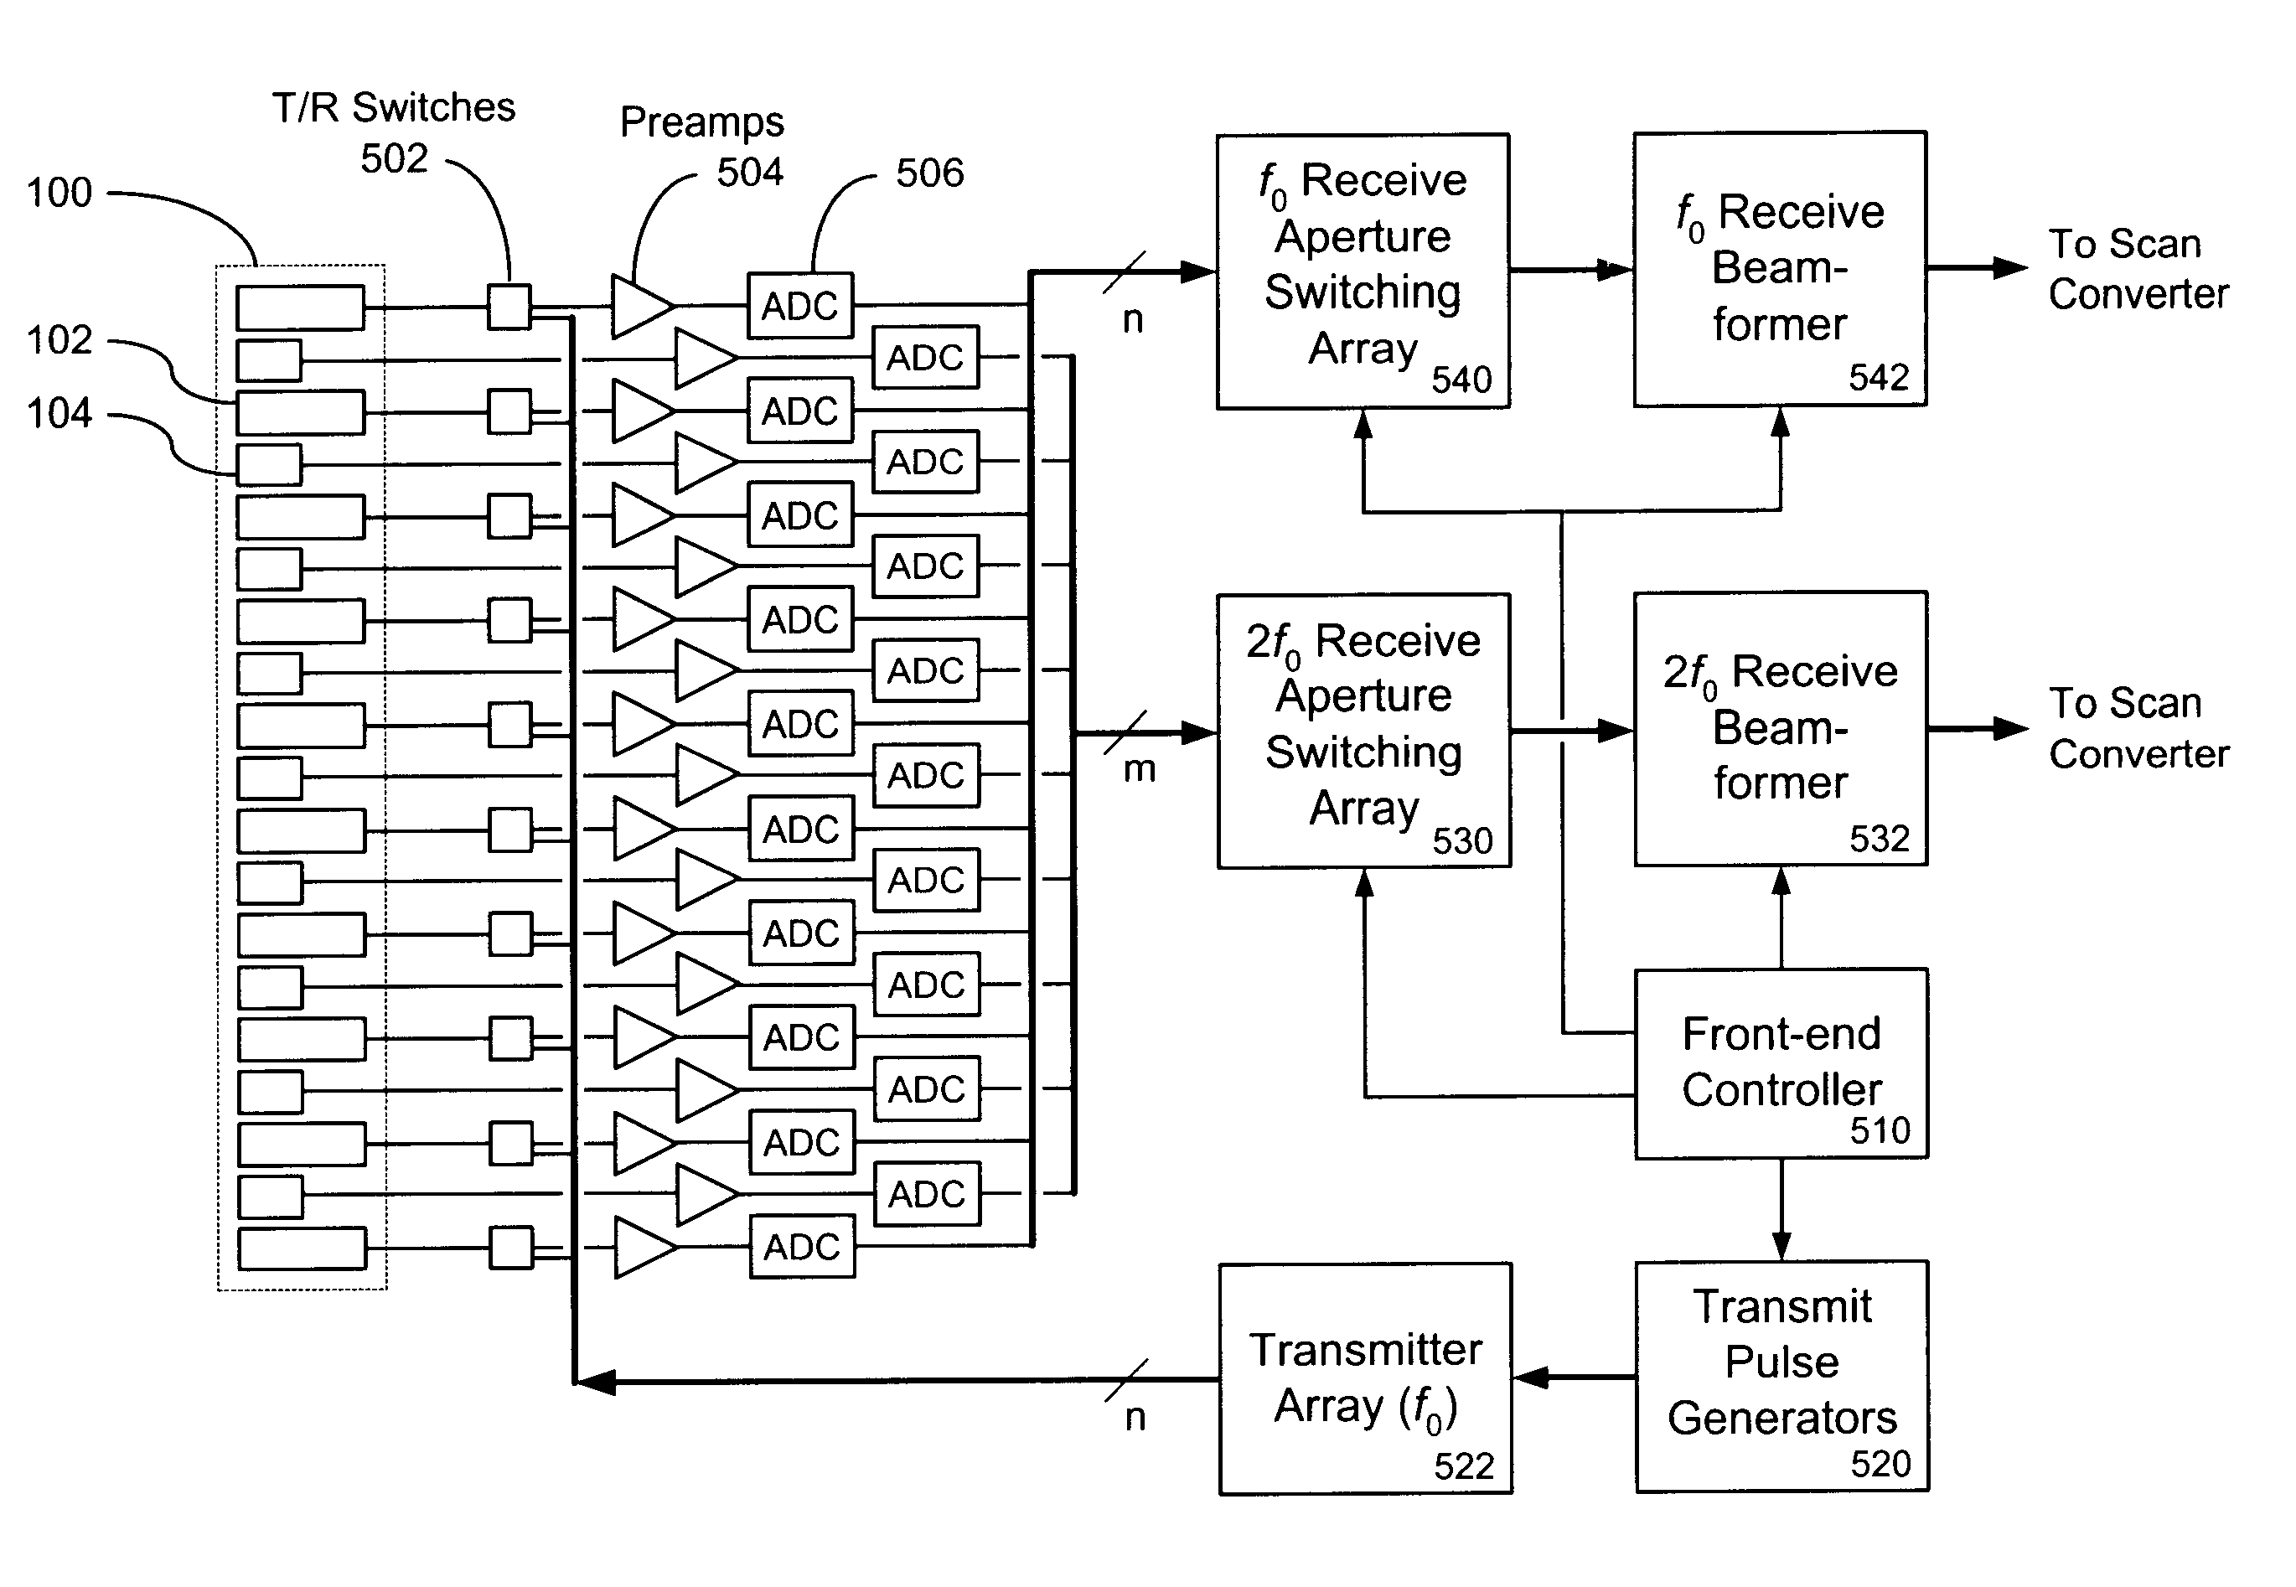
Matrix Array
Example of Transmit/Receive circuitry in Matrix Arrays

Slide 18
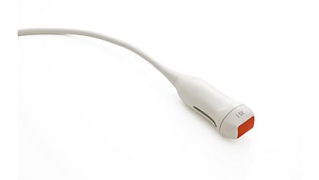
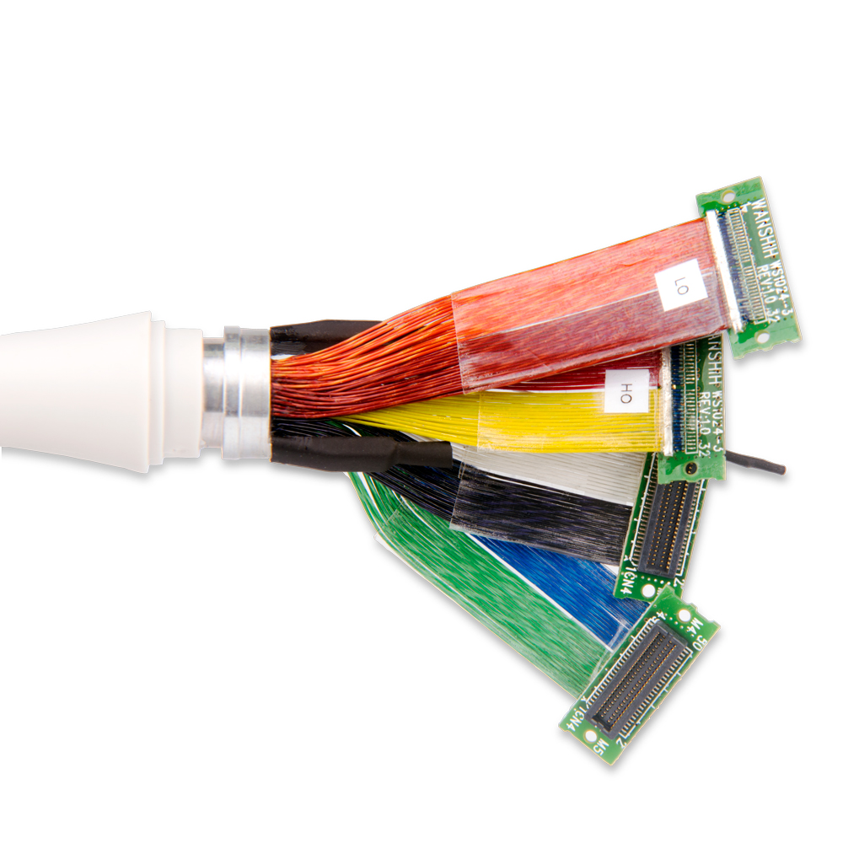
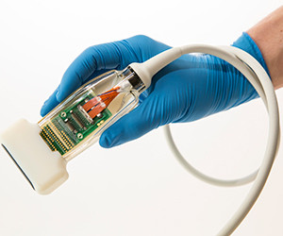
Matrix Array problems
Testing is an issue. (Limited testing devices on the market)
The arrays typically do not fail.
More “electronic” issues.
Over-current draw problems
Component failures
Cabling problems

Slide 19
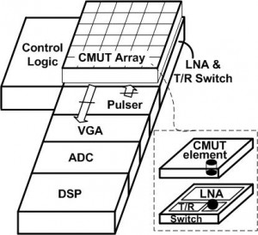
CMUT Technology
What is CMUT?
Capacitive micro-machined ultrasonic transducers (CMUT) is a relatively new concept in the field of ultrasonic transducers. Most of the commercial ultrasonic transducers today are based on piezoelectricity. CMUTs are the transducers where the energy transduction is due to change in capacitance. CMUTs are constructed on silicon using micromachining technique. A cavity is formed in a silicon substrate, and a thin layer suspended on the top of the cavity serves as a membrane on which a metallized layer acts an electrode, together with the silicon substrate which serves as a bottom electrode.
If an AC signal is applied across the biased electrodes, it will generate ultrasonic waves in the medium of interest. In this way it works as a transmitter. On the other hand, if ultrasonic waves are applied on the membrane of biased CMUT, it will generate alternating signal as the capacitance of the CMUT is varied. In this way, it works as a receiver of ultrasonic waves.^{[1]}

Slide 20
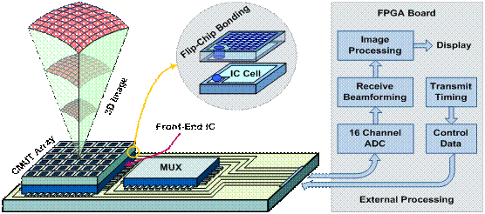
CMUT Array
Capacitive Micro-machined Ultrasound Technology

Slide 21
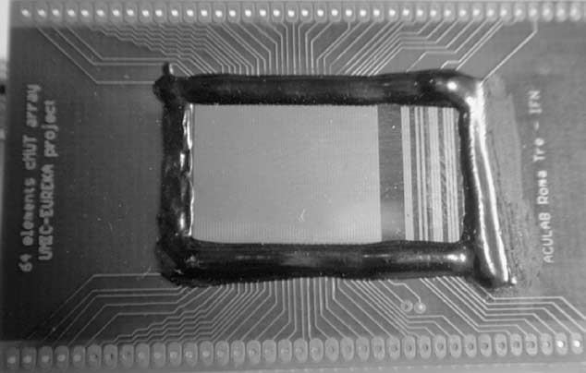
CMUT Array
Sixty-four-element CMUT linear array mounted on a PCB, with an
epoxy resin protecting the wire-bond connections.

Slide 22
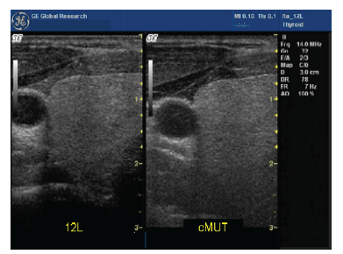
CMUT Array
PZT Transducer CMUT Transducer

Slide 23
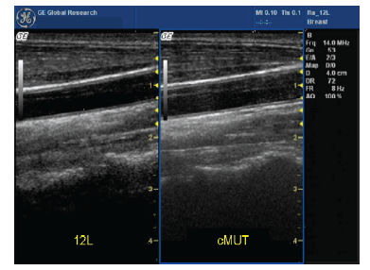
CMUT Array
CMUT 2D images are more electronic in the way they are formed. The result is a “softer: image.

Slide 24
Dead elements
FL
FL
PZT Array Types
Element
Thickness
Fractured array element
Very often the transducer elements are completely broken along with a loss of electrical continuity. These are “dead” elements whose absence distorts the primary wave front essential for beam formation and steering. The element response is very binary in this condition. The transducing element either works or does not.

Slide 25
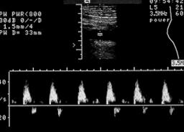
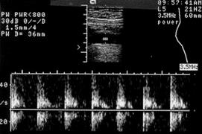
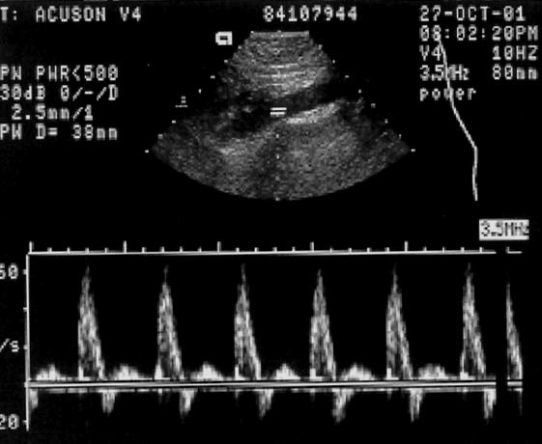
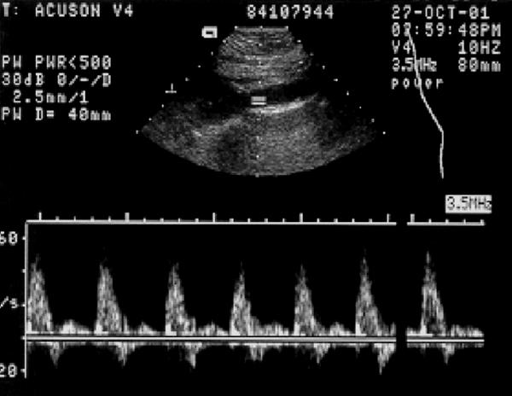
Doppler Issues
Spectral Doppler
–Flow direction ambiguity
–Reduced flow sensitivity
–Spectral broadening
–Lower peak velocity
–Poor low flow sensitivity
–Reduced sample depth
–Increased scan time
Complete array
2 dead elements

Slide 26

Testing Today’s Probes
“If it cannot be tested properly, how can it be repaired properly?”

Slide 27
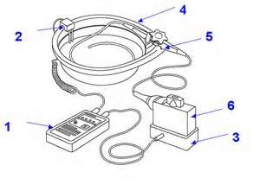
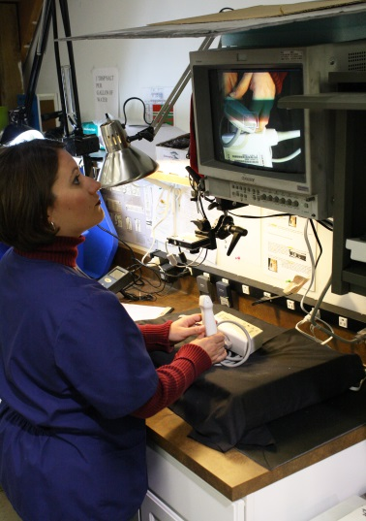
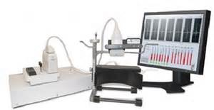
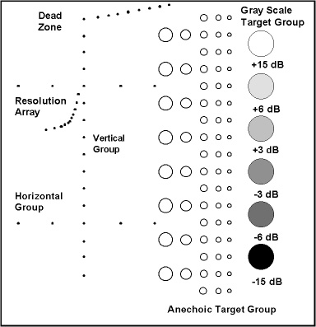
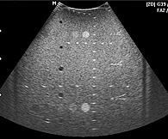
Traditional Testing Methods

Slide 28
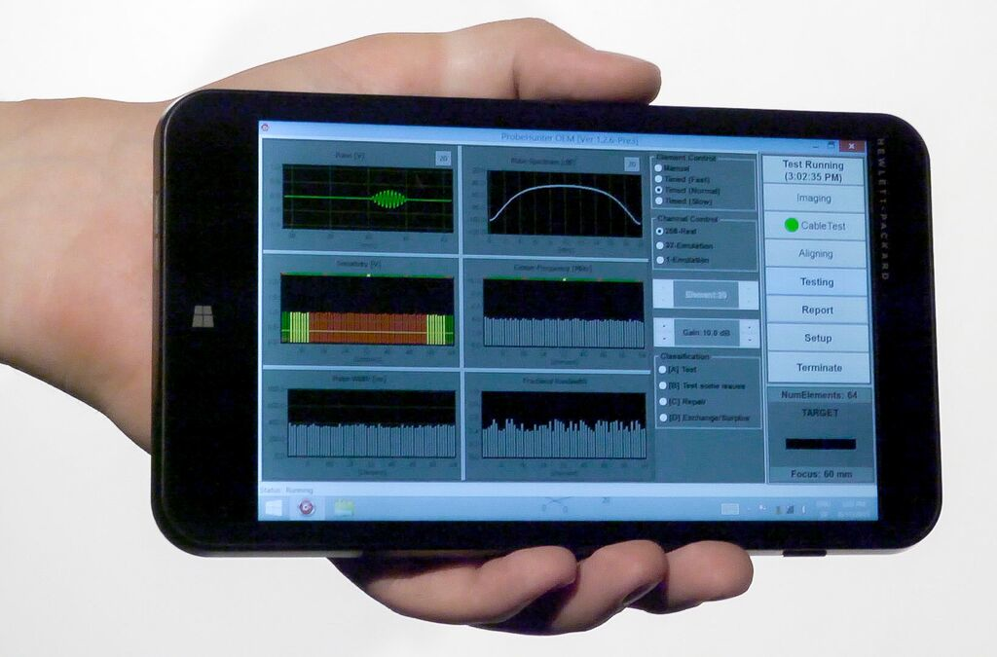
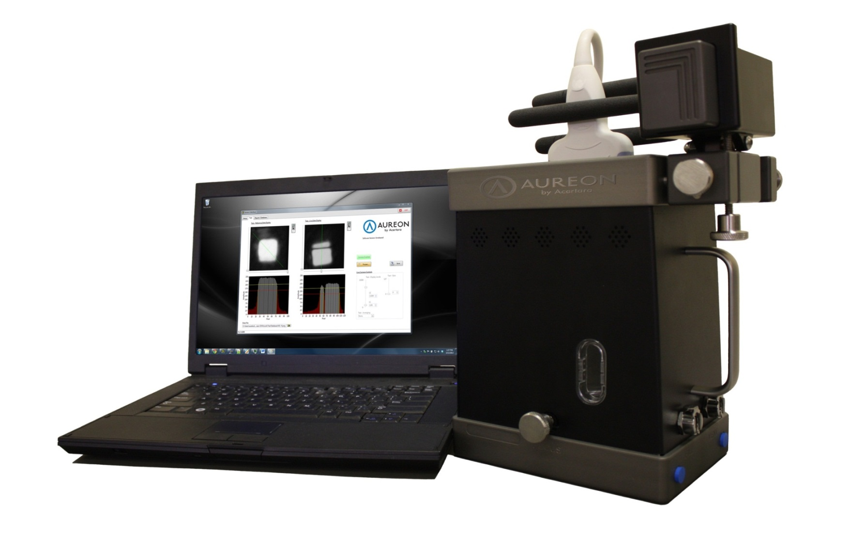
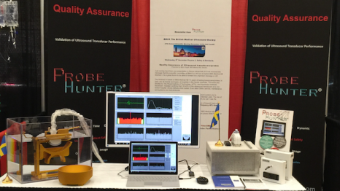
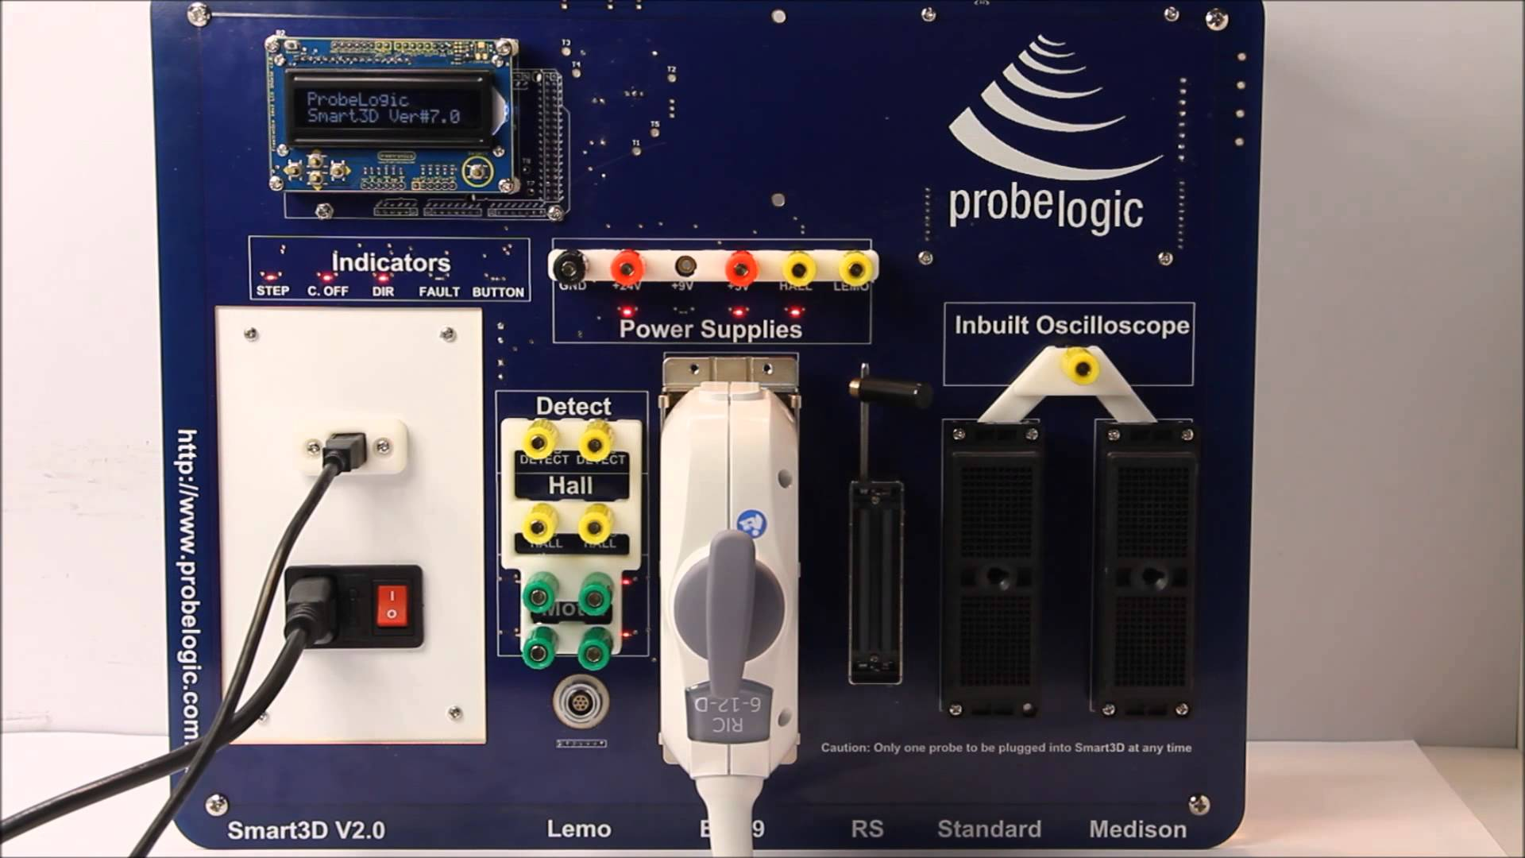
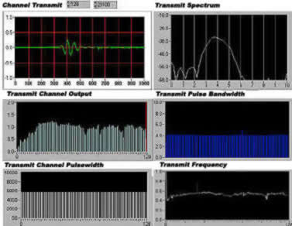
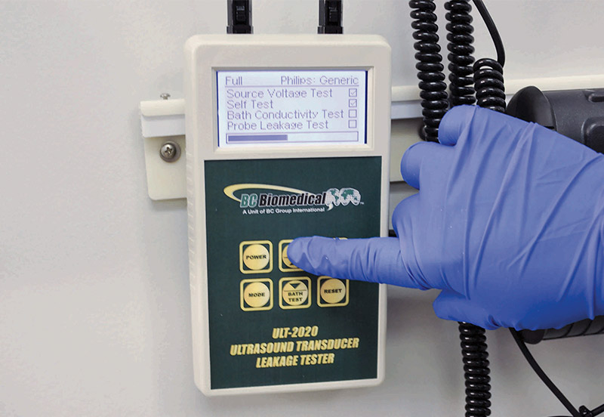
New Testing Methods

Slide 29
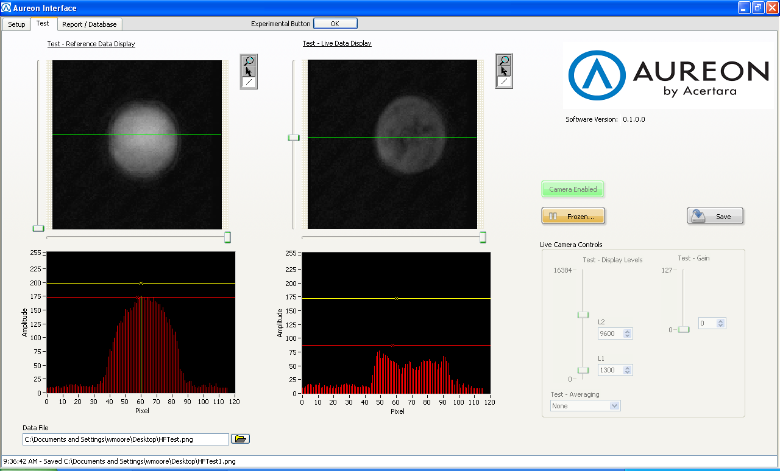
Testing Today’s Probes
The Aureon looks at the acoustic power level going to the array.

Slide 30
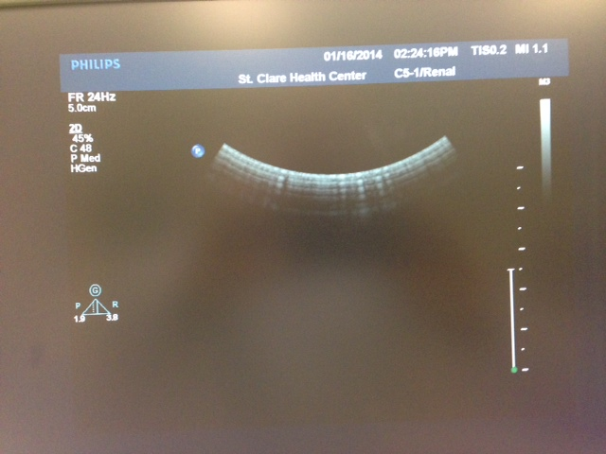
Example Test of Single Crystal Array
Customer thinks they have “weak” or “dead” elements.
“air scan” of probe

Slide 31
Example of Single Crystal Array Test
C5-1 runs a much stronger acoustical output than normal, composite arrays. “Air scans” will lead you down the incorrect path of the problem. Proper testing is no longer a need, but is required.
Stronger “zones” of array
In this case, after full testing and live scanning, the probe was found to be perfectly normal. Saving the customer thousands of $$$ in unneeded repairs.

Slide 32
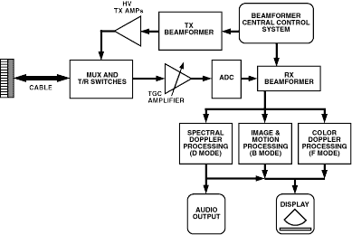
Electronic Multiplex Probes
More and more probes are electronically multiplexed today. This is causing more probes to have complex electronic problems rather than traditional dead element issues.

Slide 33
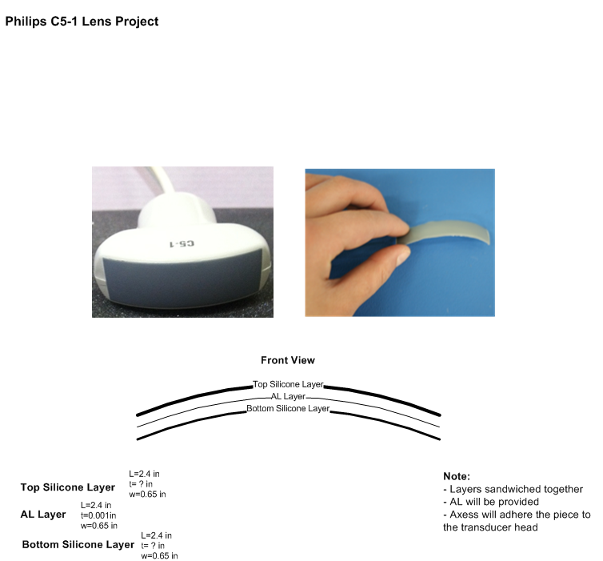
New Lens Technology
New multiple layer lenses cause more issues with repair

Slide 34
OEM lens vs. Replacement Poor Lens
OEM
Replacement

Slide 35

What do these new technologies mean to you?
Ultrasound probes continue to become more complex
What used to look like dead elements on PZT arrays can now be:
Electronic problems
De-polarized elements
Multiplexer problems
Programming issues
Probes continue to be costly
Try to train your customers in better care of their probes
Catch problems early and repair at minor levels instead of major.
Remember the clinical outcomes of bad probes

Slide 36

What do these new technologies mean to you?
Early diagnosis is critical. Remove cost. Don’t just “save money”
Problems can be deceiving. Things like “air scans” can lead you down the wrong path.
More expensive exchanges.
You need to really check the “environment” of your probes.
Are they cleaned/disinfected properly?
Are they stored and placed in the proper probe holders?
Is the room temperature good and controlled?

Slide 37

Return On Investment (ROI)
There is a real cost to the bottom-line:
Using the $221.21 rate of Medicare fees, per study/patient:
Array replacement/exchange probe: Cost; $5000
Number of patients required to “pay for” this repair/exchange – $5000/ $221.21 = 22.5
23 patients using the 15/patients /day model, equals 1 ½ days worth of patients to simply “pay” for the repair/exchange.
This means the hospital is not generating any revenue on this system for a day and a half. This does not include the cost of S&W, Overhead, etc.

Slide 38
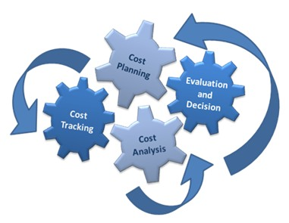
Return On Investment (ROI)
Using a carefully developed probe plan, reducing real costs can look like this:
Using the $221.21 rate of Medicare fees, per study/patient:
Lens replacement - $600
Number of patients required to “pay for” this lens repair - $600/$221.21 = 2.7
In this case, by repairing the probe when it was still in a “minor” repair category, the hospital is generating revenue and the “cost” for the repair is paid for on one system with approx. 3 patients.
Normal revenue per/system, per/day - $3318.15
After paying for minor lens repair - $2654.52
The net gain for the hospital is positive and the true cost minimized by managing the probes better.

Slide 39
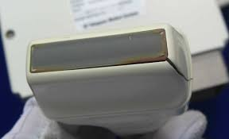
A cost-effective probe program
Get the proper test equipment
Leakage meter ie. BC Group ULT-2020
Tissue Phantom ie. ATS Model 539
Element test device (if feasible)
Magnifier device (hand-held)
Include all your probes on your PM checklist as well as, each time you perform a repair on the system.
Always perform a good visual inspection of all your probes.
Make sure your TEE users are doing a leakage test before disinfection. Each time this should be done. Ask the sonographers consistently if they are having problems with any probes.
Document any findings and plan for the repair or exchange if needed.

Slide 40
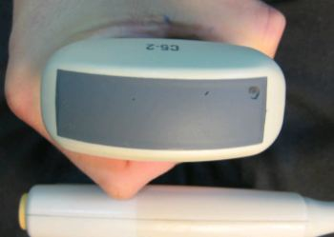
Probes in the U.S.
There are approx. 500K to 600K probes in-service in the U.S. alone
Less than 25% of probes in the U.S. are tested and/or repaired regularly
Probes continue to constitute the highest failure item on any ultrasound system
Repair is still the lowest cost-alternative to replacement
Repairing a probe vs. replacing offers the customer several better options:
You know the history of your own probe. (When purchased, how many scans on it, etc.)
You know the environment the probe has been used in. (Care, cleaning, storage, etc.)
If a probe is replaced, you have no history available on the probe
Test and baseline your probe inventory.
Test ALL your probes on each PM

Slide 41
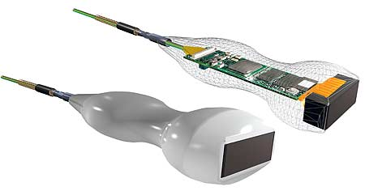
Q & A

