Slide 1

Troubleshooting Today’s
X-ray Systems
Presented by
John DiPasquale
ISO 9001:2015 CERTIFIED

Slide 2
A little about me…
Got my start in electronics while in the USAF
Aircraft electrician – 4 yrs.
BMET – 18 yrs.
Technician, Manager, Instructor and Regional Manager
After military service
8 years in various imaging and biomedical capacities including asset management for both in-house and 3rd party contract positions
Left industry to teach HS Mathematics in the Connecticut Vocational Technical HS System
Came back to industry in 2006
1st OEM experience with Hologic
Technical trainer on both analog / digital imaging systems and support systems for their mammography lines
Moved to Wisconsin in early 2013 and began career with TP in December of that year.
Education & Credentials
Masters degree in Education
Bachelors degree in Electronics Engineering and Business Administration
AAS in Instructor and Biomedical Equipment Technologies
ICC CBET since 1994
USAF Master Instructor
ISO 9001:2015 CERTIFIED

Slide 3
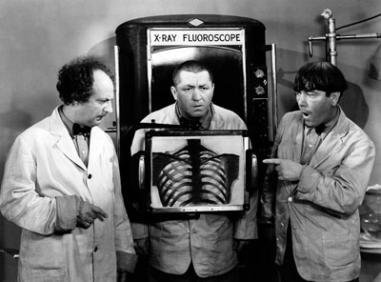
What we are going to cover…
X-ray System’s Subsystems
Troubleshooting

Slide 4
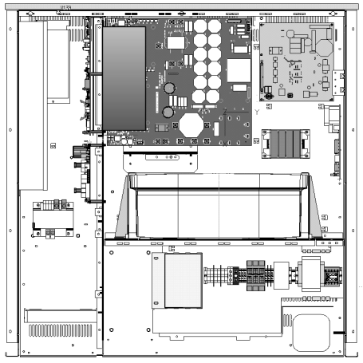
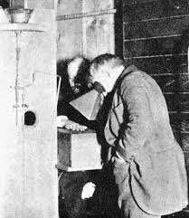
X-ray System’s Subsystems…
Generator Systems
Imaging Systems

Slide 5
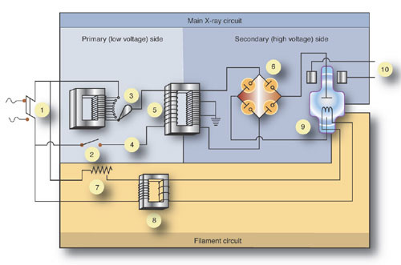
Generator Systems
The Basics…

Slide 6
Generator Systems(2)…
Required Circuits
Power
Line to transformer
230VAC to 480VAC
Single or three phase
PHT / SHT
Controls length of x-ray
Develops kV
Split Secondary
Phase shifting
Regulated
Older days
Step up transformer, 1:500 ratio
AC voltages & line frequency
Currently
Rectifier & frequency controlled inverter circuits on primary side
Rectified secondary
PFT / SFT
Develops mA
Direct & indirectly heated cathodes
Negative side of tube
Split regulation
Filament preheat & boost
mA amount during x-ray
Older days
Step down transformer, 200:1
AC voltages & line frequency
Currently
Rectifier & frequency controlled inverter circuits on primary side
Rectified secondary

Slide 7
Generator Systems (3)…
Specialty Circuits
Rotor circuits
Phase shift caused by capacitor start motor circuit
Speeds
Low (≤ 4500 RPM)
High (≥ 10K RPM)
Start circuits
AC
Pulsed DC
Brake circuits
DC
Temp electro magnet
Timer circuits
Controls the length of the x-ray
Radiographic (high dose x-rays)
2 timers
Simultaneous start
Primary (5 seconds maximum – radiographic mode)
Backup (energizes after ~6 seconds)
Fluoroscopic (low dose x-rays)
5 minute & resettable
Interlock Circuits
Monitors all conditions set by law or the operator
Techniques
Environmental
Prevents exposure start
Unless all conditions are satisfied
Types:
Relay logic
And gate logic
Microprocessor controlled today

Slide 8
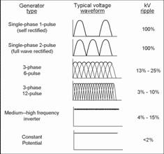
Generator Systems (4)…
Generator Types
Voltage Waveforms
Single Phase
Half wave
Full wave
Three Phase
6 pulse
12 pulse
High Frequency
Most common today
Pulsating DC
Constant Potential
Generally found in portable systems if used

Slide 9
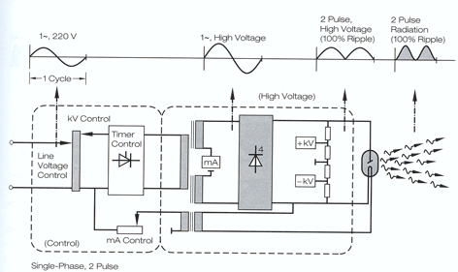
Generators – Single Phase, Full Wave

Slide 10
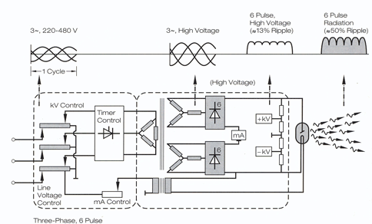
Generators – Three Phase, 6 pulse

Slide 11
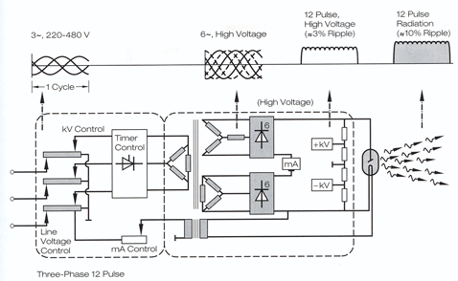
Generators – Three Phase, 12 pulse

Slide 12
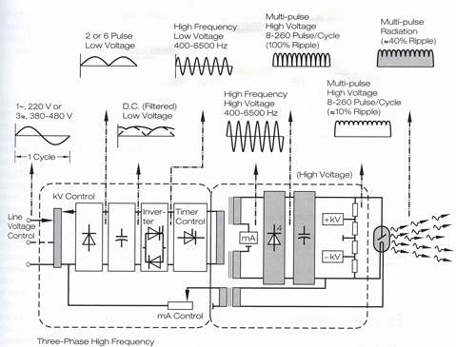
Generators – High Frequency

Slide 13
Imaging Systems…
Radiographic Imaging Systems – Types & Components
Film Systems Components
3D Top & Tube Stands
Tube & Collimator positioning
X, Y, & Z axis movements
α & β rotations
Table / Wall Stand
Phototimers
Bucky/Grids
Film
Direct
Screen type - Single/double emulsion
Cassettes
Paper
Screen
Processor
Manual
Automatic
Viewing
Light Boxes
Hot lights
Film Storage Rooms
Size
Temp & Humidity controlled
CR Systems Components
3D Top & Tube Stands
Tube & Collimator positioning
X, Y, & Z axis movements
α & β rotations
Table / Wall Stand
Phototimers
Bucky/Grids
Cassettes
Intensifying screen
Plate
Reader
Laser
PMT / camera
Light - flashing
Computer
Processing software
Image Storage
Monitors
Technologist
Physician
PACS
Storage & Retrieval
Digital Systems Components
3D Top & Tube Stands
Tube & Collimator positioning
X, Y, & Z axis movements
α & β rotations
Table / Wall Stand
Phototimers
Bucky/Grids
Detectors
Direct
Scintillation layer type
Flash circuits
Types
Fixed
Wireless
Computers
Processing software
Image Storage
Monitors
Technologist
Physician
PACS
Storage & Retrieval

Slide 14
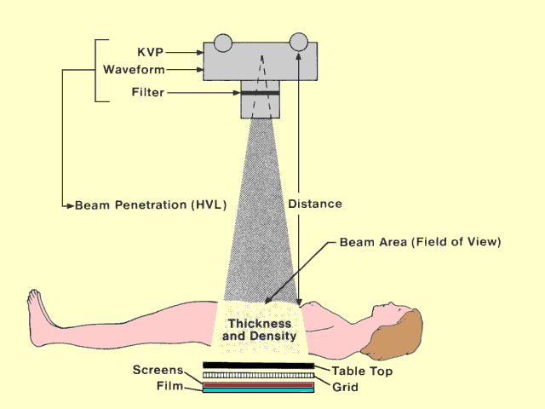
Imaging Systems (2)…
Radiographic Imaging
Key Terminology
SID – Source to Image Distance
SOD – Source to Object Distance
OID – Object to Image Distance
Magnification of Image
HVL – Half Value Layer
How much aluminum is needed to cut dose in half
Used to measure changes in inherent filtration
Focal Spot
Actual
Physical area bombarded by electrons
Effective
Geometric derived value of central ray used in determining size
Filaments are rated by this.

Slide 15
Imaging Systems (3)…
Fluoroscopic Imaging Systems – Types & Components
Film Systems Components
Spot film device
Holds I.I. device
Phototimer
Film
Electro-mechanical device
Image Intensifier Tube
Converts x-rays to light energy & brightens image
Light Sensor
Part of auto kV circuit
PMT
Mirror Optics
Directs image to different viewing /recording devices
Pick up devices
Camera tubes
Monitors
CR Systems Components
Spot film device
Holds I.I. device
Phototimer
CR cassette
Electro-mechanical device
Image Intensifier Tube
Converts x-rays to light energy & brightens image
Light Sensor
Part of auto kV circuit
PMT / PDA
Mirror Optics
Directs image to different viewing /recording devices
Pick up devices
Camera tubes
CCD cameras
Monitors
Digital Systems Components
Spot Film Devices
Houses detector
Electronic image capture
Detectors
Direct
Scintillation layer type
Flash circuits
Types
Fixed
Portable
Light Sensor
Part of auto kV circuit
PDA
Pick up devices
CCD cameras
Computers
Processing software
Image Storage
Monitors

Slide 16
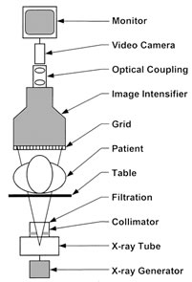
Imaging Systems (4)…
Fluoroscopic Imaging
Key facts…
Generally real time exams
Typically uses an under-table tube and radiation is shooting upward
Exam dependent
May require use of contrast media
x-ray altering media that either positively or negatively affects the image depending on what is used to make something standout
X-ray tube & Imaging Device mounted on C-arms to maintain SID

Slide 17
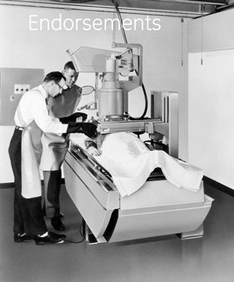
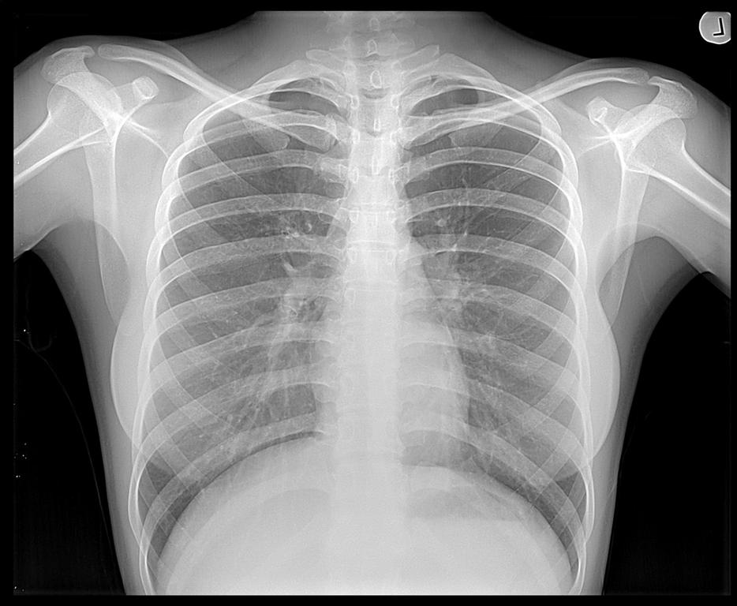
Troubleshooting Today’s X-ray Systems…
General Info & Thoughts
Radiographic
Fluoroscopic
Preventive Items

Slide 18
Troubleshooting…
General Information & Thoughts
Discreet devices evolution
Individual components
Single purpose PCBs
Multiple purpose PCBs
4 key checks
Signal in
Signal out
Power
Reference
Earth – Ground (Protective)
Circuit
AC
DC
Floating

Slide 19
Troubleshooting (2)…
General Information & Thoughts (cont.)
Analysis questions to ask yourself
What was it told to do?
Did it do it?
Another set of questions
Proper squiggly in?
Proper squiggly out?
Size & shape

Slide 20
Troubleshooting (3)…
General Information & Thoughts (cont.)
X-ray machines are VERY logical
These systems must have things happen in a sequential order
It is a building process
Figure out what is missing in the process and focus on that
Types of “logic” used over the years
Relay
And/Or Gates
Microprocessors & programs
Microprocessor looks for information (feedback)
Time period responses
Understand the limitations of the test equipment you are using…
Example: Oscilloscope vs DMM
Both read voltage
Both are connected in parallel to circuit
Use circuit reference NOT ground
Difference is the time based response
Oscilloscope
Voltage at an instant in time
Time per division
DMM
RMS voltage over time
Sampling rate

Slide 21
Troubleshooting (4)…
General Information & Thoughts (cont.)
Understand the components PRIMARY function in the system
Generator
Produce kV & mA
Control exposure length
Control Panel / Operator Console
Sets techniques
OGP
Manual
Environment
Table
Patient height
May have top adjustments
Motorized
Floating
May or may not tilt
90/90
90/(15-20)
2 key signals for generator
Houses Bucky/Grid assemblies - movement
Understand the components PRIMARY function in the system (cont.)
Wall Stand
May or may not - tilt or be motorized
Houses Bucky/Grid assemblies
Similar inputs as table
Stand Movements (Tube & Detector)
3D Movements – X, Y, & Z axis
Position Movements – α & β
Brakes & Tube positioning detents
Collimator
Light field represents x-ray field
May be manual / automatic
Automatic – PBL / ACSS associated acronym
CAN system
Typically 4 blades w/ 2 motors
May have IRIS function – 8 blades w/ 4 motors (Fluoro)
X-ray Tube
Produces the x-rays
Houses the rotor

Slide 22

Troubleshooting (5)…
General Information & Thoughts (cont.)
The unwritten rule of troubleshooting…
If you don’t know what you are looking for – stay out of the machine!!!
Justifying what the machine tells you will only lead you down the rosy red path to nowhere & probably give you a headache from beating your head up against the wall…

Slide 23
Troubleshooting (6)…
Radiographic Systems Suggestions
Get as much information from the end user as possible describing what is wrong with the system or about the problem.
Do not be afraid to ask questions and get clarification if you aren’t sure what you are being told, especially if the message isn’t clear cut
Table won’t go down
The image isn’t clear, blurry, has lines in it
Allow the system to help you identify what may be happening and causing your issue
Example:
Generate a table top x-ray
Generate a table x-ray
Generate a photo-timed x-ray
Know the differences on how the system is expected to perform and focus on those areas.
What was added/removed by the environment change

Slide 24
Troubleshooting (7)…
Radiographic Systems Suggestions (cont.)
Half split methodology
Generator vs Imaging System
Items needed
Intensifying screen
kV meter
mA/mAs meter
Generate an x-ray
Use either a 2 or 3 point technique
Screen glows – x-rays coming out
kV meter – indicates selected kV
mA/mAs meter – indicates amount of selected mAs
If all are good, problem will generally lie in the imaging system, NOT the generator
If in the generator
Figure out what’s missing
If kV is missing
All interlocks satisfied
2 key external interlock signals
Cassette present
Bucky movement
Are items reset
Error codes, information available
If mA/mAs missing
Filaments open
Proper filament regulation during standby & boost
Proper regulation for mA during x-ray
Are the power supplies proper and working

Slide 25
Troubleshooting (8)…
Radiographic Systems Suggestions (cont.)
If problem is in the Imaging System, then the type of Imaging System determines what needs to be checked/done
Film Based
CR Based
Detector Based
Film Based
Film Processor biggest culprit
Compare sample against daily QC results for processor
If not within range – processor needs attention
Generally speaking
Chemical strength
Temperature issues
Optical Density (OD) not proper
Dark Room
Safe light
Chemical fumes
Storage cabinet
Cassettes
Poor contact
Light leaks

Slide 26
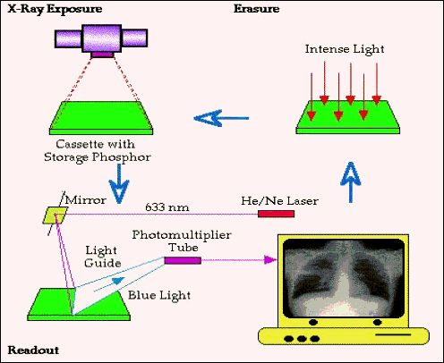
Troubleshooting (9)…
Radiographic Systems Suggestions (cont.)
CR Based
S-curve value
Must be ≥ minimum value for reader to work
Similar in nature to OD value used in film but generally higher
Reader
Not clearing plate
Flash deteriorating
Ghosted image (double exposure)
Defective laser
Defective pickup device
Computer
Data transfer
Corrupt program
Defective computer
Monitor
SMPTE adjustment
Defective display

Slide 27
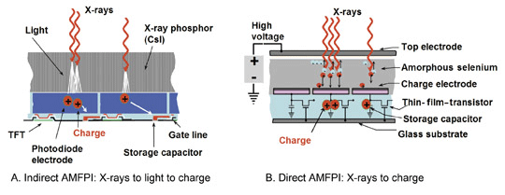
Troubleshooting (10)…
Radiographic Systems Suggestions (cont.)
Detector based
Detector files
Correct & current files
Latest mapping/calibration files
Detector
Power supply
Flash deteriorated or not working
Defective pixels
Bad cables (fiber optic)
Wireless
Defective battery
Not paired
Computer
Data transfer
Corrupt program
Defective computer or PCB
Files corrupt, missing or incorrect
Monitor
SMPTE adjustment
Defective display

Slide 28
Troubleshooting (11)…
Fluoroscopic Systems Suggestions
All previous items discussed still apply
Half split methodology
Generator info
Two key additional checks to add on the generator side though
Max R output of the tube ensuring the generator is doing its part
Ensure you measure it according to manufacturer’s specifications
Use the probe sensor indicator to set distance
Use different items of thickness & density in the beam
Verify the auto kV circuit is working
On the Imaging System side one has to keep in mind this is live imaging – not a single shot
Image Intensifier Tube
Biggest factor are the voltages to the acceleration plates
High voltage
Requires a HV probe for your meter
Some systems have representative low voltage test points for this
Use a mirror to check the phosphor output of the tube
Digital Detector
High Voltage to Detector
Use mirror to check the phosphor output of the detector

Slide 29
Troubleshooting (12)…
Fluoroscopic Systems Suggestions (cont.)
Collimator
Fluoro typically has an 8 blade collimator effectively creating a octagonal (circular) input to the I.I.
Smaller the field, the larger the magnification of the item being examined.
Most systems have 3 different levels of magnification
Most common problems
Motors
Calibration
PMT / PDA
Typically positioned on the output side of the I.I. / detector
Used to sense the amount of light coming out of the I.I. / detector
Part of the auto kV adjustment circuit used to ensure the correct amount of light is being sent to the pickup device.
Alters penetration of the x-rays by changing kV
Changes output light back to “normal” value
Pickup devices
Types
Video tubes
CCD cameras
Takes the light from the I.I./detector and sends it off to the computer for processing as digital data
Video tubes output degrades over time
CCD cameras
Require defect maps for computer processing
Bad pixels
Camera Iris not working correctly
Mirror Optics
Directs the output of the I.I./detector to different devices for the purpose determined by the radiologist.
Mirror movement
Light out

Slide 30
Troubleshooting (13)…
Fluoroscopic Systems Suggestions (cont.)
Spot Film Devices (C-arm)
Older days
Electro-mechanical nightmares
Movement controls for adjusting the c-arm mechanism during the exam
Positions film for a radiographic exposure based on programming pattern
1x1, 2x1 (L/H), 4x1, 6x1, 9x1, 12x1, 16x1
Temporarily shifted operation of the system from fluoroscopy to radiography and then back again when completed
Records what Doctor saw during an exam
Higher mAs & dose to patient
Phototimed x-ray
Collimator leaves Iris mode goes to rad mode, then back to Iris mode
Brakes c-arm during rad exposure
Spot Film Devices (C-arm) (cont.)
Newer devices
Movement control for positioning the c-arm over the patient during the exam
Does an “image capture” of the fluoroscopic image that is seen by the doctor
Multiple screen systems can show both the live fluoro exam and the most recent image capture
Lower radiation to patient as the fluoro image is what is captured
Less mechanical devices for FE’s to concern themselves with
More remote movement controls for operator’s to use creating multiple ways of controlling the movements of the components.
All images processed by computer on the system

Slide 31
Troubleshooting (14)…
Fluoroscopic Systems Suggestions (cont.)
Computers
Input connections
Fiber Optic Cables used with Imaging
Keyboards
Mouse
Power supplies
HDDs
Damaged
Corrupt files
Maps & Calibration files
Video cards
Image processing
Monitors
Calibrations
SMPTE Patterns
VGA/HDMI outputs
Color / Monochrome images
Use separate monitors
Set color for B&W (monochrome) if desired
Power supplies
Proper pixelization
Doctor vs technologist monitors

Slide 32
Troubleshooting (15)…
Suggested Preventive Items for the Field Engineer
Cloning computer hard drives
Suggested programs to use
Norton Ghost
CloneZilla
Frequency
After initially installed
Changes to programming
Any software upgrade
Annual PM
Backups
At the conclusion of a PMI
Things to consider
Generator
System calibrations
3D Top / Floor Stand
Table
Collimator
Wall Stand
Computer information
When performing service
Do a backup before you begin
Perform the work necessary
Do a backup after the service is done
Update info left on site
For those of you servicing multiple sites
Sharing information between all engineers responsible for the site
Do NOT solely rely on the internet for access to this information

Slide 33
Contact Information
Technical Prospects
1000 County Road CB
Appleton, WI 54919
Main #: (920) 757-6583
Toll Free #: (877) 604-6583
Fax #: (920) 757-6591
www.technicalprospects.com
My information:
John DiPasquale, ext. 8480 jdipasquale@technicalprospects.com
Parts/Sales:
Customer Service Reps, ext. 2101
parts@technicalprospects.com
Training Information:
Linda Fuerst, ext. 8202
training@technicalprospects.com

