Slide 1


Getting the Attention of Your C-Suite A Biomed’s View From Above
Jennifer DeFrancesco, DHA, CCE, CHTM
April 6, 2018

Slide 2




Session Overview & Speaker Background
Session Overview
A biomed turned C-Suite administrator gives practical tips and advice to garner support from your leadership team and management.
Speaker Background
Dr. Jennifer DeFrancesco currently serves as the Acting Associate Director for the Dayton VA Medical Center. Prior to her current appointment, she served as the Chief Biomedical Engineer for the Veterans Integrated Service Network (VISN) 10 serving Indiana, Michigan and Ohio.
Her VA career has included assignments as the Chief of Biomedical Engineering at the Indianapolis VAMC, VISN 11 Lead Biomedical Engineer, Chief of Biomedical Engineering at the Richmond VAMC and a prior detail to the Office of Healthcare Technology Management (10NA9).
BS & MS in Biomedical Engineering from the University of Miami (FL), Doctorate in Health Administration
Certified Clinical Engineer (CCE), Certified Healthcare Technology Manager (CHTM)
US Representative to the WHO/PAHO 2016 Edmundo Granda Ugalde Leaders in International Health Program
Graduate of VHA’s Technical Career Field (TCF) Program for Biomedical Engineers, Healthcare Leadership Development Program (HCLDP) and Executive Career Development Program (ECDP)
Co-Chair of VHA’s Biomedical Engineering Recruitment and Retention (BERR) group 2012-2018
Awards and Honors
2016- VHA’s Certified Mentor of the Year, AAMI Young Professional Award, VHA’s Chief Biomedical Engineer of the Year, TechNation’s Professional of the Year
2017- Received AAMI’s Bright Idea Award, Named to the University of Miami’s Inaugural 30 under 30 class
2018- Named to Dayton Business Journal’s 40 under 40 class
Involvement
AAMI- Member of the Technology Management Council (TMC), Chair of the HTM Career Planning & Guidance Task Force, Former Mentor in the Mentorship Program, Annual Conference Committee
ACCE- Former Co-Chair of the Education Committee
Member of the American College of Healthcare Executives (ACHE) and Indiana Biomedical Society (IBS)

Slide 3

HTM- From Basement to the Front Office Overview
Integration with Clinical and Administrative Stakeholders
IT/ Informatics
Maturing Organization
Transforming Biomed to HTM
Tactics for forming
Relationships with C Suite
Daily
Long-Term

Slide 4
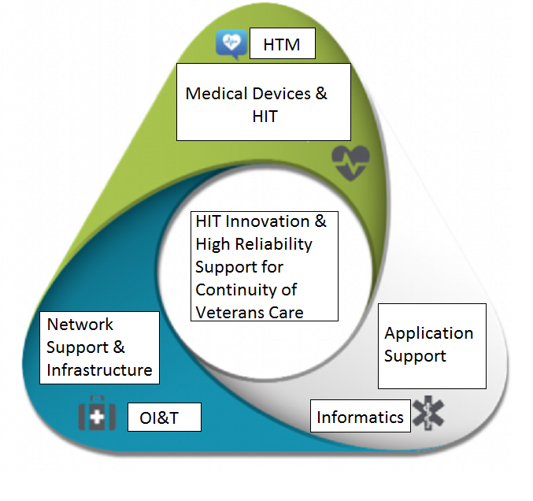
Building Relationships- A Stronger United Front
Helps Build and Land Cohesive Support Message to C-Suite
Builds Confidence
Solves Problems for Your Leadership
Goal to always appear as the solution

Slide 5
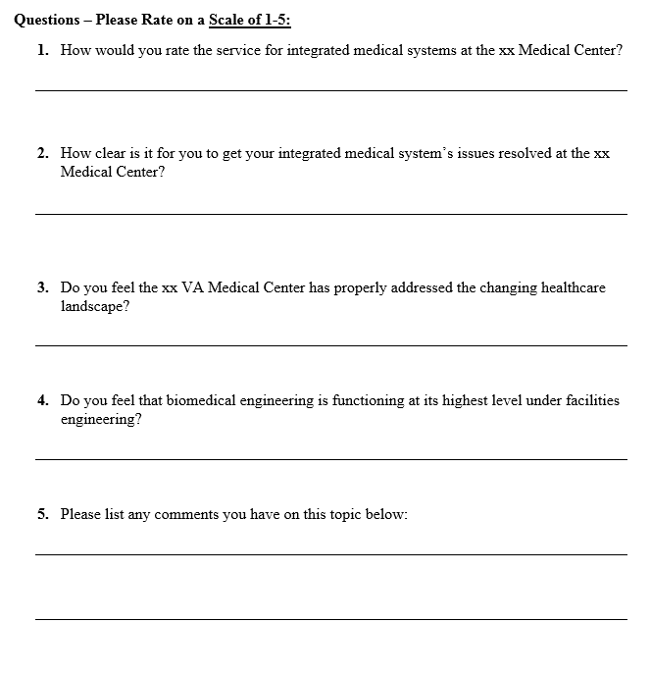
How to Build Your HTM Program
Perform Gap Analysis on Current State of Biomed Program and Gaps to Service in Your Organization
Review Quantitative Data
CMMS
Customer Satisfaction
Review Qualitative Data
Customer Interviews
Internal
External
Focus Groups
Feedback from leadership
Synthesize Solutions

Slide 6
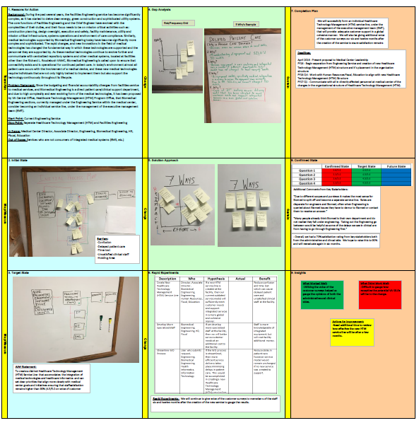
Sample- Process Issues (Quantitative & Qualitative Data)

Slide 7
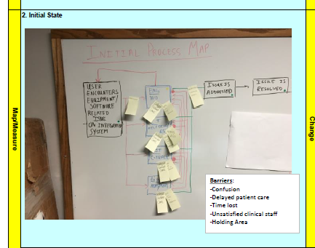
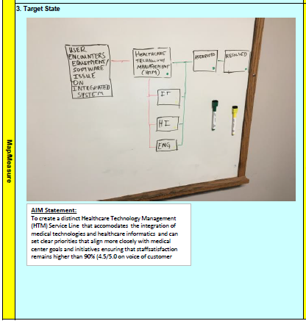
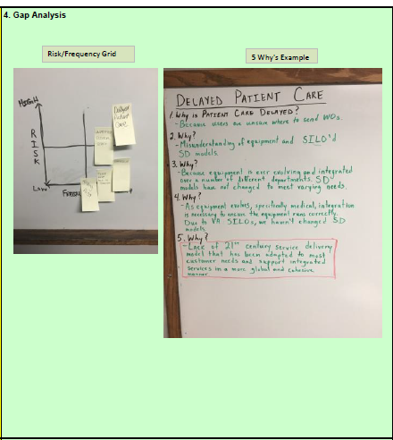
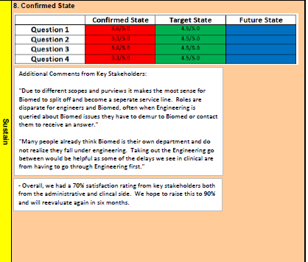

Slide 8
A Vision for the Future…
Healthcare Technology Management (HTM)
Clinical Stakeholders
Administrative Stakeholders
Community Partners
Executive Leadership Team

Slide 9
From HERE to THERE
Recognize your Vision might be counterproductive to another’s vision or organizational positionality
Executive Decision Memorandum
Stakeholder Meetings
Critical Conversations
Business Planning
You want everything
It’s okay to ask
Be prepared to give alternative solutions
Project Growth
Break vision into smaller pieces

Slide 10
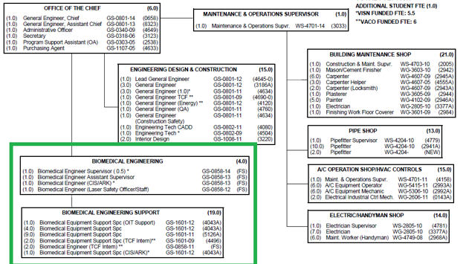
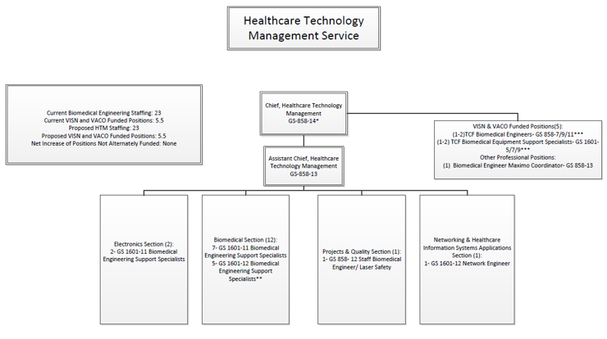
Detail- Dayton VAMC
Redefining Service
Redefining Role
Projecting Growth

Slide 11
Selling Points- What’s in It for the Organization?
Financials
Funds are completely separated and administered
Governance Structure already in place
Streamlined communication to work & collaborate with other services
Equal partner with CIO and CHIO
Proactively position facility to address evolving healthcare technology and information systems needs
Medical Device Protection
Strategic Planning
Successful model
Alignment and KPIs
Comparable Sites- Viewed as leader in country for HTM
Growing community Partner
Academic Affiliates
Elevating HTM innovations/ model for others
Recruitment
Diverging Service Delivery Models to meet customer needs

Slide 12
Relationships with C-Suite
Daily
Consistency
Solution-Oriented
Bigger Picture
Engaged
Long-Term
Strong Vision
SMART steps
Flexibility
Integrate Healthcare Trends and Organizational Goals

Slide 13
Perspective When Speaking with Your C-Suite
Schedules
Shifting Priorities
Timeliness
Top & Bottom
Marathon vs. Sprint

Slide 14


Questions & Contact Information
Email: Jennifer.DeFrancesco@va.gov

