Slide 1
What’s New With ACI & How to Benefit from Certification as an HTM
Martin J. McLaughlin
Manager, Certification

Slide 2
Agenda
About AAMI & ACI
Recent ACI Policy Changes & Reminders
ACI CEU Pre-Approval Program
Maximizing your ACI Certification
100% Team Certified Award
Recertification
Questions

Slide 3

AAMI brings together a
diverse international community of more than 7,000 healthcare
professionals dedicated to developing, managing and using health technology safely and effectively.
AAMI achieves this through the development and use of AAMI standards, professional certification, education, summits and other technical resources.
To learn more and
get involved visit
www.aami.org

Slide 4

About AAMI
45
Staff members headquartered in Arlington, VA
Healthcare device manufacturers, clinicians, HTMs and end users engaged in standards development
2,000+
25+
Governmental and association partners

Slide 5

Don’t miss the health technology event of 2019!
Cleveland, OH • June 7ꟷ10, 2019
80+ education sessions
New interactive theaters
Engaging main stage speakers
Approximately 200 exhibitors
Networking events
Rock & Roll Hall of Fame

Slide 6

The AAMI Credentials Institute (ACI) provides focused certification programs for healthcare technology professionals seeking to grow professionally.

Slide 7

AAMI Credentials Institute
Certified Biomedical Equipment Technician (CBET)
Certified Radiology Equipment Specialist (CRES)
Certified Healthcare Technology Manager (CHTM)
Certified Industrial Sterilization Specialist (CISS)
  Ethylene Oxide (CISS-EO)
  Moist Heat (CISS-MH)
  Radiation (CISS-RAD)

Slide 8
ACI Policy Changes & Reminders
CEUs vs. Points – 30 CEUs are needed every three years.
Grace Period – The grace period after the initial expiration date has been shortened from one year to three months.
Suspended Designations – Starting in 2019 the CLES and CQSM designations will no longer be offered, however, those certified can still maintain the designations.
Audit System – 10 percent of renewals will be audited. It is highly encouraged that you submit supporting documentation with your renewal.

Slide 9
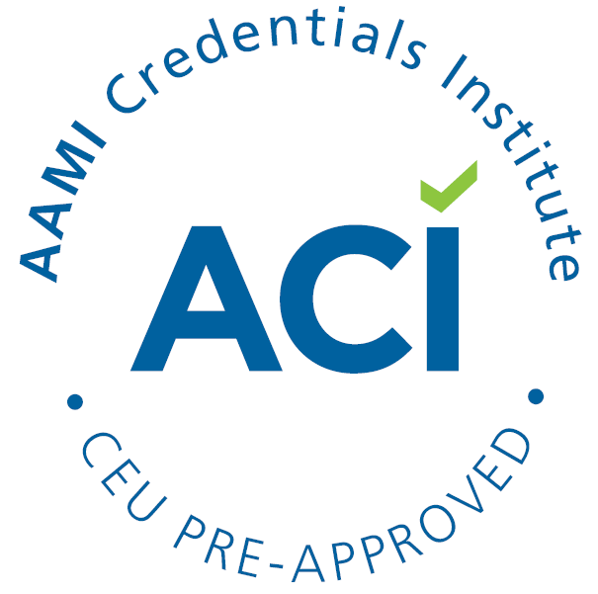
ACI CEU Pre-Approval Program
  Does your local or state HTM society provide
  educational training?
  Join over 70 courses approved for CEUs in 2019 by applying for the ACI CEU Pre-Approval Program. As a pre-approved training course, you will:
      Be listed on the CEU pre-approval webpage.
      Have the ACI pre-approved CEU logo to include on all of your marketing materials.
      Increase your scope of interest by attracting individuals in need of CEUs for certification renewal.
  Visit www.aami.org/aci to find the application, or contact ACI at aci@aami.org for more information.

Slide 10
Steps to Maximizing your ACI Certification
  Let the WORLD know what you’ve earned!
  You can’t expect to gain anything from a certification that no one knows you earned. Here’s how you can get some instant exposure:
        Include your designation after your name in email signatures, on any name badge that you wear in a professional setting (Frank Zappa, CBET), and any professional social media outlets (LinkedIn).
        Post about your certification on LinkedIn to let your professional community know that you’ve taken the steps to advance your career via certification.
        Tell your co-workers about it. Fill them in on the entire process so they are aware of the time and effort you put into earning your certification!
        Update your resume with the newly earned designation. This can be easily verified online in the ACI Certification Directory.

Slide 11
Steps to Maximizing your ACI Certification
  Set up a meeting with your manager…
  Whether they are aware of what ACI certification is or not, make them aware! They need to know that you, as a certified employee, are an investment. Here are some reasons why:
        Continued education requirements to maintain your certification will guarantee to your employer that your wealth of knowledge is constantly growing and that you are devoted to professional growth.
        Passing the exam is a feat in itself that displays a wide knowledge base and solid understanding of the field in which you were certified.
        Certification provides legal comfort for employers in cases of malpractice or patient injury linked to a faulty device. Running BMETs through the ACI certification process should be a MUST on any HR list of requirements.
    Make ACI certification a goal for YOUR performance plan!

Slide 12
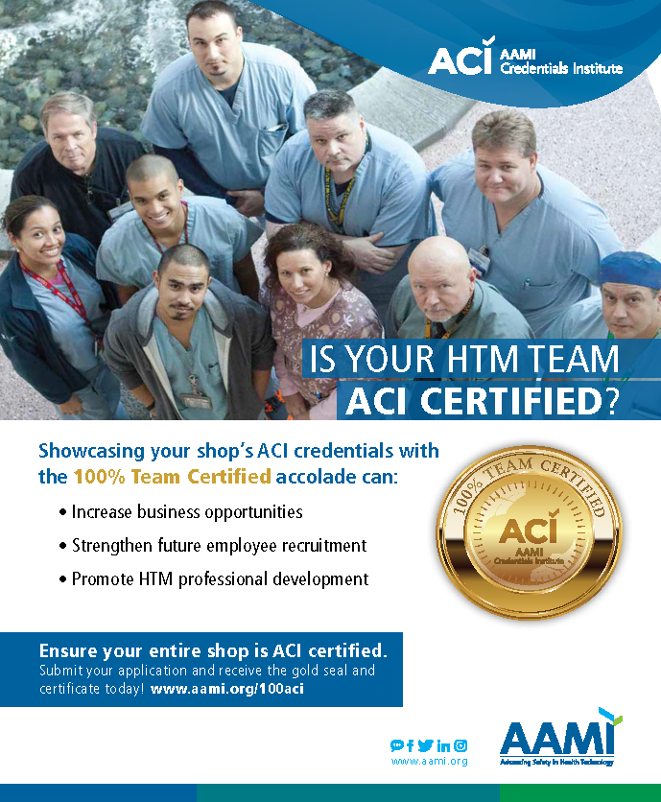
Does your shop qualify?
Apply today!

Slide 13
ACI Recertification Policy
Category 1: Earn an additional, relevant certification
HTM Related (CBET,CLES,CRES,CHTM,CQSM,CISS,CCE): 5 CEUs/Cert
Healthcare Related (CHSP, CQSP, CMLT, Dialysis Certs): 2 CEUs/Cert
Technology Related (A+, NET+, MCSE, CET): 2 CEUs/Cert
Business Certifications (CPM): 2 CEUs/Cert
Max 15 CEUs per cycle

Slide 14
ACI Recertification Policy
Category 2: Leadership Roles
  Paid or volunteer positions on HTM and healthcare related committees.
    Examples: ACI Certification Board, HTM Society Role, Hospital Committee, Hospital Association(AHA,ACHE), Engineering Association(ASHE,HIMSS), Volunteer activities (missions).
  30+ hours/year = 4 CEUs
  <30 hours/year = 2 CEUs
  Max 15 CEUs

Slide 15
ACI Recertification Policy
Key Points
The new policy requires that only active society members are granted CEUs, and the amount granted is based on the hours of activity per year.
Solely being a member of an organization does not qualify for CEUs.

Slide 16
ACI Recertification Policy
Category 3: Development of Educational Content
  Write items for ACI 5 items = 1 CEUs
  Published opinion based article (min 500 words) = 1 CEUs
  Published peer-reviewed (1,200 – 1,500 words) = 3 CEUs
  Published technical article (1,200 – 1,500 words) = 3 CEUs
  Write a book 1 chapter = 3 CEUs
  Max 15 CEUs
Key Point – Blog entries do not qualify for CEUs

Slide 17
ACI Recertification Policy
Category 4: Professional Development
Earn 1 CEU per hour of attendance *
  Attending educational class (such as AAMI), webinars, in-service, vendor presentations or vendor school, or HTM conferences (seminars/sessions)
  Earn 2 CEUs per hour of attendance *
  Teaching educational class/seminar, presenting a technical paper, or presenting a webinar
  Earn 0.5 CEUs per hour of attendance *
  Indirectly related courses (Communication, Management, Auditing..)
  Minimum 15 CEUs - No Max Limit
  *Proof of CEU is required when submitting your journal. This can be a conference name badge, certificate of completion, or sign-in sheet.

Slide 18
ACI Recertification Policy
Category 5: College or University Courses
Must be related to exam content. Must receive a “C” or higher. Must provide transcripts.
  Attending a course 1 CEU / 10 hours of class time
  Teaching a course 3 CEUs / 10 hours of class time
  Max 15 CEUs

Slide 19
ACI Recertification Policy
Category 6: Work Experience
  Full time (HTM Field) 1.5 CEUs / year
  Part-time/Military Reserve (HTM Field) 0.5 CEU / year
  Max 6 CEUs
  Only the years employed during the 3-year recertification cycle are valid for reporting.
  Even though the max in this section is 6 CEUs, an individual without military or part-time employment can only claim a max of 4.5 CEUs (1.5 CEUs per year of full-time employment

Slide 20
QUESTIONS??
Contact ACI at aci@aami.org
Martin McLaughlin
Manager, Certification
mmclaughlin@aami.org
703-253-8275

Slide 21




FIND US!
www.facebook.com/aamiconnect
search for AAMI in groups
aami.org/connect
twitter.com/

